Slide 1
7.1 Media Intro and Print Media
Edwards 224-232

Slide 2
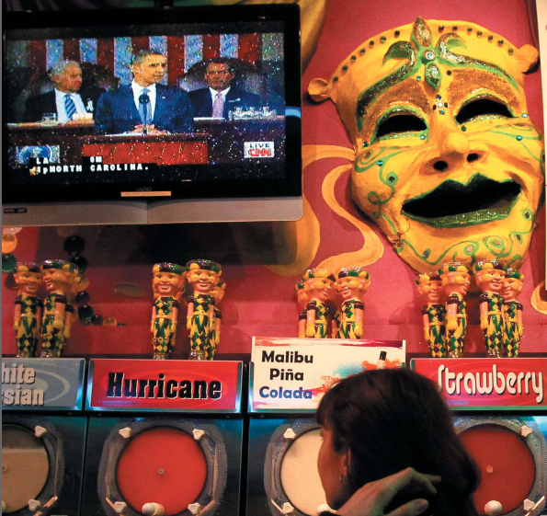

Slide 3
7.1 Quiz A
Newspapers and magazines are considered to be ____________ media.
What is one reason that newspapers and magazines have declining subscription rates?
What story did a young reporter try to make about JFK that led to his boss stopping the report?

Slide 4
7.1 Quiz B
What secret did FDR have that the media kept for him?
What percentage of campaign money is spent on TV ads?
Subscriptions and circulation of newspapers and magazines are ______________.

Slide 5
Intro
Linkage Institutions – things that link people to the gov
Media
Parties
Elections
Mass media – TV, radio, newspapers, magazines and Internet
High-tech politics – politics that are shaped by technology
60% of campaign spending is on TV ads
Usually negative 2/3

Slide 6
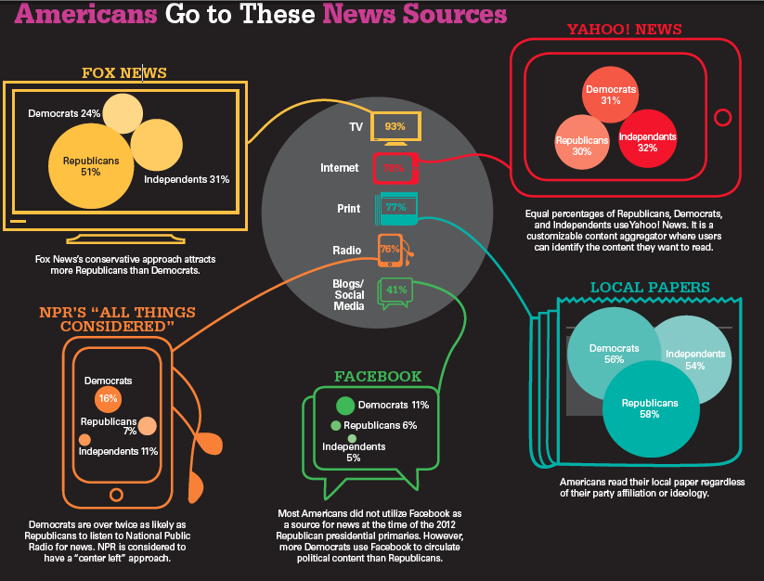

Slide 7
History of Media and Politics
Before Vietnam/Watergate, media and government basically worked together
After, they are at opposition
Whistleblowers – ppl inside the gov or a company tattle
investigative journalism – news investigates to find out what’s really going on

Slide 8
Development of Media Politics
Hoover wouldn't’t meet with reporters
“The President of the United States will not stand and be questioned like a chicken thief.”
FDR loved the media, gave two press conferences (meeting w/ media) a week
Press didn’t tell ppl he was in a wheel chair
Kennedy’s girlfriends weren't talked about
Vietnam and Watergate changed this
Led to investigative journalism b/c media felt it was deceived
Clinton/Lewinski – 75% of press conferences about scandal

Slide 9
Trends in Media and Politics
Vietnam/Watergate made ppl and press more cynical (don’t believe the hype) and negative
Now campaigns are viewed as a horserace with candidates’ strategies being at the forefront
What they do and how that moves the polls
Is investigative journalism’s and the press’ focus on the negative intended to help the ppl by finding the truth or an attempt to gather ratings?

Slide 10
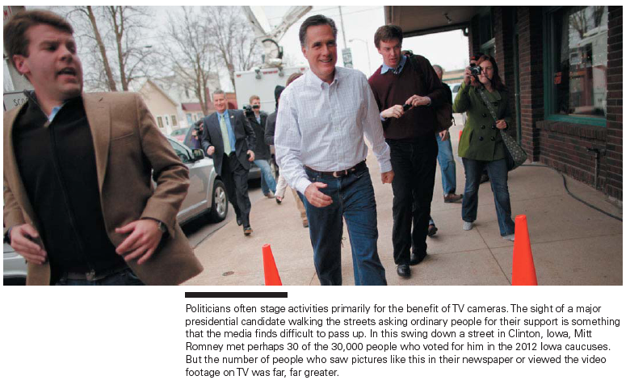

Slide 11
Print Media
Newspapers and magazines
Regular newspaper readers are better informed about politics
“Those who read the news are better informed than those who watch the news.”
TV and Internet had caused a decline in newspaper and magazine circulation
Internet news is cheaper, so news sites can’t pay for a lot of reporters
No one wants to pay for the news anymore

Slide 12
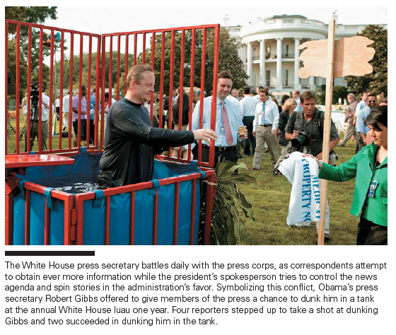

Slide 13
7.2 Radio and TV, Electronic, Cable News, Internet
Edwards 232-238

Slide 14
Radio
Was used a lot in WWII
For news of what was happening
First president that used it was FDR during Great Depression
Called “Fireside Chats” where you could sit in your living room and chat with the big cat
Radio was how most people learned about what was happening in WWII

Slide 15
TV
JFK/Nixon was in the first televised presidential debate
Some say JFK won b/c he looked more cool and young
Nixon refused makeup and sweated a lot
“Television replaced newspapers as the most important communication medium in American politics that very night.”

Slide 16
Vietnam
First ‘televised war’
Most networks had journalists reporting from Vietnam
It allowed people to see how brutal war was first hand
Walter Cronkite, CBS News anchor came out against the Vietnam war
President Lyndon Johnson said “If I’ve lost Cronkite, I’ve lost middle America.”
Today, cable news, the Internet, and so many more choices are making the nightly network news less influential (15% today compared to 40% in the 60s)

Slide 17
FCC – Federal Communications Commission
Regulates radio and over-the-air tv
Only ‘broadcasting’
Only stuff that ANYONE can get FOR FREE from the airwaves
Not satellite or cable (have to pay)
Standards of what you can say at what times
Regulates monopolies to make sure the broadcasting industry is competitive
Candidate fairness
Equal time – if ad is sold to one candidate, you must sell it for the same price to the opponent
Right of reply – if you’re slammed on a non-news show, you have the right to reply on that same show

Slide 18
Broadcasting/Narrowcasting
In the past, we had broadcasting
Media was for everyone, like a big net casted out
Now, we have narrowcasting
Ppl choose what kind of information they want
Liberal/conservative news networks, shows, websites
500 channels
Lots of room for news and politics
24 hour news networks
C-SPAN – Cable-Satellite Public Affairs Network
Government hearings, Congress votes

Slide 19
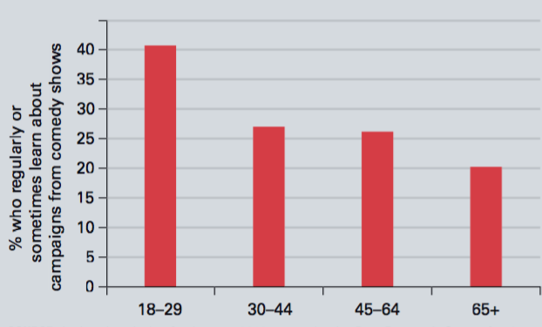
Infotainment News
A lot of young people get their news from comedy shows like SNL and the Daily Show
Studies show they don’t learn as much as if they watched the real news
Those same studies show that they learn a lot more than if they didn’t watch any news at all

Slide 20
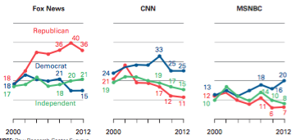
Party Aligned 24-Hour News Networks
We turn to news that agrees with our politics
“Selective exposure” through party aligned news networks
First was Fox News
Conservative aligned
Then, MSNBC
Liberal aligned
CNN and networks are more centered, but most people say they lean liberal

Slide 21
24 Hour News Networks
Pros
Cons
Makes ppl more aware of politics
Shows them what is at stake
Very negative and confrontational
Talking heads arguing w/ each other
Like WWE
More about being first with a story than being right

Slide 22
Quiz 7.2A
Which federal agency regulates the broadcast media?
Who won the first televised presidential debate?
Radio was to WWII as tv was to __________.

Slide 23
Quiz 7.2B
Who lost the first televised debate?
Selective exposure tells us that people will probably watch the news network that _________________.
A recent survey said that many young people are getting their political news from ___________ shows.

Slide 24
7.3 Private Control, Reporting, Finding, Presenting
Edwards 238-246

Slide 25
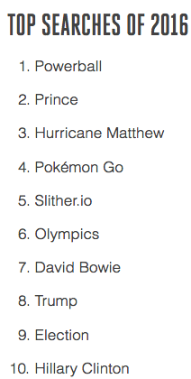
Impact of the Internet
Some think the Internet will lead to more democracy b/c ppl can find facts about candidates
Research shows that they just don’t care enough to search for politics
0.12%, 796th place
Makes communication between politicians and citizens easier
Social networking
A way to organize supporters
Blogs
Easy to make, hard to get readers
Opened up political voice of some elites, not really the average person

Slide 26
Private Control of the Media
US, most media is controlled by private companies, not the gov
Canada and Europe are government controlled
Pros of private control
Leads to a more independent media
Free to criticize the gov
Cons of private control
Private = for profit
Objective is to get ratings so they can charge more for ads
More about sensational/less about important
Cut foreign coverage to save $
Controlled by huge corporations (elitism)
80% of newspapers are controlled by three chains

Slide 27
Media control of Issues
Decides which issues are more important, can motivate interest groups to act
This is much bigger in narrowcasting
Fox News, MSNBC
For ratings (viewer outrage = ratings)
When media corporations are parts of PACs, it can influence their news coverage
Make them less reliable

Slide 28
Reporting the News
Finding the News
Beats: Specific locations from which news frequently emanates, such as Congress or the White House.
Trial Balloons: An intentional news leak for the purpose of assessing the political reaction.
Reporters and their sources depend on each other- one for stories, the other to get them out

Slide 29
Reporting the News
Presenting the News
Superficial describes most news coverage today
Sound Bites: Short video clips of approximately 15 seconds.

Slide 30
Purpose of the News
To get higher ratings so they can charge advertisers more for commercials
Not to inform the people
This leads to more sensational stories than real news
Also, not reporting something that might make the corporate owners angry

Slide 31
Problems with Broadcast News
Oversimplifies political issues
Is more about candidates and their personalities and personal lives than the issues
The media often creates politicians’ persona
Dick Cheney = Darth Vader
Bill Clinton = Frat Boy

Slide 32
Reporting the News
Many people believe the news favors one point of view over another.
Generally not very biased along liberal / conservative lines.
But, generally are biased towards what will draw the largest audience.

Slide 33
7.3 Quiz B
Give one problem with 24 hour news networks.
What was the most searched term on the Internet in 2012?
The book said the news can often be superficial. What does that mean?

Slide 34
7.4 Bias, Wrap-up
Edwards 246-252

Slide 35
Bias in the News
Many people believe the news favors one point of view over another.
Generally not very biased along liberal / conservative lines.
But, generally are biased towards what will draw the largest audience.
Conflict, violence, scandal
Talking heads – one person talking to the camera
When used, spliced in with action video

Slide 36
People care about sensational news, not important news

Slide 37
The News and Public Opinion
Research shows:
News can’t change how ppl vote
It can change how important they think issues are
Helped Clinton 92 and Obama 08 win
Made Ford and Gore lose debates they actually won
Because they are “the gatekeeper” of the news, they influence public opinion on issues and policymakers

Slide 38
Policy Entrepreneurs and Agenda Setting
Policy agenda – the policies that policymakers/people are paying attention to
Trump?
Sanders?
Policy entrepreneurs – ppl who “invest” their “political capital” in getting attention for an issue
Can be politicians or ppl
Can “invest” by giving press conferences, lobbying, protesting, etc.
Big deal was Civil Rights in the 60s
Used media (TV) to publicize their policy agenda
Policy entrepreneurs can use public relations firms to stay relevant in the media

Slide 39
Media and the Scope of Government
Media is a ‘watchdog’ – keeping an eye on the gov for the ppl
Ppl say it causes more good than harm
Reporters are often cynical about gov leaders
“seeing them as self-serving, hypo- critical, lacking in integrity, and preoccupied with reelection.”
Media increases the scope by asking the gov to do what is right
Which usually means more gov programs

Slide 40
Individualism and the Media
TV lets candidates be more individualized and less dependent on their parties or policies
Prez is covered most - 65%
Then Congress – 29%
Then SCOTUS – 6%
No cameras in SC, rare interviews

Slide 41
Democracy and the Media
“Information is the fuel of democracy.”
Everyone thought modern access to info would increase democracy
Everyone was wrong
Media says it is superficial because that’s what pppl want
And if ppl watch, they get ad revenue
“The people who bring you the evening news would like it to be informative and entertaining, but when these two values collide, the shared orientations of the television news world push the product inexorably toward the latter.”

Slide 42
7.4 Quiz B
The section said that the media serves a purpose as a _____________ meaning that it keeps an eye on the government to make sure it is doing what it is supposed to.
In general, the media ____________ the scope of government.
The text talked about __________ heads, which is a shot on the news of just someone’s face discussing an issue.

