Slide 1
16.1 Reformation
721-727

Slide 2
Intro
Nigerian missionaries to the US???
Two big cultural traditions that start in Unit 3
The spread of Christianity out of Europe and worldwide
The spread of modern science out of Europe and worldwide
“In some ways, science was a new and competing worldview, and for some it was almost a new religion. In time, it became a defining feature of global modernity, achieving a worldwide acceptance”

Slide 3
How was Christianity divided internally?
Western Europe was Catholic
Russia and Eastern Europe were Eastern Orthodox
Remember the Great Schism?
(Original: p. 462; With Sources: p. 722)

Slide 4
Externally, how would you describe Christianity to the rest of the world and why?
On the defensive against Islam
Muslims took Constantinople and almost took Vienna, Austria.
Also
(Original: p. 462; With Sources: pp. 722-723)

Slide 5
What act launched the Protestant Reformation in 1517?
Martin Luther, a German priest posted his Ninety-five Theses (problems) on the door of his church.
Reformation = re-forming of the Catholic Church
Luther just wanted to fix the Church, not make a whole new one
(Original: p. 463; With Sources: p. 723)

Slide 6
What were some of the issues in the Church, of which people were critical?
luxurious life of the popes
Popes and clergy viewed as holy
Jesus probably wouldn’t like the Crusades
corruption and immorality of some of the clergy
Bible not in the vernacular (language of the people)
Regular people couldn’t read the Bible b/c it was in Latin
the Church’s selling of indulgences
Get out of purgatory cards
(Original: p. 463; With Sources: p. 723)

Slide 7
In what ways did Luther’s understanding of his relationship with God challenge the Church’s authority?
He believed that salvation came through faith alone.
In general, the source of authority was not the teachings of the Church, but the Bible alone.
All of this called into question the special position of the clerical hierarchy and the pope in particular.
We don’t need a middle-man (the Catholic Church) to get to God.
Sacraments (rituals like communion) are just symbolic and not holy.
(Original: p. 463; With Sources: p. p. 723)

Slide 8
Women in the Reformation?
The Reformation teachings and practices did not offer women a greater role in the church or society.
Prots had less reverence for Mary and female saints.
Protestant opposition to celibacy and monastic life closed the convents, which had offered some women an alternative to marriage.
No more nuns
Luther married an ex-nun because that’s what an ex-priest should do
The reading of the Bible for oneself stimulated education and literacy for women.
(Original: p. 463-465; With Sources: pp. 723-725)

Slide 9
Protestants = Printing
Johannes Gutenberg invented the moveable type printing press in Germany in the 1500s
Bi Sheng did it in China 400 years earlier. Just sayin’
Helped spread the 95 Theses around Europe quickly
Luther translated the Bible into German and soon had it printed and spread around Europe
Spread so much that it standardized the German language

Slide 10
Protestant Churches

Slide 11
To what extent did the Thirty Years’ War (1618-1648) have on French Society?
Wars between Catholics and Protestants in France
Spread to most of mainland Europe
Ends with the Peace of Westphalia
when kings allow for princes (HRE governors) to choose either Catholic or Protestant for their individual dippin’ dots
The unity of a Catholic Europe was now broken forever and the final end of the Holy Roman Empire (though it wasn’t really strong anyway)
(Original: p. 465; With Sources: p. 725)

Slide 12
Impact of the Thirty Years’ War on Europe
Most countries joined in and spent a lot of money and lost a lot of soldiers and citizens (GER 30%)
The loss of resources and power kept most countries from doing more expanding on each other, which led to Europe being extra-large dippin’ dots still today
Since both Catholics and Protestants thought the other was being controlled by the devil, they thought Satan was coming to get them = witch hunts
First of about 500 times France is going to be ravaged
Franco Prussian War, WWI, WWII, WWIII, WWIV and so on

Slide 13
The Catholic Reformation AKA The Counter Reformation
Faith and good works = salvation.
Killed indulgences.
Burn heretics.
Some former Catholics come back.
Created the Jesuits (smart, friendly priests who were ambassadors to leaders in non-Christian countries like in the Middle East and China)
England, France, and Germany stay pretty Protestant.
Spain, Portugal, and Italy stay pretty Catholic.
A Catholic guy lived in Rockcastle County once.

Slide 14
Witch Hunts
1450 to 1750 tens of thousands of victims
Over 75% women
Mostly widows, old maids
Mostly in Catholic vs. Protestant areas like GER, FR
Less conflict = less witch hunts
Also took place in America

Slide 15
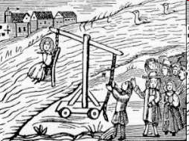

Slide 16
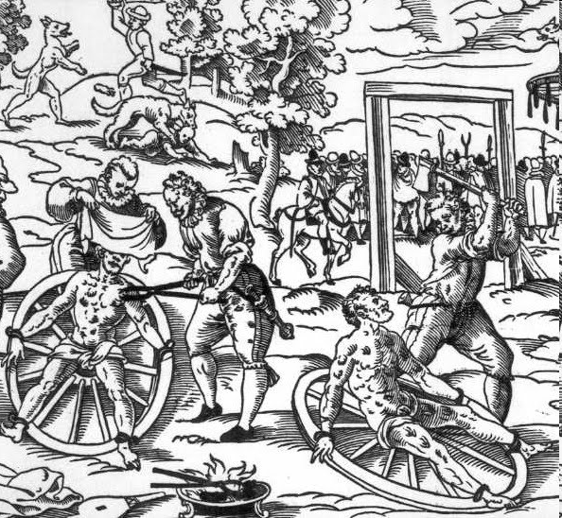

Slide 17
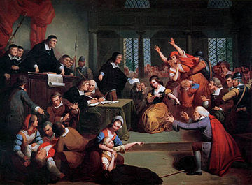

Slide 18
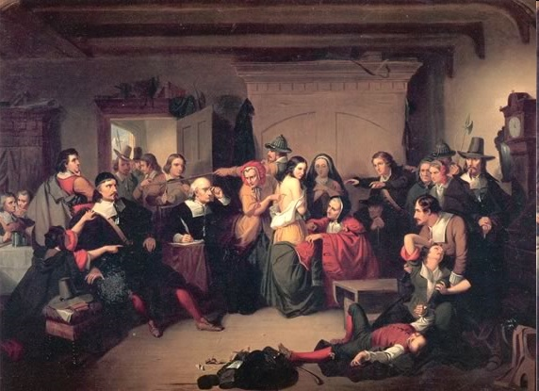

Slide 19
16.1 Quiz A
Who fought in the 30 Years War?
List one problem Luther had with the Catholic Church.
How did women lose power in the new protestant churches?

Slide 20
16.1 Quiz B
From which country was Luther?
What was the name of Luther’s list of problems he had with the Catholic Church?
How did word of Luther’s problems with the Catholic Church spread so fast?

Slide 21
16.2 Christianity Outside of Europe
727-732

Slide 22
Spread of Christianity beyond Europe
British North America – protestants (puritans) didn’t want to convert natives
Latin America – Catholic, very missionary
By Dominicans, Franciscans and Jesuits
Siberia – by Eastern (Russian) Orthodox

Slide 23
How was European imperial expansion related to the spread of Christianity?
Christianity motivated European imperial expansion and also benefitted from it.
Motivated – need to convert savages
Portuguese spread it to Africa and Asia
Spanish and French missionaries were most prominent in the Americas
Russian Orthodox missionaries spread it to the settlers in Siberia
Benefited – Church got money in tithes and by sponsoring explorers
The Spanish and Portuguese viewed their movement overseas as a continuation of a long crusading tradition, which only recently had completed the liberation of their countries from Muslim control.
(Original: p. 467; With Sources: p. 727)

Slide 24
Why Spain and Portugal were the best at spreading Christianity
Strong European colonial control in Latin America and the Philippines
No literate religious traditions in either Latin Americas and the Philippines
Nothing to counteract the push for the new religion like in China, India, or Middle East

Slide 25
Christianity and Native Americans
When Aztecs and Incas took over, the native people took their religion
Makes sense to take the Europeans’ religion
Majority of natives were baptized by 1700
Church leaders destroyed native shrines, peed on “idols”, held “processions of shame” and flogged “idolaters”
Taki Qnqoy Rebellion – spirits of Andean gods possessed natives and made them dance and prophesize the return of the gods to kill the Spanish
Squashed quickly by peninsulares
Religious syncretism in Andes – llama blood to bless a new church

Slide 26
Syncretism in Mexico
Catholic saints take over the roles of local gods
Patron saint of water now becomes the water god
Priests always Spanish, but church leader was usually native
Prayers and offering given to these saints for luck, protection
“In such ways did Christianity take root in the new cultural environments of Spanish America, but it was a distinctly Andean or Mexican Christianity, not merely a copy of the Spanish version.”

Slide 27
Christianity in China
Had to be respectful of customs because China was controlled by a strong bureaucracy
Focused on helping the Chinese elite
Got on their good side by sharing science, technology, geography from Europe
Downplayed their roles as missionaries at first
Didn’t pee on idols, instead were totally cool with them because they had to be
Less than 1% converted, mostly elites
Seen as weird, rituals as superstitions, communion = cannibalism
Pope starts to crack down on Chinese Christians
Emperor then kicks out missionaries

Slide 28
Why were missionary efforts to spread Christianity so much less successful in China than in Spanish America?
The Americas’ political, economic and social powers were destroyed. This didn’t happen in China because they were always strong.
In China, Europeans needed permission of Chinese authorities to operate in the country, but in the Americas, the Europeans were running things.
In China, the conversions were focused on the elites
By the Jesuits (the society of Jesus)
Smart, science- based missionaries who were friendly and cool
In the Americas, the missionaries wanted to convert the masses and were less friendly and cool
(Original: p. 470-471; With Sources: pp. 730-731)

Slide 29
How the government forced peasants into labor positions
Cotton textile production in India
Cotton became popular in Europe
Indian government forced peasants to work in cotton fields and in textile factories
Silk textile production in China
Silk remained popular in Europe
Chinese government forced peasants to grow mulberry plants (that support silk worms) and to work in silk factories
Frontier settlement in Siberia
Russian government gave seeds, farm equipment and grain to peasants to have them settle land in Siberia so Russia could claim the land there

Slide 30
16.2 Quiz A
List one way specific way the Spanish treated the people, their shrines or their idols because they weren't Christians.
Why wasn’t there a big push of missionary work in British North America?
Give one specific example of how native beliefs or practices were blended or applied to Catholic beliefs or practices.

Slide 31
16.2 Quiz B
What is one reason that Christianity didn’t take off in China like it did in the Americas?
List one way specific way the Spanish treated the people, their shrines or their idols because they weren't Christians.
List one thing you know about Taki Onqoy.

Slide 32
16.3 Culture in Islam, China and India
732-737

Slide 33
Africanized versions of Christianity emerged, such as Santeria and Vodou, in the New World. From what were these syncretic religions derived and how did the Europeans perceive these practices?
Syncretism – the fusion of two or more religions
Santeria and Vodou (Voodoo/Vodun)
Mix of Catholicism and Native or African religions
Animal sacrifice, spirit possession, other fun stuff
Europeans perceived these practices as evidence of sorcery or witchcraft and attempted to suppress them.
(Original: p. 473; With Sources: pp. 732-733)

Slide 34
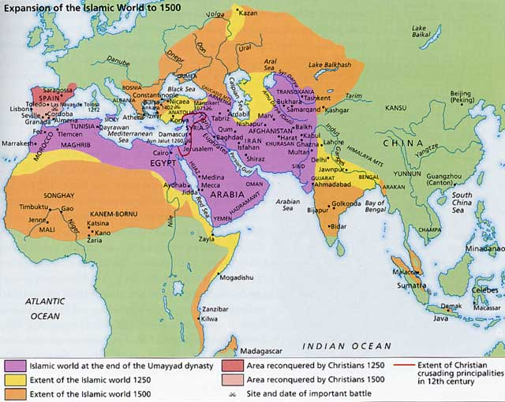
Where does Islam spread to in Unit 4 (1450-1750)?
Across most of India (except southern tip)
Sub-Saharan Africa
Deeper into Southeast Asia

Slide 35
What accounts for the continued spread of Islam in the early modern era?
It depended on wandering Muslim holy men, Islamic scholars, and itinerant traders, none of whom posed a threat to local rulers.
Different from military spread in Unit 3
often intermarried with local people
generally did not insist that new converts give up some of their older practices.
offered a connection to the ‘house’ of Islam. (Dar al Islam)
(Original: p. 473; With Sources: p. 733)

Slide 36
What accounts for the emergence of reform or renewal movements within the Islamic world, especially in the mid-eighteenth century in Arabia?
Islam became syncretic too
Sufis were a mix of Islam and spiritualism, dancing, head bangin’
Used to spread Islam on the outskirts of Dar al Islam by blending it with other religions
Wahhabism rejects syncretism and focuses on pure, orthodox Islam
On Arabian Peninsula (Saudi Arabia)
A reaction to Sufi syncretism
Destroyed Sufi tombs, banned tobacco, controlled women more
Similar to ISIS view of Islam today – anything different is evil!
(Original: p. 474; With Sources: p. 734)

Slide 37
Buddhism continues to spread throughout east Asia
Neo-Confucianism continues to grow
Mix of Confucianism, Buddhism and Daoism
Major religion of China
Strong foundations in southeast Asia (Vietnam, Cambodia) via Indian Ocean
Korea and Japan stay Buddhist

Slide 38
Religious Challenges in China
Similar to Luther’s Protestant challenges to the Catholic Church
Wang Yangming challenged Confucianism
All ppl can become virtuous without a strict Confucian education
Later discredited by scholars and blamed for Manchu takeover
Too individualistic
Buddhists told normal ppl they could reach enlightenment without withdrawing from the world
Kaozheng (Ming) – “research based evidence”
studied lots of stuff, looked for proof in ancient documents

Slide 39
A new cultural change was especially appealing to women in India. What did the bhakti movement and its practices provide for them?
Move away from the caste system thanks to the Bhakti movement
Social criticism of the caste system
Bhakti – songs, prayers, dances, poetry to get to moksha
Not following dharma, karma
Rejected Brahmin’s ideas
Similar to Sufism, blurred the distinction between Hinduism and Sufism
(Original: p. 476; With Sources: p. 736)

Slide 40
Fun Fact: Mirabai
High caste poet who refused sati
Took an untouchable as her guru (spiritual teacher)
Washed his feet and drank the water
Poems read widely and challenged caste norms

Slide 41
From what did Sikhism evolve?
Mix of Hinduism and Islam in 1600s
Came out of Bhakti movement
Northern India
Guys with beards and turbans
Inclusive of women
Generally awesome
Major syncretic religion
(Original: p. 477; With Sources: p. 737)

Slide 42
16.3 Quiz A
What religion in India was basically a mix between Islam and Hinduism?
Describe Wahhabism in two words.
What do Wang Yangming and followers of kaozheng have in common?

Slide 43
16.3 Quiz B
Sikhism is a mix of Hinduism and __________.
Give one reason why Mirabai may have not been liked by the Hindu establishment in India.
What movement in Islam was characterized by its dislike of “deviations from the pure faith” and religious blending practices by groups like the Sufis?

Slide 44
16.4 Scientific Revolution
737-747

Slide 45
Who were the men that created the Scientific Revolution?
Scientific revolution – proving theories through experiments and reason
Copernicus from Poland - Heliocentric
Galileo from Italy – Heliocentric, Pope forced to recant
Newton from England - Gravity
(Original: p. 477; With Sources: p. 737)

Slide 46
What was the long-term significance of the Scientific Revolution and its applications to the affairs of human society?
Challenged the authority of the Church.
Challenged social hierarchies like slavery, monarchies, and peasant exploitation.
Used to legitimize inequalities of race and gender.
Brought the wonders and the horrors of the Industrial Revolution.
(Original: p. 477; With Sources: p. 737)

Slide 47
21. Why did the Scientific Revolution occur in Europe rather than in China or the Islamic world? (Original: p. 478-479; With Sources: pp. 738-739)
Europe:
No centralized power in Europe which fostered competition and innovation.
Catholic Church lost power after Hundred Years’ War
Couldn’t quickly stop science
Took learning from other cultures, especially the Islamic world.
Astronomical, medical texts.
Columbian Exchange put them at the center of a massive exchange of ideas from around the world.
Power of universities – colleges that were exempt of the control of the state and the Church
Focused on scientific research
Studied Aristotle’s importance of empirical (provable) evidence

Slide 48
Islamic World:
Scientific study was there, but viewed with suspicion as being anti-Quran.
Quranic studies and religious law held the central place.
This is because Islamic leaders became more conservative in response to movements like Sufism.

Slide 49
China:
Chinese education focused on preparing for a rigidly defined set of civil service examinations
Not scientific, instead, about being a good person.
Scientific subjects were relegated to the margins of the Chinese educational system.

Slide 50
What was revolutionary about the Scientific Revolution?
Medieval thought – earth was stationary and at the center of the universe (Geocentric)
God put us at the center because we are important
Nicholas Copernicus’ argument—was that “at the middle of all things lies the sun” and the earth, and other planets, revolved around it.
The earth was no longer the center of God’s attention.

Slide 51
What was revolutionary about the Scientific Revolution?
Galileo Galilei developed--an improved telescope, furthered Copernicus’ findings of a heliocentric universe
Published works
Pope finds them and puts him in front of the Inquisition
Sir Isaac Newton formulated the law of universal gravitation.
All objects on earth and in space have gravity
Gravity is what formed the universe
Scientific, not religious explanation
Kepler - “the machine of the universe is not similar to a divine animated being but similar to a clock.”
(Original: p. 480; With Sources: pp. 739-741)

Slide 52
What did Enlightenment thinkers share?
a belief in the power of knowledge to transform human society. (scientific revolution applied to society)
They also shared a satirical, critical style, a commitment to open-mindedness and inquiry. (question everything)
(Original: p. 482; With Sources: p. 742)

Slide 53
Enlightenment Thinkers You Should Know
John Locke – Two Treatises on Government
Ppl have the right to rule themselves
Adam Smith – Wealth of Nations
Modern capitalist economy would be favorable for all
Voltaire – Treatise on Toleration
Outwardly challenged the authority of the Church

Slide 54
Voltaire throws shade:
This little globe, nothing more than a point, rolls in space like so many other globes;we are lost in its immensity. Man, some five feet tall, is surely a very small part of the universe. One of these imperceptible beings says to some of his neighbors in Arabia or Africa : “Listen to me, for the God of all these worlds has enlightened me; there are nine hundred million little ants like us on the earth, but only my anthill is beloved of God; He will hold all others in horror through all eternity; only mine will be blessed, the others will be eternally wretched.”

Slide 55
Religious views of the Enlightenment
Deism – God is a watchmaker. Created the universe and walked away. Doesn’t watch over us.
Panthesim – God and nature are the same. God can be proven by science.

