Slide 1
1.1 Government and Politics
Edwards 9-12

Slide 2
Chapter 1
Edwards

Slide 3
Intro (2-7)
Young ppl are less involved in gopo than older ppl
Participants in politics get more benefits from the gov
Young v. old

Slide 4
Government Intro (9-10)
Federal Government – President, courts, “bureaucracy” and Congress
Two questions about governing:
How should we govern?
What should government do?

Slide 5
Functions of National Government (10-11)
https://www.youtube.com/watch?v=Sre7GuNEjpE
National defense – keep ppl safe from other countries
Provide public goods and services – roads, schools etc.
Collective goods – goods or services that cannot be denied to any citizen
Examples - clean air, clean water, roads, fire protection
Preserve order – national Guard, police (inside the borders)
Socialize the young – teach kids about gov, and America (Education)
Collect taxes – use them for awesome stuffff!!!!

Slide 6
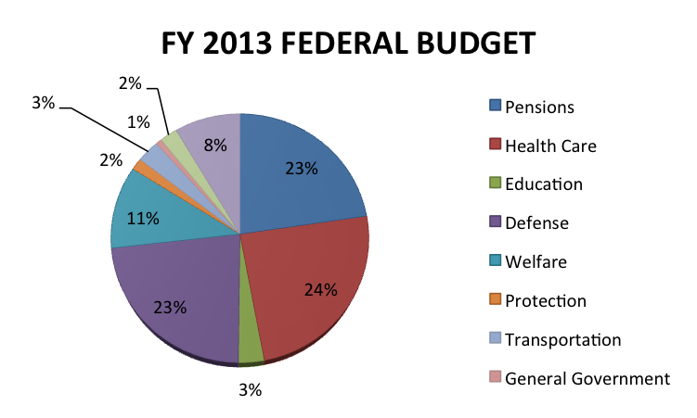
$ shows the real function of government

Slide 7
Politics (11-12)
Politics – “Who gets what, when and how”
Who - Politicians, voters, parties
What – benefits
How – how ppl participate (including candidates)
Whom we select to govern
How ppl participate in the gov: (POLITICAL PARTICIPATION)
Campaign/contribute
Vote
Activist groups – Protest
Contacting gov
Civil disobedience
Breaking unjust laws

Slide 8
Politics (11-12)
America has a low voter turnout
Single-issue groups – activist groups focused on one issue
Abortion, gay marriage, gun control
Interest groups – groups of people with a common interest that try to influence the gov
Linkage institutions – things that link ppl’s ideas to the gov
Media (biggest)

Slide 9
1.2 Policymaking/Democracy in America
Edwards 12-16

Slide 10
12-16 Quiz A
Name two things that make up a modern democracy.
Political parties, elections, media and interest groups make up __________ institutions. Check your notes on this one.
Finish this sentence, the US government is based on majority rule and minority __________.

Slide 11
12-16 Quiz B
These include the media, elections, parties and interest groups. They connect the people to the government. What are they called?
This was defined as any action by the government. It is created by the ____________-making system.
Which of the following is not part of “traditional economic theory”?
Voting rights
Economic equality
Citizen control of policy agenda

Slide 12
Policymaking System (12-15)
Lesson 1.2

Slide 13
Policymaking System (12-15)
Policy – an action by the gov
Policymaking system – everything that goes into making policy (ppl, linkage institutions, the gov)
Policy agenda – main goals of the gov
Things the gov thinks is most important
Political issue – when ppl disagree about a problem politically

Slide 14
Policymaking System (12-15)
Policymaking institutions – three branches of gov
Why? They make governmental policies
The bureaucracy is so powerful, that many think it is the “fourth branch”
All four influence policy, take the environment for example (page 14)
President asks Congress to make a law
Congress makes law
Bureaucracy makes rules about the law (Environmental Protection Agency)
Courts decide if the first three agree with the Constitution

Slide 15
Democracy in America Intro (15)
Democracy – people run the government
Two types of democracy:
Direct democracy – citizens vote on every policy
Republic AKA Representative Democracy – citizens elect representatives to be their voice
Why is US a republic?
Because it is too big. Do you want to vote on roads in Colorado?

Slide 16
Democracy in America Intro (15)
Lincoln: Forefathers established a government “of the people, by the people and for the people”
Democracy – citizens rule themselves (of) (by)
Best interests of the citizens (for)

Slide 17
Traditional Democratic Theory (15-16)
Five things that make a modern democracy:
Voting Equality
Participating citizens
Free speech/press
Citizens control the agenda
Rights for all citizens (inclusion)
So, has America always had a “modern democracy”?

Slide 18
Traditional Democratic Theory (15-16)
A true democracy must have majority rule and minority rights
Majority rule – the most votes wins
Minority rights – rights that noone, not even the majority can take away
Speech, press, life

Slide 19
1.3 Three Theories
Edwards 16-18

Slide 20
1.3 Quiz A
Robert Putnam thinks that pluralist theory might have a problem because Americans are becoming…
Which theory is focused on the power of wealth on the government?
Why do hyperpluralists believe that nothing ever gets done in the government?

Slide 21
1.3 Quiz B
The NRA, NOW, and ACE are examples of what type of groups?
Which of the three theories is most optimistic/positive?
Finish this quote about elitism: “a few powerful Americans do not meerly influence policymakers-they _____ the policymakers.”

Slide 22
Three Contemporary Theories of American Democracy (16-18)
“Who really runs the country?”
Three lenses to look through to answer this question.
Pluralism
Hyperpluralism
Elitism

Slide 23
Three Contemporary Theories of American Democracy (16-18)
Pluralism – many groups want influence on gov, and most get some influence
Optimistic
No one group dominates
De Tocqueville’s “nation of joiners” quote

Slide 24
Three Contemporary Theories of American Democracy (16-18)
Elitism – gov is controlled by upper class
Everyone gets a piece of the pie, but the poor get a sliver
1/3 of all of the money in the country is held by 1% of the population – Occupy Wall Street Movement (2011)

Slide 25
Three Contemporary Theories of American Democracy (16-18)
Hyperpluralism – so many strong groups trying to get influence that the gov is weakened
Pluralism gone sour
If a group loses influence in Congress, they’ll move to the courts
Thus clogging up the system
“Groups have become sovereign”

Slide 26
1.4 Challenges to Democracy and Political Culture
Edwards 18-23

Slide 27
1.4 Quiz A
Give one reason how diverse political interests leads to policy gridlock.
What term means the “overall set of values shared by a society”?
What term means “supporting the rights of the average citizens in their struggle against the elites”?

Slide 28
1.4 Quiz B
Give one reason why “escalating campaign costs” are a challenge to democracy.
What term means the “overall set of values shared by a society”?
When Tocqueville came to America, few people had the right to vote, but what did he predict would happen in the future regarding voting rights?

Slide 29
Challenge 1: More complex issues (18)
Government today is very complex
Regular citizens don’t know the details about healthcare/war

Slide 30
Challenge 2: Low participation in government (18–19)
*Low political participation is a major GOPO topic
Young ppl’s low participation rates scare a lot of ppl

Slide 31
Challenge 3: Campaign costs are increasing
At least 1 mil to win a seat in the House
Politicians get most of it from interest groups
Super PACs (political action committees)
*Major GOPO topic
Corporations and rich people can do things for (like make commercials) candidates but can’t give them money outright
Are they representing the people, or the people who pay for their campaigns?

Slide 32
Challenge 4: People have more diverse political interests (19-20)
So many different interests being tended to, it leads to political gridlock (when nothing can be done because both sides on an issue veto the other)
Bill making
Supreme Court Decisions

Slide 33
American Political Culture and Democracy Intro (20)
American Political Culture – the overall set of views shared by Americans
Five aspects
Liberty
Egalitarianism
Individualism
Laissez-Faire
Populism

Slide 34
American Political Culture Aspects: Liberty (20)
“Give me liberty or give me death!”
“Better dead than red!”
Liberty – basic freedoms in Bill of Rights
Free from governmental oppression

Slide 35
American Political Culture Aspects: Egalitarianism (22)
Egalitarianism – “equality”
“We hold these truths to be self evident, that all men are created equal” – Declaration of Independence
Everyone gets a fair chance
Voting rights
Americans see themselves as very egalitarian

Slide 36
Egalitarianism

Slide 37
American Political Culture Aspects: Individualism (22-23)
Individualism – people can survive on their own
Frontier mentality up until 1900
Frontiers lead to individualism
Government should stay out of people’s lives as much as possible

Slide 38
American Political Culture Aspects: Laissez Faire Economy (23)
Laissez-Faire economy – government should stay out of the economy
Means “let them do what they want” – Idea by father of capitalism, Adam Smith
Major tenet of capitalism
Government takes less taxes from citizens, but, because of this offers less services than other countries
Like universal healthcare and state-funded college

Slide 39
American Political Culture Aspects: Populism (23)
Populism – “peopleism” – the government should represent the regular people
Liberals says it is to protect the regular people from the huge corporations
Conservatives say it is to keep business-owners free from the government taking their money through regulations and taxes

Slide 40
1.5 Culture War and Scope
Edwards 23-26

Slide 41
1.5 Quiz A
Who are the sides in the “culture war” that Edwards talked about?
Define gross domestic product.
If the government spends more money, what does it have to do to be able to pay for that spending?

Slide 42
1.5 Quiz B
Though some people believe we are having a “culture war” in the US, the data shows that we are actually…
Rounded to the nearest trillion (seriously), how much money does the US spend each year?
What is one argument that conservatives make for maintaining a smaller scope of government?

Slide 43
A Culture War? (23-24)
A Culture War – big divide between liberals and conservatives
About 50% red (conservative) 50% blue (liberal)
Don’t see other side’s points
“A divided America encourages our enemies, disheartens our allies and saps our resolve-potentially to a fatal effect”

Slide 44
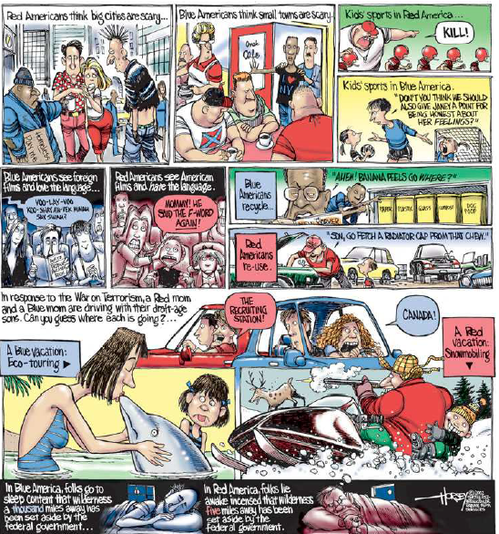

Slide 45
A Culture War? (23-34)
There isn’t a lot of evidence showing a deep political divide
Most Americans are closer to the middle on the political spectrum
More on this later

Slide 46
The Scope of the American Government (25-26)
Spends 1/3 of our gross domestic product – all the money made by a country in one year
3.7 trillion
Mostly on Medicare and wars
Deficit now is at …

Slide 47
How Locke and Hobbes led to Democrats and Republicans.

Slide 48
Constitutional Underpinnings

Slide 49
Classical Origins: Ancient Greece
Athenian Democracy
Birthplace of democracy
Demos = people
Ocracy = ruled by
The Assembly
Direct democracy
Citizens vote on numerous issues
Voted on everything including war and peace

Slide 50
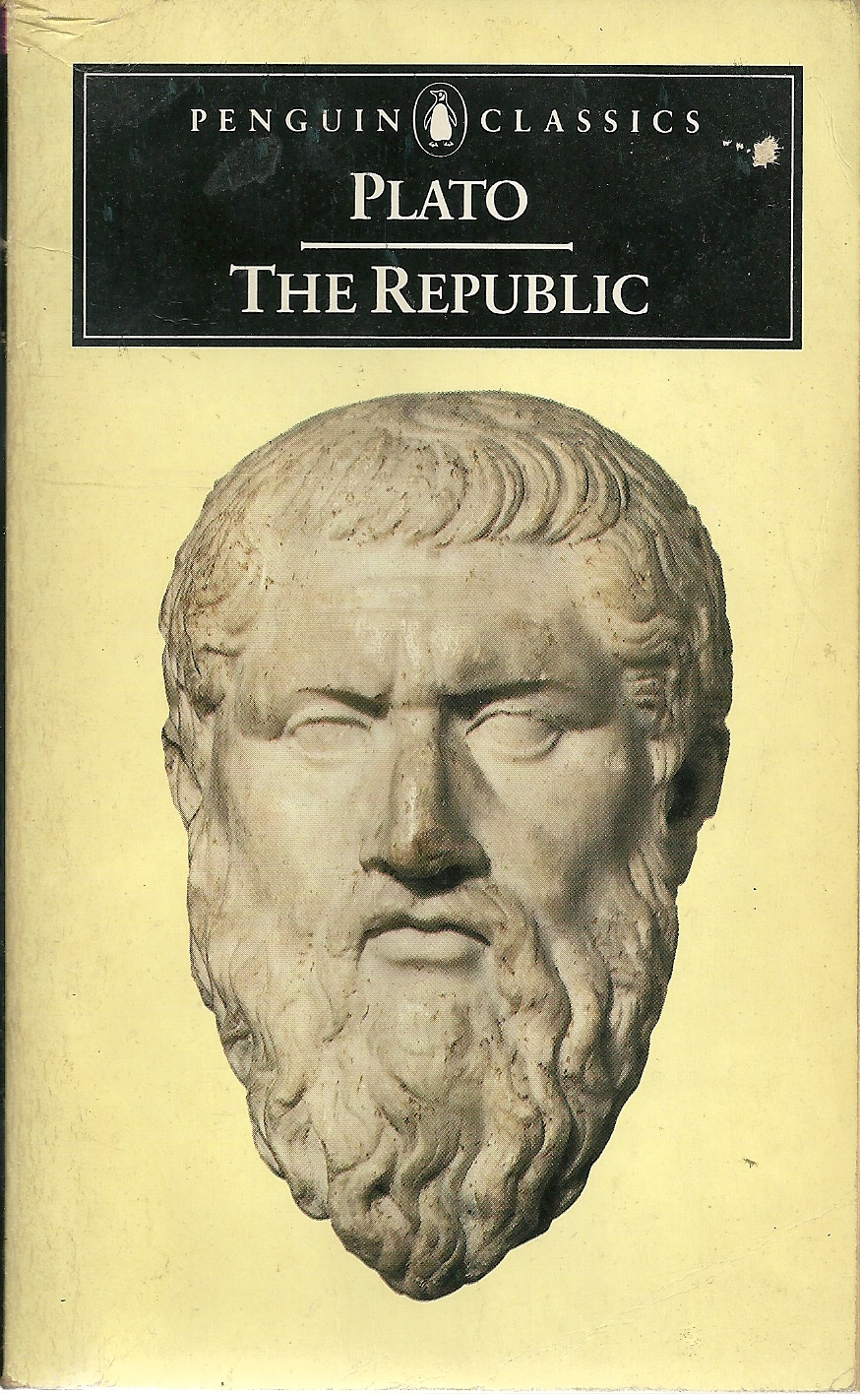
Classical Origins: Ancient Greece
Plato’s Republic
Republic is an ideal state
Justice defined as all three parts of our soul working together
Rational, desiring, and spiritual
Society has three parts too and all parts must play their role
Guardians (leaders)
Producers (farmers)
Auxiliaries (soldiers)
Probably not attainable because people are selfish

Slide 51
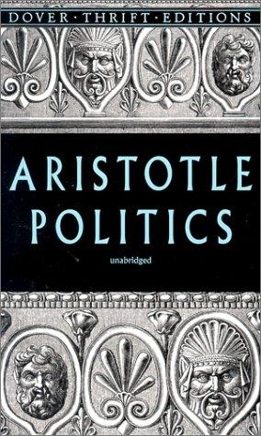
Classical Origins: Ancient Greece
Aristotle’s Politics
Justices is attainable through many forms of government as long as it works for the “common good” of the people
Monarchy is more likely to give justice than a democracy because of the tyranny of the majority
Monarch could be like a caring parent

Slide 52
Classical Origins: Ancient Rome
Roman Republic
Re(s) – concern
Public = of the people
Remember, rep = represent
Citizens chose representatives that made decisions on their behalves
More similar to American democracy
We are a democratic republic

Slide 53
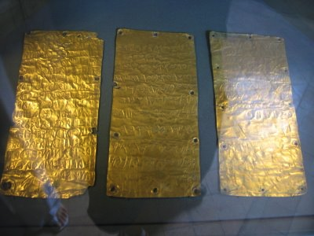
Rights Originating from Ancient Rome: The Twelve Tables
Roman laws were written down on twelve bronze tablets called the Twelve Tables and displayed in the Forum
Trial by judge/jury
Wills/contract are binding law
Libel/sedition/perjury illegal
Habeas corpus (must know why you are being detained)

Slide 54
English Heritage: Magna Carta (1215)
Nobles vs. King John
Limited king’s power
Cannot raise taxes without the consent of a council of nobles
Cannot imprison nobles without reason
Guaranteed nobles a speedy trial

Slide 55
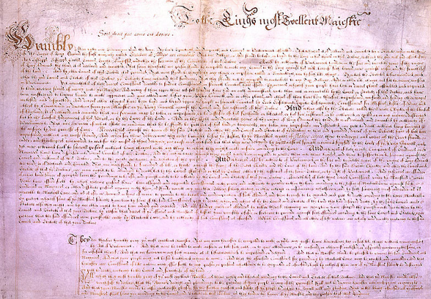
English Heritage: Petition of Right (1628)
Applied protections of the Magna Carta to rest of the English citizens
Restricted the monarchy further

Slide 56
Quiz 1a
What type of government occurs when citizens vote on all issues?
The Twelve Table come from ancient ___________.
Who came up with the word “republic”? Hint – that was the title of his book.

Slide 57
Quiz 1b
What type of government occurs when citizens elect representatives who speak for them?
The Magna Carta was all about nobles wanting to have control over what rules?
Which Greek city-state is known as “the birthplace of democracy”?

Slide 58
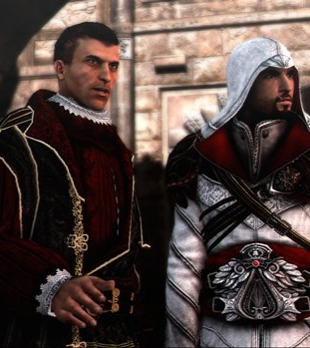
Machiavelli’s The Prince (1532)
A letter Machiavelli wrote to the Prince of Florence, Italy to tell him how he could stay in power.
He said it is better to be feared than loved and that then ends justify the means (the end result justifies doing crappy things to get it).
The only job of someone in power is to stay in power.
Influences philosophers like Hobbes later on.

Slide 59
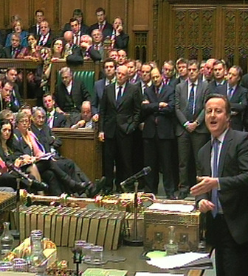
English Heritage
Parliament
House of Lords
House of Commons
Petition of Right (1628)
Applied protections of the Magna Carta to rest of the English citizens
Restricted the monarchy further
English Bill of Rights (1689)
Free parliamentary elections, speedy trials, prohibit cruel and unusual punishment, petition the monarch, no taxation without consent of Parliament

Slide 60
The Enlightenment 1500s – 1700s
Age of Reason
Inspired by the Scientific Revolution
Critical thinking and logic applied to human behavior
Break from tradition, heredity, fundamentalism
Natural Laws applied to society - Natural Rights
Each individual born with natural rights such as life, liberty, property
Rights that we had in a “state of nature” (before there was civilization)
Rights that no one, not even the government, should take away without a good reason
Social Contracts
Established relationships between individuals/citizens and governments
Based on mutual consent

Slide 61
The Enlightenment 1500s – 1700s
Social Contracts:
Established relationships between individuals/citizens and governments
Based on mutual consent
Citizens give up some rights to the government in exchange for security
Government is able to take some rights away because they have the “consent of the governed”

Slide 62
Quiz 2a
What was Machiavelli’s most famous work?
The US has a Senate and a House of Representatives. This probably came from…
The social contract is between the ___________ and the ___________.

Slide 63
Quiz 2b
Finish this Machiavelli quote: “the only job of someone in power is to…”
The ideas of a bicameral (two house) legislature and a bill of rights came from...
What was the name of the time where people started to use reason and rationality? It influenced governmetn a lot.

Slide 64
The Enlightenment from England
Thomas Hobbes
Leviathan
Society inherently evil and thus requires a strong central government ex. absolute monarch
John Locke
Second Treatise on Civil Government
Society inherently good
State of nature (natural rights) - life, liberty, property
Consent of the governed
Right to overthrow

Slide 65
Thomas Hobbes’ The Leviathan
“Every man is Enemy to every man”
“[In a state of nature]…the life of man, solitary, poor, nasty, brutish, and short…”
“It followeth that, in such a condition, every man has a Right to every thing--even to one another's body. And therefore, as long as this natural Right of every man to everything endureth, there can be no security to any man.”
“The only way to erect . . . a Common Power, as may be able to defend them from the invasion of [foreigners] and the injuries of one another, and thereby to secure them…is, to confer all their power and strength upon one Man.”

Slide 66
John Locke’s Second Treatise on Government
“The state of nature has a law of nature to govern it, which obliges every one: and reason, which is that law, teaches all mankind … that, being all equal and independent, no one ought to harm another in his life, health, liberty, or possessions”
“Men being, as has been said, by nature, all free, equal, and independent, no one can be put out of this estate, and subjected to the political power of another, without his own consent.”
“Whensoever therefore the legislative [violates the social contract and tries to enact] an absolute power over the lives, liberties, and estates of the people; … they forfeit the power the people had put into their hands for… and it devolves to the people, who have a right to resume their original liberty, and, by the establishment of a new legislative, [such as they shall think fit] provide for their own safety and security, which is the end for which they are in society.”

Slide 67
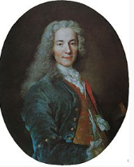
The French Philosophes
Baron de Montesquieu
Spirit of the Laws
Checks and balances
Separation of powers
Voltaire
Outwardly criticized the Catholic Church
Early influential secular philosopher
Advocated for a strong separation of church and state
Candide: The Optimist
Rousseau
On the Social Contract
Citizens must give their rights up to the “general will” of the people
Even if they disagree with it

Slide 68
Colonial America
House of Burgesses (1619)
Representative form of government in Virginia
Mayflower Compact (1620)
Social contract for common good/survival
Fundamental Orders of Connecticut (1639)
First written constitution
Outlined individual rights

Slide 69
Colonial Resistance
Navigation Acts from Parliament
Proclamation of 1763, Sugar Act (1764), Stamp Act (1765)
Ideological Arguments
Taxation without representation
Virtual representation
First Continental Congress
Declaration of Rights and Grievances
Petition to the King
Second Continental Congress
Olive Branch Petition
Declaration of Independence (1776)
Articles of Confederation (1777, 1781)

Slide 70
Quiz 3a
What did Hobbes think life was like for humans in a state of nature?
Who came up with separation of powers? *hint* it wasn’t us.
Name one thing published by the Second Continental Congress.

Slide 71
Quiz 3b
What did Locke think life was like for humans in a state of nature?
Who wrote in his book, The Social Contract, that people must give up some rights so the general will of the people can be upheld?
What was Voltaire’s biggest enemy?

Slide 72
Tocqueville’s Democracy in America

Slide 73
Tocqueville Quiz A
Where was Tocqueville from?
Why did he think America was the right place for democracy?
What happened in France 46 years before he wrote his book that probably led Tocqueville to write it?

Slide 74
Tocqueville Quiz B
Why would French people think Tocqueville knew what he was talking about when he wrote about America?
What happened in France 46 years before he wrote his book that probably led Tocqueville to write it?
If asked what the world would be like in the year 2020, what would Tocqueville probably say?

Slide 75
About Democracy in America
One of two most impotant books on American government
Other is The Federalist Papers
French aristocrat
After the French Revolution
Bloody, violent, commoners v. nobles
Traveled around America meeting with rich, poor, and government officials

Slide 76
About Democracy in America
Saw America as an example of “the great democratic revolution” that was going to take place everywhere
Thought it was inevitable and decreed by God
Thought America was a good example of a real democracy because it had an “equality of conditions”

Slide 77
About Democracy in America
Two major theses
1. Equality of conditions is why America is a good democracy
2. A positive effect was made on culture because of democracy
The major work studied at colleges on government and politics today
Quoted by presidents and others

Slide 78
About Democracy in America
Written in the 1830s
Between American Revolution and Civil War
After France’s revolution
Audience was French leaders who saw democracy and equality as something that would go away
Used by Americans as the best description of what democracy in America is and why it is so awesome

Slide 79
Democracy in America Excerpt
Equality of condition is why society, gov, and laws are fair in US
Equality is part of culture and society. It is what makes the US the US
We’re not equal in Europe, but we will be soon and it will last forever
Equality is what the world is going toward
God has made it where we need to go

Slide 80
Democracy in America Excerpt
Before, in FR, monarchs ruled by force
All the land was owned by very few
The Church (clergy) made some equality
Other things that brought some equality
Lawyers, business, literacy, printing press, guns
Enlightenment (reason) made a lot of people think about what is fair

Slide 81
Democracy in America Excerpt
Equality really started when nobles (who had gotten rich w/o the king’s help) started fighting with the king
Just like the Magna Carta (which led to the Petition of Right)
Equality and democracy cannot be stopped and if you fight them, you are fighting God

Slide 82
Democracy in America Excerpt
We need to study the US, b/c the US got democracy w/o blowing up half the country
They love freedom. Its why they left England
I studied US to help France, but I’ve found that the US is freedom, it is democracy
It can show us what is to come for us.

