Slide 1
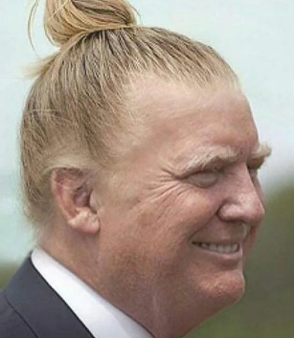
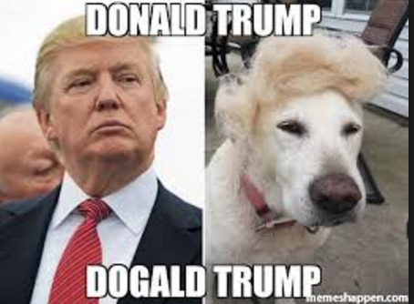
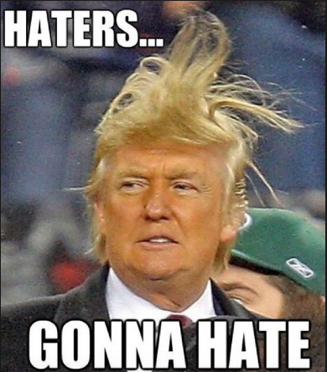
Executive Branch! I can’t wait!!!!
12.1 Intro

Slide 2
Intro
Obama had to do a lot of stuff
Healthcare
Economic crisis
Nukes in North Korea and Iran
Wars in Afghanistan and Iraq
Names for the president
Leader of the free world, commander in chief
Presidential power myth
Checks and balances at every turn
Congress and cabinet are beholden to others, not the president

Slide 3
Great Expectations
A new president is expected to fix the country single-handedly
Two views of the presidency
Want the president to be powerful, like FDR or Lincoln
Don’t trust centralized power like a king
“The distinctive aspect of the American Creed is its antigovernment character. Opposition to power, and suspicion of government as the most dangerous embodiment of power, are the central themes of American political thought.”

Slide 4
Who They Are
Natural-born American citizen
35 years old
Lived in US for 14 years
All white males
All protestant except for JFK (Catholic)
Harding was nominated because he looked like a president
Most say our worst president
Teapot Dome scandal – took bribes for oil drilling contracts

Slide 5
Presidents’ Backgrounds
Army commanders
Congressmen
Governors
Peanut farmers
Actors
CIA Directors
Vice presidents
Businessmen

Slide 6
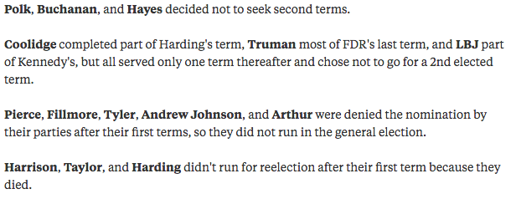
Elections
2 term limit (22nd Amendment)
2 terms! 2 terms!
Terms are 4 years
Can decide not to run for a second term
You do not have to know this ->

Slide 7
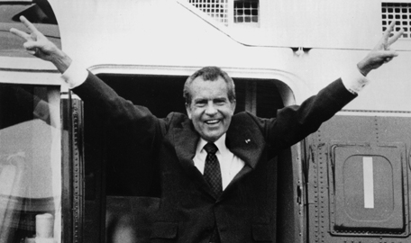
Succession
Accidental presidents – take over after president dies or resigns
Nixon – most famous president that resigned
25th Amendment – succession amendment
Who is president when they can’t perform their duties?
What happens when the
VP dies?
Pres appoints, congress
confirms

Slide 8
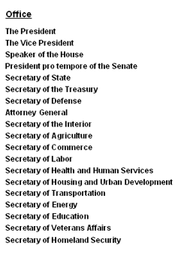
Line of Succession
President
Vice President
Speaker of the House
President pro Tempore (Senate)
Cabinet
Secretary of State
All the way down to the last cabinet position (16 people)

Slide 9
Impeachment
Impeachment is just bringing charges against a president, not removing them
Can be “for high crimes and misdemeanors”
Majority vote in the House to impeach
House prosecutes the president
Chief Justice of SCOTUS is the judge
All 100 senators make up the jury
2/3 vote leads to removal

Slide 10
Times Presidents were Impeached
2 impeachments, both were not removed
Johnson wanted to be lenient with southern states during reconstruction, radical republicans said that would put the country at risk
Didn’t receive 2/3 of senate votes
Clinton was impeached for lying to the public about an affair with an intern
Didn’t receive 2/3 of senate votes
Nixon was going to be impeached for Watergate, but he resigned before the impeachment happened

Slide 11
The Politics of Impeachment
Doesn’t have to be a crime
Must be a grave offense
Can’t be a policy disagreement (though it was for Johnson)
It is a political process, so Congress can impeach for any reason
*Impeachment can turn a country against Congress if it seems unwarranted. Sarah Palin wanted to impeach Obama last year and republicans collectively told her to shut up.

Slide 12
12.2 Presidential Powers and Chief Executive
405-414

Slide 13
Constitutional Power of the President
Original president had less power and less responsibility
Because they feared a monarch
Made most important decisions be shared with Congress
Declare war, sign treaties, appoint judges, make laws
Constitution wanted pres to be responsible
Made short terms and impeachment a means for keeping pres in check

Slide 14
Expansion Power
The power of the pres has grown with each new one
War grows power (Civil, WWI, WWII)
Wilson and FDR made the pres have a role in managing the economy
FDR in the Great Depression

Slide 15
Perspectives on Presidential Power
Before VIETNAM and WATERGATE, a good pres meant a strong pres
Pres was viewed as above the law
After, weaker presidents took over
Ford and Carter
They were criticized and the strong Ronald Reagan was pres for most of the 80s
Divided gov made it hard for Reagan, Bush 41, Clinton, Bush 43, and Obama to get anything done

Slide 16
GOPO Test
The president is called the ”chief” of which two branches?
How did Vietnam and Watergate change how presidential power was perceived?
According to many, what is the most useless job in the executive branch?

Slide 17
The Chief Executive
Job is to “preside” over the administration of the government
Executive means executor or “doer”
Cons: “take care that laws be faithfully executed”
Bureaucracy spends $4 trillion a year, 4 million employees
Presidents have taken more responsibility in the bureaucracy by closely governing and appointing leaders and heads

Slide 18
Executive Orders
Orders made by the pres to control the bureaucracy
Desegregate military
Create EPA
Create Department of Homeland Security
Often challenged by Congress, especially if its something they denied in the first place
Pres has authority if it involves the bureaucracy and it is constitutional
Obama pushing for Guantanamo Bay closure through executive order

Slide 19
Vice President
“not worth a pitcher of warm spit”
Only job in Constitution is to preside over Senate and break ties
Presidents choose VPs who
Can help them win swing states
Balance the ticket (moderate if they are too liberal/conservative)
Can give them an edge (DC insiders)
Advise them closely

Slide 20
ACG Test
The president is called the ”chief” of which two branches?
What branch can be effected by executive orders?
According to many, what is the most useless job in the executive branch?

Slide 21
The Cabinet
The heads of departments in the bureaucracy
Remember, all are appointed by the president but confirmed by the senate
14 secretaries and one attorney general
Washington had 3, presidents keep adding members
Advise the president, but are more beholden to their members of department
Examples:
State (foreign affairs), Labor, defense, Agriculture, Homeland Security (newest)

Slide 22
The Executive Office
3 main offices that advise the president
Always on GOPO Exams
National Security Council (NSC) – foreign and political advisers. Focus on threats at home and abroad
Council of Economic Advisers (CEA) – advise on the state of the economy. Stocks, market, etc.
Office of Management and Budget (OMB) – prepare the president’s budget and sends it to Congress

Slide 23
White House Staff
Aka aides
Information, policy options, assistants
Different presidents dealt with aides differently
Chief of Staff – controls the White House Staff and reports to the president

Slide 24
First Lady
Adams and Madison counseled husbands
Wilson ran the government when husband had a stroke
Roosevelt the same
Since Johnson, first ladies pick an issue
Laura Bush was literacy, Michelle Obama is health
Clinton became a senator, Secretary of State and ran for president
What will Millanetiq$###*a Trump’s issue be?

Slide 25
12.3 Chief Legislator and Party Leader
414-422

Slide 26
Chief Legislator
Pres must work with Congress to get any legs passed
State of the Union – Cons says pres must address Congress “from time to time”
Does it once a year
Bill action:
Sign it = law
Veto it = Congress can override with 2/3 in each house
Only 4% of vetoes have been overriden
Not sign it for 10 days = law
Pocket veto (not sign it during last 10 days of session) = not a law
Line item veto – pres could mark out certain parts of a bill and leave in other parts
Unconstitutional for pres
Some governors can do it

Slide 27
GOPO Test
What official role does the First Lady have in the government?
What happens if a president doesn’t sign a bill?
What is another name for the cabinets in the executive branch?

Slide 28
Party Leadership
Most legs are committed to the pres in their party, opposed to pres of opposite party
Pres leads to more party polarization
Legs usually vote on party lines, but not always “Slippage in party support”
Go with pres or constituents? Legs go with constituents every time
“When constituency opinion and the president’s proposals conflict, members of Congress are more likely to vote with their constituents, whom they rely on for reelection.”

Slide 29
Leading the Party
Why would a party leader support the pres?
Photo ops, mentions in the media, rides on Air Force One, attention that brings more pork to constituents
Parties are decentralized, so the pres can’t really do much to penalize a leg members who is hatin’
Coattails effect – if pres of my party is popular, I am more likely to win my legs election
When my election is the same year as the pres’s
Diminishing effect over time, but still a thing
Pres is a big campaigner for legs members
In general, pres’s party loses seats in midterm elections b/c ppl are generally angry w/ gov

Slide 30
ACG Test

Slide 31
Public Support
Legs are close to pres of same party when he’s liked, far away when he’s not
Higher pres approval ratings lead to more getting done in Congress and vice versa
Generally, support of legs is at the margins
Most in my party will still love me, the other party will still hate me (just a few extras here and there)

Slide 32
Electoral Mandates
Electoral mandate – the voters picked me and my policies, so I am mandated to carry them out
Makes pres seem legit
To legs - If you are against a new pres, you are against the ppl?

Slide 33
Legislative Skillz
Reagan’s budget director David Stockman recalled that “the last 10 or 20 percent of the votes needed for a majority of both houses on the 1981 tax cut had to be bought, period.” – America
Pres can give huge breaks to legs and their constituents in his budget
Honeymoon period – first six months of new pres. Country likes him, so he sends lots of bills. Legs better pass them b/c ppl like the pres.

Slide 34
Setting Priorities
Biggest role of pres in legs is setting the agenda
What legs should focus on
Everyone listens to the pres, only constituents from one state listen to legs
Legs usually more beholden to their party, their constituents and their LOBBYISTS

Slide 35
12.4
422-431

Slide 36
Chief Diplomat
National security policy – defense and foreign policy
Diplomacy – repping US w/ other countries
Diplomatic relations – we are friends w/ your country
Pres can make or break diplomatic relations
Pres makes treaties, but Senate must apporve them by 2/3 vote
Executive agreements – agreements between pres and world leaders that don’t have to be approved by the Senate b/c they involve the executive branch
Sometimes, pres negotiates peace between two countries
Carter w/ Israel and Egypt
Pres is leader of the Western world, so he leads other capitalist countries like England and Japan to do what is best

Slide 37
GOPO test
Legislators are most concerned with…
The president
Their constiutents
Lobbyists
The Supreme Court
Edwards talks about the “two presidencies”. What are they?
Why does the president claim to have an electoral mandate?

Slide 38
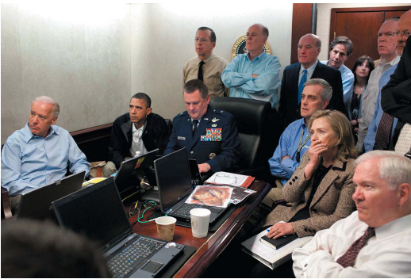
Commander in Chief
Cons wanted civilian control of the military
1.4 million soldiers
Nuclear weapons, “the football”

Slide 39
War Powers
Congress is supposed to declare war, but the pres might have to send troops in an emergency
Congress never declared war on Korea or Vietnam
War Powers Resolution – pres can send troops, but must withdraw if Congress doesn’t approve within 60 days
Legislative veto - Congress can pass a resolution within the 60 days that is unvetoable (unlikely and possibly unconstitutional)
Due to Vietnam shadiness
Generally ignored by every pres

Slide 40
Crisis Manager
Crisis – surprise event that could harm citizens
FDR and Pearl Harbor
JFK and Cuban Missile Crisis
Bush 43 and 9/11
“Crises are rarely the president’s doing, but handled incorrectly, they can be the president’s undoing” – Oh Edwards! You’re a frickin’ poet, man.
Pres must act quickly

Slide 41
Working with Congress on National Security
Checks and balances on national security
Congress provides the funding
Pres provides the action (sending troops)
Legs more likely to criticize or support pres on national security than to make their own policy
“Two presidencies” – foreign and domestic
Legs will more likely support pres on foreign policy than domestic policy
b/c legs don’t want to be viewed as not supporting our protection

Slide 42
Going Public
“Public support is perhaps the greatest source of influence a president has, for it is more difficult for other power holders in a democracy to deny the legitimate demands of a president with popular backing.”
Since JFK, the pres is on TV a lot
Image is everything
Bush 43 on the “Mission Accomplished” ship
Pres is head of state and head of gov
Both symbolic and actual leader
Not like the Queen of England

Slide 44
ACG Test
Edwards talks about the “two presidencies”. What are they?
Why does the president claim to have an electoral mandate?
What is the term for a contact made between the president and the leader of another country?

Slide 45
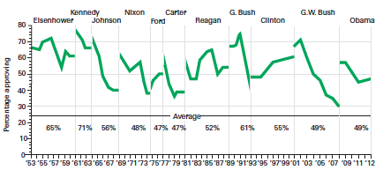
Presidential Approval
Presidential approval rating: “Do you approve or disapprove of the way [name of president] is handling his job as president?”
Often around 50%

Slide 46
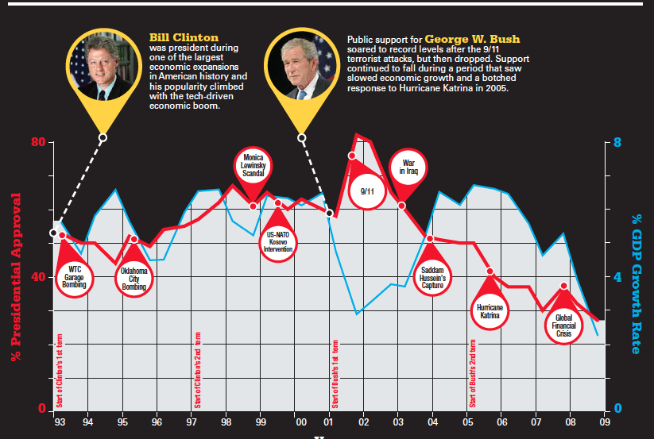

Slide 47
Presidential Approval
Party identification is the base of approval/disapproval
40 percent higher than opposition party
Changes in approval ratings come from war, economic booms/busts, and foreign problems
Citizens approve/disapprove more based on issues than personality or the impact on their own pocketbooks
Weird, right?
Rally events – surges due to pres handling a crisis well
Usually rare and short-lasting
9/11

Slide 48
GOPO test
What three word term describes how the people of the US are perceiving the president’s work at his or her job?
The things described in question 1 usually start _______ and end _______.
Who makes the call on whether or not to bomb another country?

Slide 49
12.5 Policy Support, Public Motivation, The Press
431-437

Slide 50
Policy Support
“Bully pulpit” – pres can make public support her or him if they are good speakers
Pulpit is where a preacher stands
Not all presidents are great speakers
Partisan polarization makes support for presidents difficult
We are predisposed to hear what we want to hear
“In the absence of national crises, most people are unreceptive to political appeals.”

Slide 51
ACG Test
What three word term describes how the people of the US are perceiving the president’s work at his or her job?
The things described in question 1 usually start _______ and end _______.
Which term describes how the president can force congress to do what she or he wants because they are so influential?

Slide 52
The President and the Press
“The press is thus the principal intermediary between the president and the public, and relations with the press are an important aspect of the president’s efforts to lead public opinion.”
Pres and press are often at odds
White House Press Secretary – gives daily press conferences
Answer questions on behalf of the pres
Prime-time presidential press conferences
Rare, usually when something big is happening
Last one was when Obama personally shot and killed Osama bin Laden

Slide 53
Nature of News Coverage
Most focus on what the pres is doing, not on policies
Report on a pig roast
Usually just a bunch of sound bites
Bias – most media is not biased to one side
Party-aligned networks are biased (MSNBC and Fox News)
“The news tends to be superficial, oversimplified, and often overblown, all of which means it provides the public with a distorted view of, among other things, presidential activities, statements, policies, and options.”
Media tends to report in themes
Ford was a ‘bumbler’

Slide 54
Nature of News Coverage
Pres coverage tends to be negative
Clinton – 2 neg to 1 pos comment
Watergate led the media to report against the pres regularly (they were afraid to before)
Also, it led to the media reporting what other stations reported without having to verify it themselves (independent verification)
Bill and Monica’s ‘compromising position’
CBS reported Bush 43 got in trouble when he was in the National Guard
Later found that the docs were forgeries

Slide 55
The President and Democracy
“From the time the Constitution was written, there has been a fear that the presidency would degenerate into a monarchy or a dictatorship.”
Lincoln suspended habeas corpus during Civil War
FDR ordered Japanese internment in WWII
Bush 43 and Obama held prisoners at Guantanamo Bay, Cuba without trials during the war on terror

Slide 56
The President and Democracy
Criticism of pres having too much power is dependent on your policy views
Oppose pres = too much power
Support pres = cool
Divided government seems to slow change
But research shows that major change happens just as much during divided gov than when a party has both houses and the White House

Slide 57
The Presidency and the Scope of Government
Some presidents have increased the scope
FDR, Wilson, Teddy Roosevelt
Some have lessened it
Reagan, Bush 43
Congress increases the scope more than the pres
American people are ideological conservatives and operational liberals
They think they want the gov to be smaller, but they vote to increase the gov to help themselves

Slide 58
Bureaucracy

Slide 59
Key Definitions and facts
Bureaucracy – a large complex organization of appointed officials
Often used with a negative connotation
“They can’t get anything done because they are a huge bureaucracy.”
America’s governmental bureaucracy includes all the departments that ‘execute’ the laws and are therefore within the executive branch
2.7 million civilian, 1.4 million military
Biggest branches: military, then postal service
Departments/agencies – usually can use them interchangeably
When talking about the cabinet, we say departments
“Department of State”, “Department of Homeland Security”

Slide 60
ACG Test
Which member of the White House staff is responsible for scheduling interviews with the pres and giving daily press conferences?
Give an example of a pres that increased the power of the federal gov.
What term means “a large complex organization of appointed officials”?

Slide 61
Key Features of a Bureaucracy
Hierarchical authority – chain of command, with one level above another level
Hierarchy means ‘ranking system’
Job specialization – each worker has special duties
Formal rules – ‘red tape’ must follow ‘standard operating procedures’ even if it doesn’t make sense to do so
Mr. Brock needs markers

Slide 62
Gopo Quiz
Which member of the White House staff is responsible for scheduling interviews with the pres and giving daily press conferences?
Give an example of a pres that increased the power of the federal gov.
What term means “a large complex organization of appointed officials”?

Slide 63
Spoils System
AKA ‘patronage system’
President decides who has jobs in the bureaucracy from the Cabinet down
Jobs in the bureaucracy went to people that helped the president get elected
Started with Jackson
“To the victor belong the spoils.”
Led to elite upper-class males holding all the important positions
All friends of the president, even if they knew jack squat about what they were running

Slide 64
Pendleton Act
Created the federal civil service/killed the spoils system
Jobs are awarded in positions under the cabinet heads based on merit, not party loyalty
Most have to take tests to show they know what they will be doing
OPM (Office of Personnel Management)
Does the hiring for most federal departments
Makes sure the Pendleton Act is enforced by giving jobs to those most deserving

Slide 65
Hatch Act
a law stating that federal employees can't campaign while they are on the clock
and banning them from being fired for their political beliefs

Slide 66
Federal and State Employees
Amount of federal employees has stayed constant since 1950
Amount of state employees has increased steadily since 1950
Why? Block grants
Allow state governments to use federal funds for running state programs
This is an example of devolution
Also why? Federal mandates
Federal government tells state governments what they have to do to keep funding
Usually leads to state governments making new positions to meet the mandates

Slide 67
ACG Test
Since 1950, what has happened to the amount of state employees?
What act is sometimes called the “Civil Service Act”?
Why was the spoils system AKA the patronage system viewed as unfair?

Slide 68
Cabinet departments
15 cabinet departments
All headed by a secretary (Secretary of State, Secretary of Defense etc.)
Except the Department of Justice (headed by the attorney general)
All 15 are appointed by the president but confirmed by the Senate
Treasury Department is in charge of printing currency
Cabinet secretaries are more loyal to their departments than the president

Slide 69
Independent Regulatory Agencies
Job is to regulate the economy
Appointed by the president and confirmed by the Senate
President cannot remove them once they are appointed
ICC – Interstate Commerce Commission
Make sure trade is fair and regulated between states
SEC – Securities and Exchange Commission
Regulates the stock markets (securities are stocks)
NLRB – National Labor Relations Board
Keeps an eye on how business owners are treating labor unions
Federal Reserve Board – (The Fed)
Next slide, yo.

Slide 70
GOPO Test
Since 1950, what has happened to the amount of federal government employees?
List one thing the Hatch Act does.
How are heads of the independent regulatory actions treated differently than the heads of the cabinet?

Slide 71
Federal Reserve Board (The Fed)
Set monetary policy
Monetary policy is how much money is worth including inflation and interest rates
Different from fiscal policy which is how much we tax and spend
Congress/president does that (revenue and appropriations)
Only a government can regulate monetary policy. Anyone can regulate their own fiscal policy.
Most independent regulatory department
Makes decisions outside the influence of parties and interest groups
Probably a good thing

Slide 72
Government Corporations
A government group that provides a service that could be provided by the private sector
Corporation for Public Broadcasting – NPR, KET, PBS
Networks and cable could do this
Tennessee Valley Authority – electricity to the south
Power companies could do this
Amtrak – train service
Train companies could do this
US Postal Service
FedEx could do this

Slide 74
Independent Executive Agencies
Mostly non-cabinet departments
Independent from control of the executive branch (although they are part of it)
NASA (National Aeronautics and Space Administration)
GSA (Government/General Services Administration)
Manages the buildings used by the federal government
“The government’s landlord”
Most are regulatory agencies like:
FCC (Federal Communications Commission)
EPA (Environmental Protection Agency)
FTC (Federal Trade Commission)

Slide 75
Implementation
Job of the bureaucracy to implement laws
Take them from legislation to rules and ‘standard operating procedures’ in the executive branch
Why does implementation break down?
Lack of funding
Too many departments responsible for the same thing
Differing goals of the legislators who made the laws and the members of the bureaucracy that implement them
Homeland Security involved 46 departments

Slide 76
GOPO Test

Slide 77
GOPO Test
What term means to put policies into place? The bureaucracy is in charge of doing this.
What was the purpose of the TVA?
What is monetary policy?

Slide 78
Regulation
When the government controls or changes practices in the private sector
Child labor laws, TV censorship, environmental protection at factories
Munn v. Illinois upheld the right of the federal government to regulate businesses
Munn Grain Company raised grain prices even though the Illinois state government set a maximum price
Said the max price was an unconstitutional seizure of property without cause
Rationale by SCOTUS was that the product was for the people and regulating the industry was for ‘the common good’ and a right of the federal and state governments

Slide 79
Deregulation
Since Reagan and devolution, the federal government has moved toward deregulation
Airlines
Rules on where planes could fly were lifted and new companies joined, bringing down prices
Telecommunications
AT&T had a monopoly in the 1980s
Regulation for towers and phone lines were lifted
New companies joined, prices were lowered

Slide 80
Presidential Appointments to the Bureaucracy
President appoints cabinet secretaries and subheads in every department
Must be confirmed by the Senate
Even the subheads
Not contested very much, though.
Limits to the president’s appointment power
Senate must confirm by a simple majority vote
Department heads become more loyal to the department than to the president

Slide 81
Executive Orders and the Bureaucracy
An order given by the president to a member of the bureaucracy
President has jurisdiction to do so because she or he is the head of the executive branch
Examples:
Desegregation of army, affirmative action, creation of the EPA

Slide 82
President’s Economic Powers in Relation to the Bureaucracy
President can cut or add to a department’s budget
Through the OMB
Congress controls the purse-strings, though, so they have the last say as to whether or not funding is added or cut
Because they must approve the president’s budget
This is another check on the executive branch by the legislative branch

Slide 83
Divided Authority of the Bureaucracy
Both Congress and the president have authority over the bureaucracy
A check and balance of the bureaucracy

Slide 84
Oversight of the Bureaucracy
Oversight = oversee (watch over)
Legislative oversight – the right of Congress to keep an eye on the bureaucracy
Examples of legislative oversight:
Control of department budgets
Hearings and investigations (cabinet secretaries can be impeached)
Reorganizing an department
Spreading out department responsibilities to keep one department from getting too powerful

Slide 85
Iron Triangles are Stupid but GOPO Has a Crush on Them
An alliance among an department in the bureaucracy, an interest group and a congressional committee
Sometimes called subgoverments because they are so powerful
If they all three get on the same page, they can get a lot done
Example: Veteran’s Iron Triangle
Bureaucracy department – Department of Veteran’s Affairs
Congressional committee – Committee on Veteran’s Affairs
Interest group – VFW (Veterans of Foreign Wars)

Slide 86
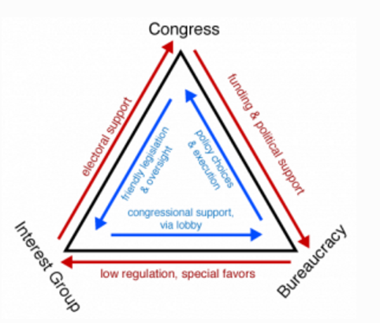

Slide 87
Issue Networks
A diverse group of people that care about an issue
Policy experts, congressional staffs, interest groups, media pundits (people who talk on TV)
Examples of members of the environmental issue network
Senator on environmental committee, Greenpeace members, Al Gore
The reason issue networks matter is because presidents pick people from favorable issue networks to fill department positions
How are they different from iron triangles?
Lots of different types of people in an issue group
Only three types in an iron triangle
Issue groups want to influence the government
Iron triangles are the government (except for the interest group)

