Slide 1
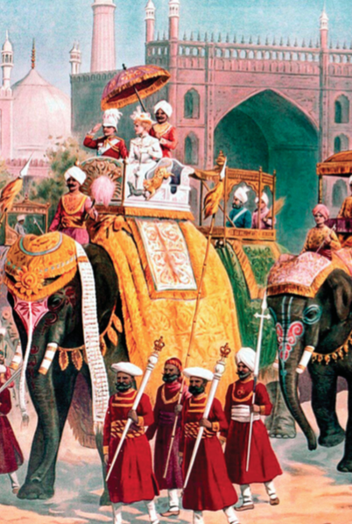
20.1 Colonization Intro
Strayer 923-928

Slide 2
Opening
Europeans didn’t speak English to African Natives.
Didn’t want to be seen as equals in language. Keep a distance
ENG, FR, GER, BEL, POR, RUS, US all had colonies and ruled differently
Between roughly 1750 and 1950, much of the Afro-Asian-Pacific world was enveloped within this new wave of European empire building.

Slide 3
A Second Wave of European Conquests
1750-1900 more EUR colonies in Asia and AFR
Not just ENG. GER, ITL, US, JPN join
Different than first wave
Didn’t destroy native populations
Not powered by the industrial rev
Used more informal control (informal empires) LA, CHN, OTM, JPN)
EUR had military firepower to keep advantage over colonists

Slide 4
“Gathering and hunting bands in Australia, agricultural village societies or chiefdoms on Pacific islands and in Africa, pastoralists of the Sahara and Central Asia, residents of states large and small, and virtually every- one in the large and complex civilizations of India and Southeast Asia — all of them alike lost the political sovereignty and freedom of action they had previously exercised.”

Slide 5
How they became colonies:
India/Indonesia – EUR was trading there and took over first economically, then by force
Africa, SE Asia – military takeovers
“The Scramble for Africa” – all EUR countries wanting AFR wealth (PAGE 593) (note Ethiopia)
Harder to conquer states w/ little central gov
Australia/New Zealand – like American colonization (many EUR ppl living there) (EUR diseases killed natives)
Aborigines 2.4% in 2000 in AUS, Maori 15% in 2000 in NZ

Slide 6
How they became colonies:
Taiwan/Korea – JPN takes over using EUR methods (firepower)
US and RUS expand their borders bringing in land and filling it with citizens
Philippines – US ”wins” them from SPN in the Spanish American War and keeps controlling them
Hawaii – military threat and disease (sovereign land with a queen) (Queen Liliuokalani)
Liberia – land for freed US slaves, colonize the natives there
Ethiopia – PWND Italy and stayed free (ITL = only EUR country to fail at taking over an AFR colony) (FAILLLL!!!!)
https://www.youtube.com/watch?v=AkRnakd6Gjo
Siam (Thailand) – works w/ENG and FR to stay independent. Becomes a “buffer zone” between them.

Slide 7
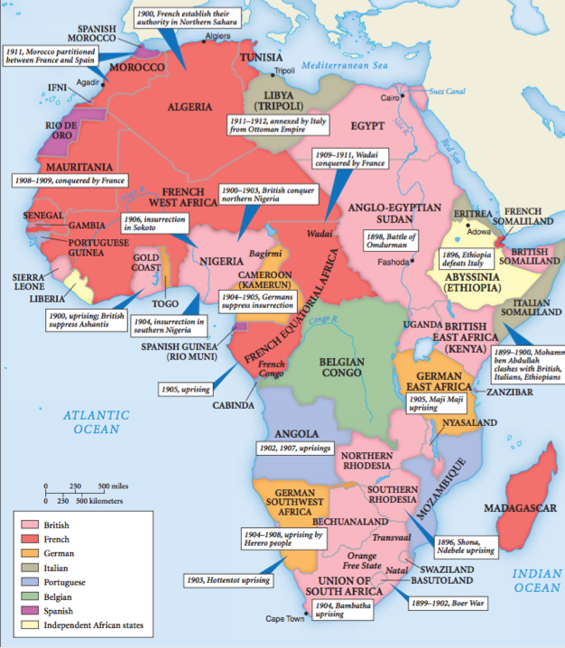
The Scramble for Africa

Slide 8
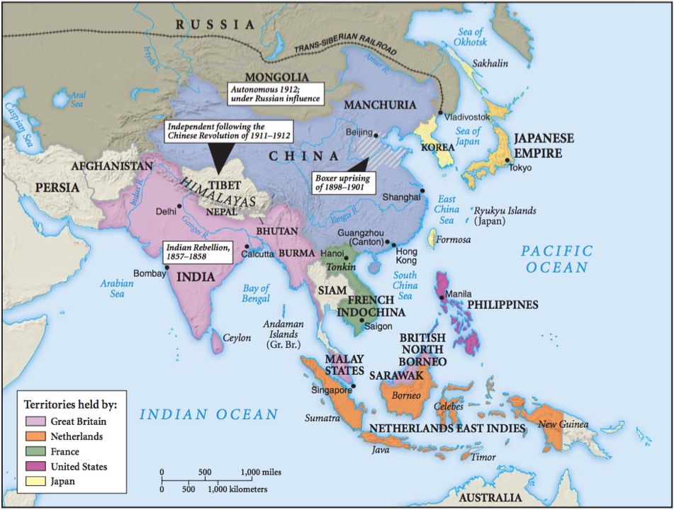

Slide 9
20.2 Colonies
Strayer 928-932

Slide 10
Under European Rule
EUR takeover changes the natives’ lives (duh!)
Lose land, liberty, property
Some native groups cooperated
Join EUR army
Elite keep power and money (used by EUR as gov officials)

Slide 11
Cooperation and Rebellion
EUR needs natives to help administrate the colonies, so they hire former native elites
EUR is far away
Hard to rule those w/ diff culture and language
FR had 50k African “chiefs” in French West Africa
Some natives get a Western education
Mid-level administrators, missionaries, teachers, translators
Numerous rebellions across colonies
Many were disorganized and decentralized
Some were not

Slide 12
Indian Rebellion AKA The Sepoy Mutiny
1700s – British East India Company (traders) allowed to get involved with Indian government
Hired sepoys (Indian soldiers) to protect them
Rumor that ENG was making them use bullets greased with cow and pig fat
Cows sacred to Hindus, Pigs taboo for Muslims
Huge war, but Sepoys are unorganized; Hindu/Muslim drama caused defeat
ENG government takes over and uses more direct rule (KNOW DIRECT/INDIRECT RULE)
Widens drama between Muslims and Hindus

Slide 13
Colonial Empires with a Difference
“Scientific racism” – similar to Social Darwinism
Race is used to separate the rulers from the ruled
Any education for natives is simple because they have “primitive minds”
No native Indian judges in India
Racism drives colonization in South Africa where natives worked for EUR for next to nothing
Harsher divides where Europeans settled a lot
Legal, political, and cultural divides
Will become apartheid in Unit 6

Slide 14
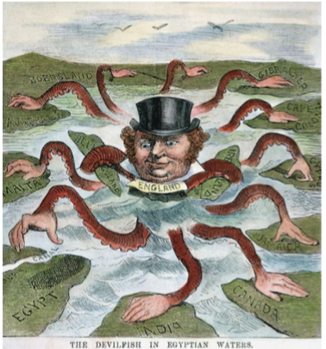

Slide 15
Colonial Empires with a Difference
EUR imperialism brought modernization to many people
Changed the lives of many
Classifying their colonial subjects
Leads to strengthening of caste in India – ENG finds old Hindu books w/ caste in them. Uses caste to classify Indians
Colonies contradicted values of EUR governments
Dictatorships, but democracy at home
Race classification is against Christianity and ideas of human equality
Didn’t want to modernize natives in their ways of thought

Slide 16
20.3 Colonial Empires
Strayer 932-940

Slide 18
Colonial rule changed the ways people worked
Subsistence farming (grow it eat it) declines
Why? Must sell stuff to pay taxes. Also, ppl want to buy stuff (consumerism)
Artisans replaced by factory-made products in EUR
AFR and ASI merchants lost economic and social power to EUR traders

Slide 19
Economies of Coercion: Forced Labor and the Power of the State
Forced gov labor for 10-12 days a year in French Africa
Like SPN use of Incan mit’a system
Congo – King Leopold II (BEL) forced labor and starved ppl.
Cut off hands and ears if rubber quota was not met
Cultivation System in Dutch East Indies (Indonesia)
20% of land must be cash crops to pay taxes
Paid for the Dutch IR, but made natives poor, subjugated
Working for Europeans and getting paid
Many in SE Asia plantations
If you lose your land to EUR, you go and work for them on their land
Farms, mines, colonial cities (much poverty)

Slide 20
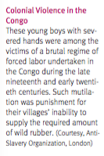
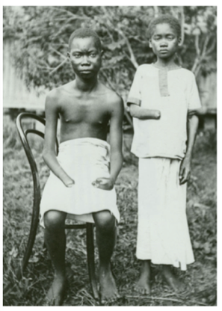
Resisting Forced Labor
Portugal forced cotton growing in Mozambique
Natives sabotaged the crops, smuggled it to sell to others for more profit

Slide 21
Economies of Cash-Crop Agriculture: The Pull of the Market
Rice cultivation promoted to natives in Burma by ENG
Led to a boom in production, profits for natives, private ownership of farms
Had environmental effects
Depleted river nutrients, forests, fish and shellfish, methane gas
Cacao grown in Gold Coast (Ghana owned by ENG)
Not hard to grow, led to peasants becoming happy capitalists
Natives became too dependent on one or two crops, and when the market fell, they paid the price
Led to new ethnic groups arriving to cultivate, ethnic tension
Led to the mistreatment of former slaves

Slide 22
Economies of Wage Labor: Working for Europeans
In plantations, mines, construction projects, and EUR homes
Sugarcane, rubber, tobacco, tea
Ppl came from India, China, Java to Southeast Asia (Vietnamish)
Disease, 50-75% women pay
ENG sent Indians to South Africa, Fiji, Malaysia to work as indentured laborers or to work off tax debt
Huge tracts of land went to EUR for plantations
80% of South Africa owned by whites (only 20% of pop)
Ppl lost their land, homes and had to work for EUR
Reservations
Bantustans in South Africa, soil and land depleted

Slide 23
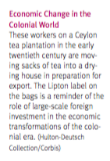
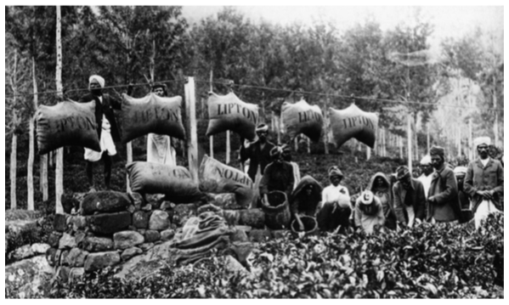

Slide 24
Economies of Wage Labor: Working for Europeans
Tin mines in British Malaysia
Mostly CHN workers
3 year contracts
Disease, accidents, poor living conditions
Gold and diamond mines in South Africa
Prison-like barracks, barbed wire
Colonial cities like Singapore (Malaysia), Cairo (Egypt), Saigon (Vietnam) were overpopulated, filthy, and dangerous
Wages too low for working poor to get by

Slide 25
Women in the colonial economy
Were farmers before EUR arrived
During colonization, men work on cash crops
Took cotton growing from women once they saw it brought money
Women had to maintain subsistence farms by themselves
Increase from 46 hours a week working to over 70
Or, many men migrate to other areas (women had to send men food to the cities)
Colonial economic opportunities for women?
Small trade, crops
Escape fathers, husbands. More witchcraft trials to restrict female travel and sexuality

Slide 26
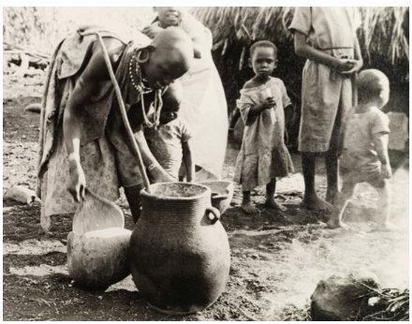
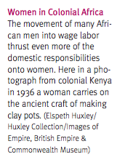

Slide 27
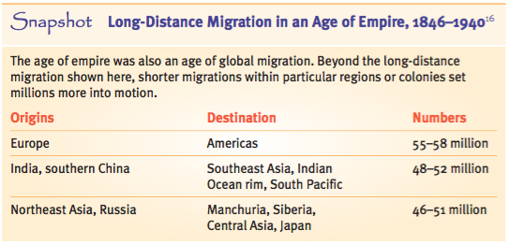
*Today, 74% of ppl in Singapore are Chinese, only 13% are Malaysian

Slide 28
Assessing colonial development
Defenders – jump-started modern growth
Integrated AFR and ASIA into world markets
Also strengthened bureaucracy and long-distance business communication
Brought modern armies, schools, and healthcare to colonial areas – railroads, roads, post offices
Critics – continued exploitation and unbalanced growth among peoples
Didn’t industrialize the colonies
ENG made IND super poor upon IND independence

Slide 29
20.4 Colonial Societies and Conclusion
Strayer 941-948

Slide 30
Education in the Colonial Era
Western education was like learning magic
So many opportunities, job, social, etc
SOCIAL MOBILITY!
Drama between natives that embraced EUR culture and those who didn’t
Some natives viewed EUR as rescuing them, making them less ignorant
In the beginning EUR thought they were “modernizing” and thus helping the world
They end up keeping them weaker, in order to exploit them

Slide 31
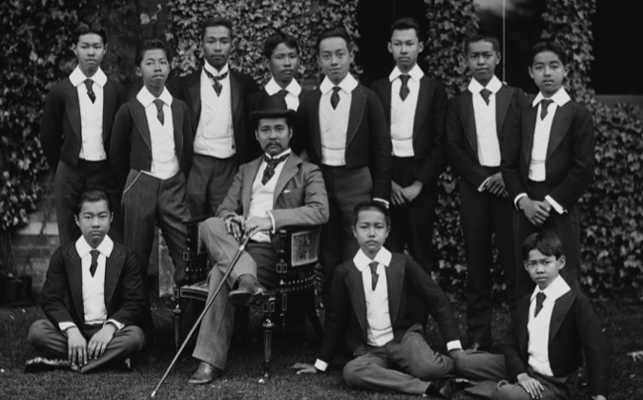

Slide 32
Religion in the Colonial Era
Christianity takes NZ, non-Muslim AFR (50 million) and Pacific Islands
Why CHR in AFR?
Old gods didn’t help AFR while EUR was defeating them
CHR=modern, educated
Gave opportunities to young, poor, and women
Spread of BUD, ISL, CHR in U3
Natives spread it to other natives

Slide 33
Religion in the Colonial Era
AFR CHRs kept some old traditions (charms, medicine men)
Like Voodoo and Santeria
Very little CHR in IND
New universal self-view of Hinduism
Uniting all Hindus against EUR aggression
Hinduism separates itself from Islam
ENG census and GOV practices split them as well
This will lead to drama later: India/Pakistan

Slide 34
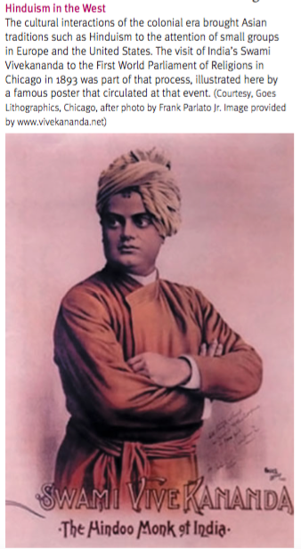
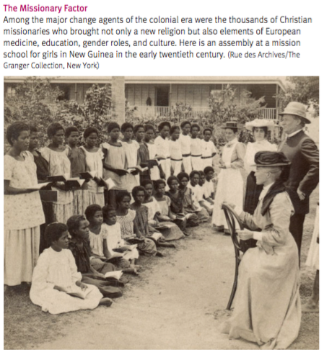

Slide 35
Africans gain self-awareness and pride
“African identity”, not tribal divisions popular around 1900
Started by Western-educated natives
United under colonization
Like Hindus in India
Saw the beauty and moral “advancedness” of AFR society
Some said that AFR made EGY and EUR stole their ideas of “civilization”. Therefore, EUR civilization came from AFR
Saw AFR societies as communal, cooperative and equal
Opposite to EUR selfish, exploitative, competitive

Slide 36
Africans gain self-awareness and pride
Pan-Africanism begins
Idea that all black Africans should unite
Pushed by Americans like Booker T. Washington and Marcus Garvey (proponent of Liberia)
Some tribes were “created” by EUR to label ppl
Some tribes were created by Africans when they moved to larger urban areas
Grouped themselves by languages or cultural practices
Nigerians start calling themselves Igbo

Slide 37
Reflections: Who makes history?
Oppressed peoples influence history too
Often those with a Western education use it against the Westerners
Slaves, women, colonized people

Slide 38
20.5 Colonial Docs
Strayer 950-959

Slide 39
Intro
150 years of ENG control of IND
“Jewel in the crown”
First ruled by BEIC w/ charter form gov that gave them mil and pol power
ENG took complete control after Indian Rebellion of 1857
ENG used landowners (princes) and Brahmins to keep control

Slide 40
On Calcutta – Nawab Muhabbat Khan - 1700s
Calcutta – capital of British India
Huge city, lots of people, pretty buildings
European art
Lots of art and stuff imported for sale at the bazaars
Its like the best of China and the West in the same set
Its generally awesome

Slide 41
A Letter to Lord Amherst – Ram Mohan Roy - 1823
Hindu Brahmin, Western educated
Wanted to end sati, modernize India
I thought ENG was going to teach us Western stuff, but you’re going to have IND ppl teach us old Hindus stuff
We don’t need it. We already know it. It’s not practical.
We can’t better ourselves if we think everything is an illusion (Hinduism)
It keeps us in darkness

Slide 42
The Azamgarh Proclamation – Bahadur Shah - 1857
Thought the Mughal Empire might take power back from ENG after the Indian Rebellion
Written by the grandson of the shah (who was powerless)
ENG is ruining both Hindus and Muslims
We should unite to run them out
If we take back over, the landowners will have power over their land and taxes will be lower
Stop low-ranking ppl from disgracing high-ranking ppl with lawsuits

Slide 43
The Azamgarh Proclamation – Bahadur Shah - 1857
ENG controls trade or taxes it to death
When we take back over, it’ll be free and the gov will even provide free transport by ships and trains for goods
ENG treats native gov workers poorly
We will treat them nice
If ENG ppl fight against ENG, we will give them good gov jobs
Artisans will be employed by our kings so they still have jobs
Leaders of Hinduism and Islam should fight the ENG in a holy war or we will take their stuff and kill them :)

Slide 44
Speech to a London Audience – Dadahai Naoroji - 1871
Started the Indian National Congress and was the first Indian to serve in British Parliament
Pros:
Ending sati, infanticide, allow widows to remarry
Equal education based on gender
Move away from superstition
Peace and order
Freedom of speech, press, and property
Railroads, irrigation, exports, telegraphs

Slide 45
Speech to a London Audience – Dadahai Naoroji - 1871
Cons:
Don’t let natives hold high office
Taxation w/o representation, high taxes w/o regard for natives’ ability to pay
Summary:
“Sakar ki Churi” the knife of sugar – you do sweet things, but you’re killing us

Slide 46
Indian Home Rule – Mahatma Gandhi - 1908
Civilization: good and bad, but mostly bad
Better houses, publishing, transportation, clothes, weapons
Slavery to the lifestyle
Women forced to work is unnatural
Modern civilization is irreligion, ruining India
Focus on selves, not God

Slide 47
Indian Home Rule – Mahatma Gandhi - 1908
Railroads spread the plague and make us sell out grain away which leads to famine
IND was civilized way before others came here
Moral, self-sustaining, not competitive
Small villages
We should be teaching you!
IND elevates the most moral, ENG is opposite

