Slide 1
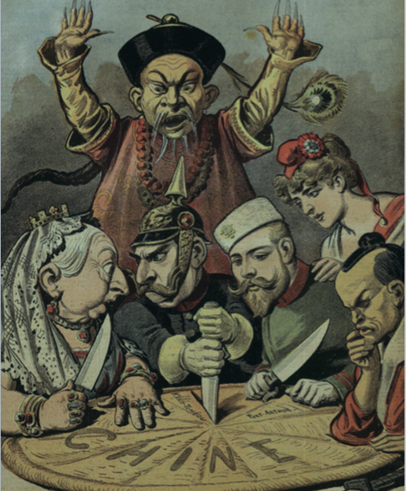
19.1 Intro and EUR in ASI
Strayer 877-882

Slide 2
Opening
Japanese textbooks downplay terrors of the “Rape of Nanjing” and Chinese “Comfort Women” in WWII
Weird b/c JPN was always in CHN’s shadow until the 1800s
Both dealt with European imperialism and industrialization differently
This would lead them to different places in the world by WWII

Slide 3
Opening
Dealing with EUR imperialism (imp) was a big deal for most countries, but not the only thing going on
AFR saw the Islamic revival and the shrinking of Islamic states
CHN had a huge pop pop and peasant rebellions
Hindus and Muslims still hate each other in India
Drama among peninsulares and creoles in LA

Slide 4
4 ways EUR contact effected areas
Military and political takeover
Inclusion in the EUR trade network
Picking up EUR culture, language, religion
Need to “modernize”, industrialize, focus on “progress”

Slide 5
The External Challenge: European Industry and Empire
EUR spread everywhere
Religion, culture, migration, industry, political control
Africa, India, Southeast Asia, Pacific Islands
Destroyed once proud empires (OTM, CHN, PER)

Slide 6
New Motives, New Means
Industrialization (1750)
Need raw materials to make stuff (wheat, meat, bananas, palm oil)
Need people to sell the stuff to (India was a market of 300 million people [consumers])
Nationalism
GER and ITL become unified = more competition for power in EUR
Everyone concerned with what foreign lands are owned
Spoiler (WWI)
Technology
Steamships and quinine (to fight mosquito-borne malaria) let Europeans get inside of Central Africa
Crazy awesome guns led them to take any place they wanted super-easy (Gatling gun)
Suez Canal made it very easy to get to Asia via the Mediterranean
Telegraphs were like early text messaging

Slide 7
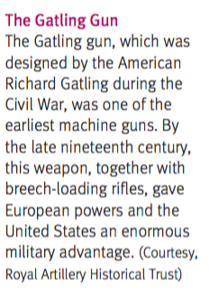
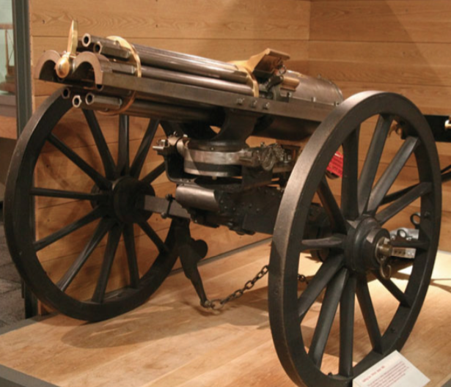

Slide 8
New Perceptions of “Other”
Middle Ages = other were just heathens, now, they are “lesser”
EUR has unlocked nature, got super-rich, couldn’t be beat at war
Asians and AFR viewed as primitive
Race used to “scientifically” determine intelligence, morality, and destiny
Phrenologists – read the bumps on your head and tell you about your character and intelligence
Duty of the white man to bring “civilization” to the barbarians

Slide 9
New Perceptions of “Other”
Social Darwinism – “other” races are behind because they are not “fit” to survive
That’s why EUR has all the nice cities and stuff
That’s why other races die off when in competition with EUR
Not DISEASE or anything stupid like that
Used to justify imperialism, slavery, “weeding out” weaker parts of a race
British bishop talking about aboriginal Australians:
Everyone who knows a little about aboriginal races is aware that those races which are of a low type mentally and who are at the same time weak in constitution rapidly die out when their country comes to be occupied by a different race much more rigorous, robust, and pushing than themselves.

Slide 10
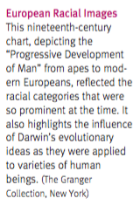
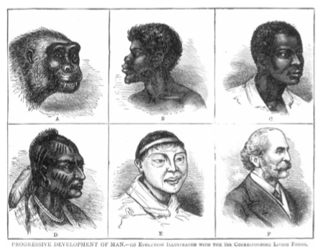

Slide 11
19.2 Internal Drama
Strayer 882-889

Slide 12
Reversal of Fortune: China’s Century of Crisis
Qing Emperor to England: “We have all things in abundance, no need for your barbarian products”
Big change for CHN going from running things throughout Asia to being dependent on EUR
Not the “Middle Kingdom” anymore

Slide 13
The Crisis Within
American crops caused pop pop, but no IR to keep production up
Ag couldn’t keep up w/ pop > leads to unemployment, starvation
Gov didn’t grow with the growing pop
Local corruption/ harassment of taxpayers
Beat delinquent taxpayers until “blood and flesh flew in all directions”
Millenarianism (the belief that big changes were coming with the new millennium (1000 years)) inspired some rebellions
Most Han (ethnic Chinese) hated the Qing as outside conquerors

Slide 14
Taiping Rebellion
Christians, not Confucians or Buddhists
Led by Hong Xiuqan (Jesus’ lil’ bro)
Wanted to start a new “Heavenly Kingdom”
Basically communist and egalitarian w/ women’s rights, universal healthcare, banned foot binding, industrialization
Qing army wasn’t strong enough to stop them
Only lost when landlords (who didn’t want com) lent Qing their armies to defeat them
Took 14 years and 20-30 million dead to stop them
Only war with more casualties was WWII

Slide 15
Western Pressures – Opium Wars
ENG sold opium to CHN to fix trade imbalance
CHN wanted only silver, not ENG products
Also, EUR only allowed to trade at one heavily guarded port (Canton)
ENG wanted to sell what they wanted when they wanted
Opium imports increased by 23 times over 50 years
Soldiers, scholars, laborers – massive addiction
Qing seize and destroyed 3 million lbs
ENG is offended and wants CHN to pay them back for the ILLEGAL DOPE CHN just destroyed
Sends a huge modern naval fleet up the coasts and the rivers in CHN and ravages them
CHN can’t fight back because they never industrialized

Slide 16
Treaty of Nanjing
Ends the Opium Wars
CHN must give Hong Kong to ENG (keeps it until 1999)
Opened five ports for ENG and other EUR countries to trade
CHN had to pay ENG for the drugs they destroyed

Slide 17
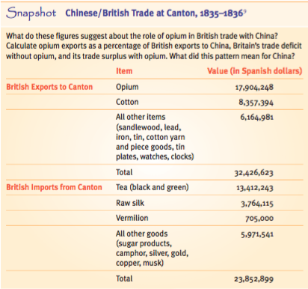
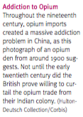
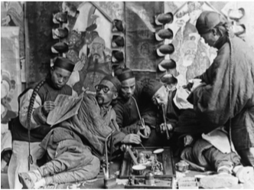

Slide 18
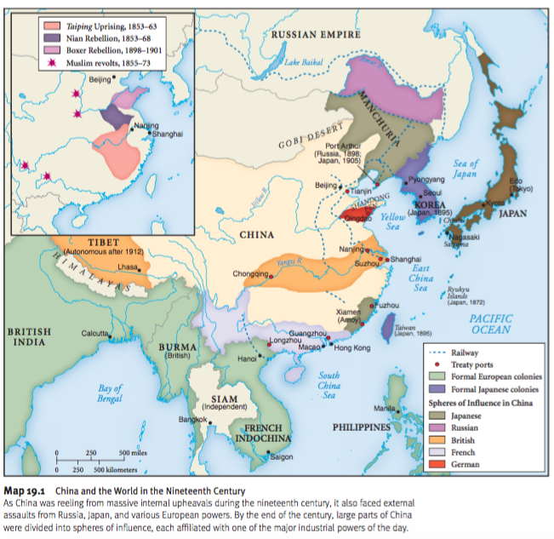
Second Opium War
CHN lost more (KOR to JPN, VIET to FR, parts of CHN to ENG)

Slide 19
The Failure of Conservative Modernization
“Self-Strengthening” movement – move to modernize and industrialize in response to the Taiping Rebellion
Irrigation, factories, coal mines, revamped civil service exam, telegraphs, more money in weapons, ships
Was fought by conservatives
Dependent on foreign resources, machines, materials
Took power from the powerful landlord class and would give it to the central Chinese gov

Slide 20
Boxer Rebellion “The Society of Righteous and Harmonious Fists”
Martial artists who killed foreigners, Chinese Christians, destroyed telegraph lines, tore up railroad tracks and overtook foreign embassies
Believed they could punch bullets out of the air (probably could)
Not stopped until CHN brought in seven other countries to help (8 Nation Alliance)
ENG, JPN, RUS, FR, US, GER, ITL, AH
By the end, CHN sided w/ the Boxers against the foreigners, but it was too late
CHN ended up having to sign the “Boxer Protocol” where they gave more money and influence to EUR

Slide 21
Outcome of the Failure to Modernize
Outcome of all of this was a hate for the Qing (foreign rulers), hate for foreign influence (ENG and others), but a need to modernize, industrialize, democratize, and westernize
Birth of Chinese nationalism that will lead to the Chinese Revolution and Chinese Republic in Unit 6
End of 2000 years of dynastic rule with “only a modest nudge from organized revolutionaries”

Slide 22
19.3 OTM
Strayer 889-894

Slide 23
The Ottoman Empire in the West in the 19th Century
How OTM was like Qing:
Not directly colonized, but power was taken greatly by EUR
“Defensive modernization” tried to become industrialized to keep up with EUR, but both were too little too late

Slide 24
The Sick Man of Europe
OTM was super-strong between 1400s-1700s
Sultan claimed title of caliph (Pope of all Muslims)
Lost tons of land in the 1800s
Balkans (GRE, ROM) to RUS, Egypt to FR and then became independent, N. AFR became independent)
Only left with Turkey, Iraq, and part of Saudi Arabia (map on 890)
Nationalism (inspired by being conquered by Napoleon) led to most of these countries want to have self-rule

Slide 25
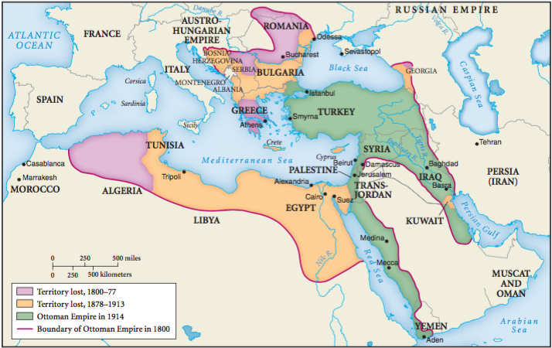

Slide 26
Sick Man of Europe
Probably would have fell much earlier but the Great Powers of EUR couldn’t agree on how to divide it up
Like CHN, failure to industrialize, loss of centralized power, corruption, landlords and warlords made the country super-weak
Janissaries weren’t as powerful now because other armies have modernized and OTM didn’t
Lost power due to decrease in overland trade (b/c Indian Ocean trade boomed)
Borrowed money from ENG and FR to try to industrialize and couldn’t pay it back, so ENG and FR moved in to occupy parts of OTM

Slide 27
Reform and Its Opponents
OTM reforms went further than China’s
No massive revolts, only some losses on the outskirts of the empire
Not totally different than who they ruled (Qing were not CHN, remember)
Tanzimat (Tanzimet) Reforms (means reorganization)
Mining, factories, telegraphs, railroads, postal service, Western law codes, secular laws
Non-Muslims given equal rights under the law, not discriminated against for gov jobs
Hated by conservatives who wanted to keep their power and the gov as a theocracy
Hung tight to the OTM and fell out of power when OTM falls in WWI

Slide 28
Young Ottomans and Young Turks
Tanzimat reforms were loved by “Young Ottomans”
Western educated, pushed for “Islamic modernism” – secular, civil rights, democracy, science-based
Blowback led to the “Young Turks” – militant secularists, focused on modernization and westernization
Separation of church and state, free elections, Western clothing for women, women-led divorces
Will lead the overthrow of the OTM and the birth of a new country, Turkey during WWI

Slide 29
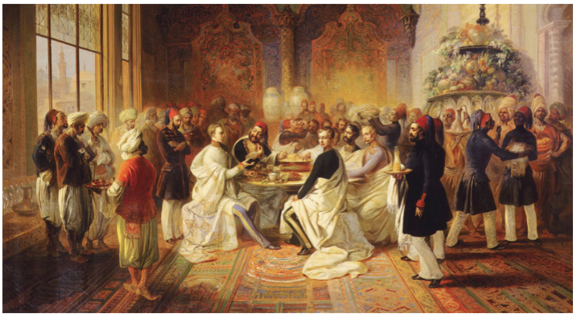
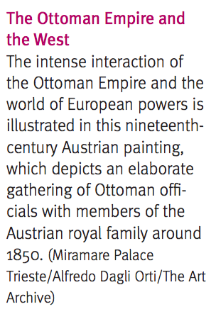

Slide 30
Outcomes: Comparing Qing China and the Ottoman Empire
Sims
Both were once huge and vibrant, now were “semicolonies” in “informal empires”
Both tried to catch up to industrialization, but failed to restore their power
EUR was too strong and the attempts were too little too late
Both saw movements of nationalism that didn’t have much of an effect before 1900
Would lead both to revolution and independence after 1900

Slide 31
Outcomes: Comparing Qing China and the Ottoman Empire
Diffs
OTM held onto Islam much more than CHN held onto Confucianism
ISL part of all society, CONF mainly just elites
CONF controlled by a huge state, ISL spread throughout culture, not just in the gov
CONF has made a comeback since the nationalist/communist backlash of the 1900s
ISL stayed strong in the Middle East even through today (with a few secular challenges here and there)

Slide 32
19.4 JPN and Conclusion
Strayer 894-903

Slide 33
The Japanese Difference: The Rise of a New East Asian Power
JPN was forced by the US to become “powerful, modern, united, and industrialized”
Completely diff from OTM and CHN
Became a huge empire (outside of EUR) and took a lot of land from its bigger brother (CHN)

Slide 34
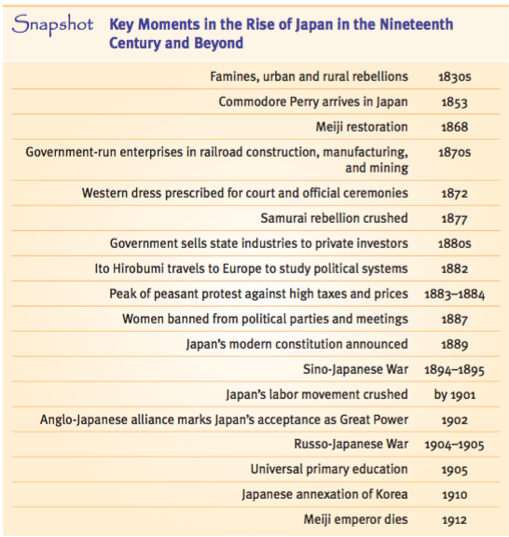

Slide 35
The Tokugawa Background
Shogun (military ruler) who acted in the name of a powerless emperor
Purpose was to keep the country from falling into warring states with daimyos (feudal lords) fighting using samurais
This is how things have worked from 1600-1850
Daimyos worked like senators, but they lived one year in the capital (Edo) (aka Tokyo) and one year in their home regions
Families stayed in Edo - called the “hostage system”
Kept daimyos “pacified, but not really unified”
Strict rules for dress, laws, taxes, and social rankings (Samurai, peasants, artisans, merchants)

Slide 36
Changes during the Tokugawa Shogunate
Samurais now didn’t have wars to fight, so they became bureaucrats like the scholar gentry in CHN, but were still super-loyal to their individual daimyos
New fertilizers, more rice, more cities (most urbanized country in 1750)
Edo – largest city in the world in 1750 (1 million ppl)
CONF led to a very literate population
Some samurai became merchants to get rich quick, but ended up losing social status
Some peasants got rich and challenged the social status of the elites
Famine mismanaged by the shogunate which led to riots
Looked like the shogunate was losing control

Slide 37
American Intrusion and the Meiji Restoration
Matthew Perry brought a note from Millard Fillmore saying “Open up or we will blow you up”.
Wanted JPN to free shipwrecked US sailors, refuel their boats, and trade
Saw how CHN got pwned by ENG, they agreed to unequal treaties w/ US
Some civil wars led to a new young emperor (Meiji) and his young followers taking over (MEIJI RESTORATION)
Wanted to fight foreign control in the opposite way CHN did, by becoming industrial, modern, and imperial

Slide 38
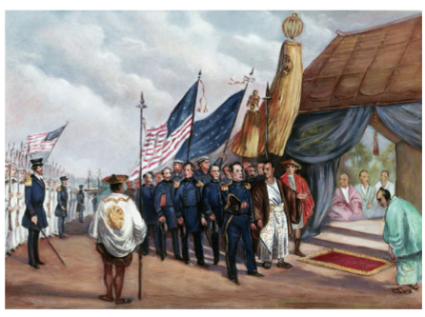
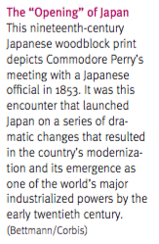

Slide 39
Modernization Japanese Style
Took power from daimyos (self-reliant) and gave it to governors (representing the emperor and national gov)
National gov collected taxes and raised one national army (not many competing local armies)
Most citizens were now equal but under the emperor (no eta (outcasts)) or shade for merchants
Infatuation with Western culture, clothes, writings
“When comparing Japan to the West, Japan stinks in all aspects.”
Used GER’s constitution, but emperor kept full power
Universal primary education

Slide 40
Modernization Japanese Style
No rise of feminism or Christianity, Shinto became the official state religion
Emperor a direct descendent of the most important goddess
Zaibatsus – five giant government run corporations, then sold to private owners
Textiles, munitions, machinery
All independent and home-grown (unlike anywhere else outside of the West)

Slide 41
Modernization Japanese Style
Okay with borrowing from other cultures b/c they already did w/ CHN
Social issues w/ industrialization
Female infanticide
Famine
Heavy peasant taxation led to riots and protests against moneylenders and gov offices
Japanese “factory girls” – from poor families, mistreated by factory owers
Attempts to unionize were met with violence and anti-union laws

Slide 42
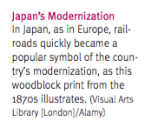
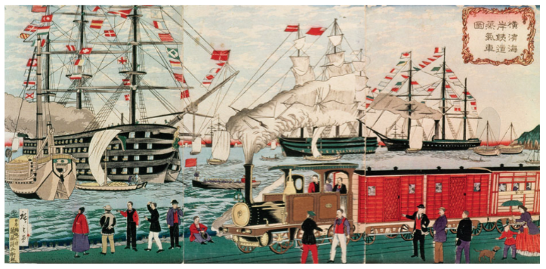

Slide 43
Japan and the World
Rising power and economic status led to revision of earlier unequal treaties with the West
“Anglo-Japanese Treaty of 1902” listed JPN as equals to all countries in all ways
Follows West’s lead by taking land they don’t own
Sino(Chinese)-Japanese War (Manchuria and Taiwan) and Russo-Japanese War (Korea) map on 920
Lots of ppl saw JPN’s rise to power as inspirational
How Eastern ppl can use industrialization against the West
Indonesia, Jews in RUS, EGY, TUR, even some in CHN

Slide 44
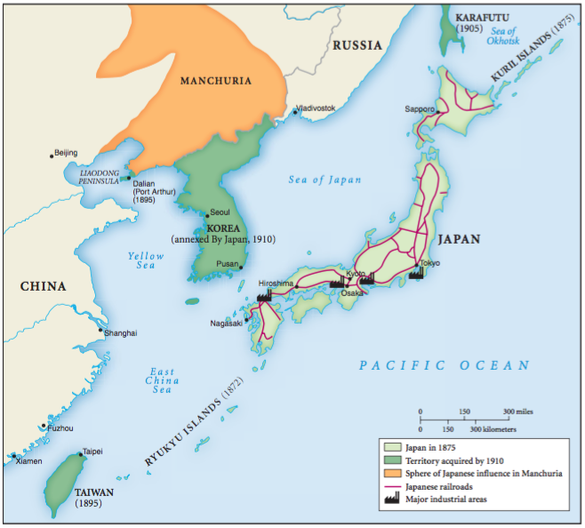

Slide 45
Reflections: Success and Failure in History
Was EUR’s IR a success?
Was JPN more successful than OTM or CHN?
Criteria? Wealth or environmental preservation?
Success for whom? What about artisans or peasants?
Was it just luck or being in the right place at the right time? JPN could learn from CHN’s bad experiences.

Slide 46
19.5 Docs
Strayer 905-913

Slide 47
Intro
Opium Wars 1839-1842
Before the US Civil War (1860s)
CHN ran East Asia in trade in Unit 4
”Silver drain”
CHN controlled all trade and restricted it heavily (Canton System)

Slide 48
Message to King George III – Emperor Quianlong 1793
We were nice to your ppl when they showed up
We don’t need your crap, we will sell you our stuff just to be nice (at Canton)
You’re ignorant to ask, but you’re a barbarian, so I’ll forgive you
You want an island for your merchants to stay, but you just want to start trading without me knowing it
I keep Christians under control here, so you guys can’t go out preaching
Listen or I will expel you all for ever
“Trembling obey and show no negligence! A special mandate!”

Slide 49
An Argument for Legalization – Xu Naiji 1836
Opium used to be taxed as a medicine
Used to bring silver in, now we send it out
They will find a way to keep selling it
Meeting at sea
We should make it legal and trade stuff for it instead of silver
If they take silver for it, their dope will be destroyed
Fire gov ppl for smoking opium, let the vagrants get high, they stink anyway

Slide 50
An Argument for Suppression – Yuan Yulin 1836
Drugs are wrong, evil
Can’t just ban its use among officials, because commoners will be officials tomorrow
Full ban led to everyone using it, partial ban will be equally useless
We need to inspect imports for opium and exports for silver - this will stop the drain
Don’t grow opium here, we need farms to make food
We lost a battle because our soldiers were high
Will lead to the superior in every relationship to fail and the country to die

Slide 51
Letter to Queen Victoria – Lin Zexu 1839
If opium is banned in ENG, how can you sell it in CHN?
We sell you stuff you can’t live without. Your crap is just toys to us.
If someone came to ENG to trade, they’d have to follow ENG’s laws
If you bring opium here, we’ll cut your frickin’ head off
“Be sure not to put this off.”

Slide 52
The Treaty of Nanjing - 1842
”This was the first Opium War, and the Chinese lost it badly.”
First of many “unequal treaties”
ENG traders can live and trade in five cities
ENG gets to control Hong Kong to work on their ships
CHN pays ENG 6 mil for the opium they blew up
Hong merchants have no say in trade anymore, ENG can trade as they please
Also, 3 mil to ENG for Hong merchants ripping them off in the past

Slide 53
The Treaty of Nanjing - 1842
12 mil to ENG for the ships and guns they had to use blowing up CHN
Seems legit
ENG will keep military there until they are paid back in full

