Slide 1
Congress is terrible
…and I hate it
Notes:
Congress is the center of policymaking in the United States, but the decentralization of power within it and between the branches makes it difficult to get things done. Here President Barack Obama delivers his 2012 State of the Union address before a joint session of Congress.

Slide 2
Intro
11.1
Congress has a 10% approval rating. Why?
2011, we were about to default on our loans and throw the whole world economy into shambles
Republicans wouldn’t allow for tax raises to pay the debt
Democrats wouldn’t allow for funding cuts (Medicare) to pay the debt
Yet almost all of them were re-elected
This should be frustrating for you as an American with a brain in your head.
Notes:
Being a member of Congress isn’t an easy job. It takes a considerable amount of time, trouble, and money to get elected, and reelected—and the reward for all that effort is a hectic job shuttling between your constituency and Capitol Hill, being expected to solve everyone’s problems but lacking the individual power to change much of anything.

Slide 3
Two Views of Congress
11.1
Congress must do two things
Represent the people
Legislate (make laws)
Too worried about representing the people
Therefore, they do lots of dumb stuff
Not worried enough about representing the people
Therefore they do a lot of selfish (self-sustaining) stuff
Notes:
Being a member of Congress isn’t an easy job. It takes a considerable amount of time, trouble, and money to get elected, and reelected—and the reward for all that effort is a hectic job shuttling between your constituency and Capitol Hill, being expected to solve everyone’s problems but lacking the individual power to change much of anything.

Slide 4
Quotey McQuoter
11.1
“Congress is the true center of power in Washington.”
Notes:
Being a member of Congress isn’t an easy job. It takes a considerable amount of time, trouble, and money to get elected, and reelected—and the reward for all that effort is a hectic job shuttling between your constituency and Capitol Hill, being expected to solve everyone’s problems but lacking the individual power to change much of anything.

Slide 5
Congress is the Center of DC
11.1
Framers wanted it that way
Their plan was “for the great debates over public policy to be resolved in Congress, not the White House or the Supreme Court
Notes:
Being a member of Congress isn’t an easy job. It takes a considerable amount of time, trouble, and money to get elected, and reelected—and the reward for all that effort is a hectic job shuttling between your constituency and Capitol Hill, being expected to solve everyone’s problems but lacking the individual power to change much of anything.

Slide 6
Members
11.1
Not a glamorous job, but there are perks
Power (most important)
$174,000 annual salary
3X average US income
Generous retirement and health benefits
Constitutional requirements
House: 25, citizen for 7 years
Senate: 30, citizen for 9 years
Reside in state
435 Representatives; 100 senators
535 Total Congresspersons
100 Senators
435 House Members <-must know this number
Notes:
Being a member of Congress isn’t a glamorous job, but it has its perks. Members of Congress receive an annual salary of $174,000, along with generous retirement and health benefits—but most attractive of all, they have the power to make important public policy decisions.
The Constitution specifies that members of the House must be at least 25 years old and American citizens for 7 years, that senators must be at least 30 and American citizens for 9 years, and that all members of Congress must reside in the state from which they’re elected. There are 100 senators, two from each state, and 435 representatives in the House.
Members of Congress tend to be lawyers, and to come from relatively wealthy backgrounds. Minorities and women are underrepresented.

Slide 7
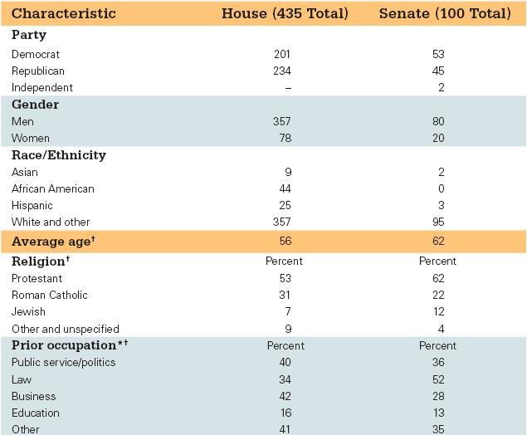
11.1
TABLE 11.1: Portrait of the 113th Congress
Notes:
Which party controlled each chamber of the 113th Congress? What religious affiliation is most represented? What occupations dominate the membership?

Slide 10
Members
11.1
Demographics
Most come from high-status jobs with high income
Not entirely a “millionaires’ club” though
Lots of lawyers, businesspeople
Groups that are underrepresented in Congress
No African American senators
Asians, Hispanics, Natives
Women are the most underrepresented in Congress
50% US population, but 18% in Congress
Notes:
How important are the personal characteristics of members of Congress? Can a group of predominantly white, upper-middle-class, middle-aged, Protestant males adequately represent a much more diverse population?
Most members of Congress can’t engage in descriptive representation, so they must employ substantive representation. This simply means that they can’t represent their constituents by being from the same background and having the same problems, but they can represent them as advocates who understand their problems and concerns.

Slide 11
The Big Question…
11.1
“Can a group of predominantly white, upper-middle-class middle-aged Protestant males adequately represent a much more diverse population?”
Notes:
How important are the personal characteristics of members of Congress? Can a group of predominantly white, upper-middle-class, middle-aged, Protestant males adequately represent a much more diverse population?
Most members of Congress can’t engage in descriptive representation, so they must employ substantive representation. This simply means that they can’t represent their constituents by being from the same background and having the same problems, but they can represent them as advocates who understand their problems and concerns.

Slide 12
Why Aren’t There More Women in Congress?
11.1
Fewer women running
Childcare
Men don’t share the same child responsibilities
Risk averse
Less likely to run than men if they are underdogs
Bias
Men tend to vote against women
Some view women as less qualified due to their status in the workplace
Notes:
Women constitute more than half the U.S. population but hold less than a fifth of congressional seats. How can this be?
When women run for office, they win about half of the time, but they’re considerably less likely than men to run. This is partially explained by childcare responsibilities. Women without children are more politically ambitious. Women also seem less likely than men to run for office when they perceive that the odds of winning are low. However, they seem more likely than men to run when they view the odds as being in their favor.
Bias is another factor that accounts for the small numbers of women in Congress. When candidates are equally qualified, there’s a bias in voters toward the male candidate. So female candidates must be more qualified than their male opponents.

Slide 13
11.2 Incumbency Advantage

Slide 14
11.2
Who Wins Elections?
Incumbents
Over 90% win reelection in House
Senators do not have it as easy
“The most predictable aspect of congressional elections is this: incumbents usually win.”
2010 – Percentage of incumbents relected:
House 84%
Senate 85%
Incumbents still perceive themselves as vulnerable
Hence fundraising and campaigning
Notes:
The most predictable aspect of American elections is that incumbents usually win. More than 90% of House incumbents win reelection, even when the policy positions of the challenger are closer to those of the voters. Senators don’t have it quite as easy. They represent larger, and thus more diverse, constituencies, and they get more media attention than representatives. They tend to be held accountable because they are more visible.
All incumbents tend to perceive themselves as vulnerable, which is one reason they spend so much time fundraising and campaigning.

Slide 15
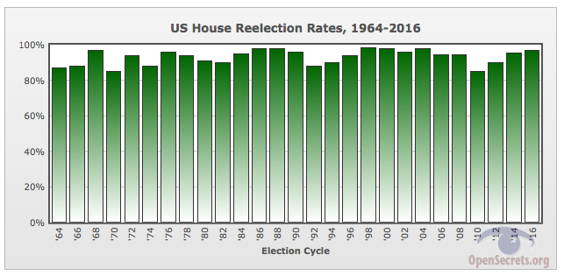
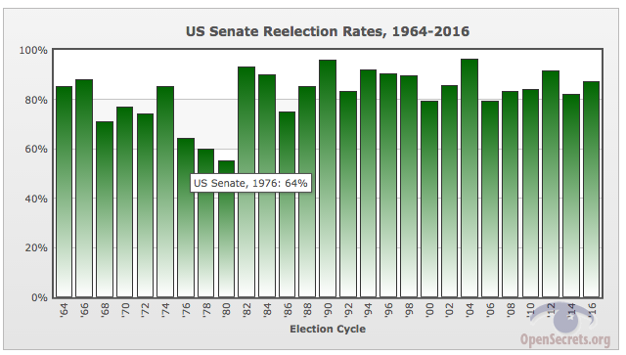

Slide 16
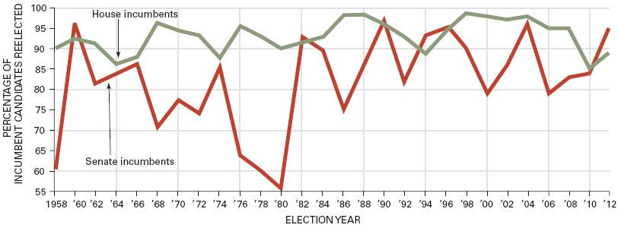
11.2
FIGURE 11.1: Incumbency factor in congressional elections
Notes:
Americans disapprove of the performance of Congress as a whole, but tend to think that their own representatives are an exception and reelect them. This makes it hard to change the makeup of Congress in a given election.

Slide 17
Advantages of Incumbency
11.2
Some say incumbents are elected to “keep up the good work”
But only 28% of Americans can name their representative
Notes:
Do Americans reelect their representatives because they agree with their voting record? Hardly. Only 11% of Americans have any idea of how their representatives voted on a given issue. If not policy, what gives incumbents their electoral advantage?
Incumbents have an advantage in visibility. They can use the congressional franking privilege to sent mailings to constituents, and they take advantage of telephone and email technology to maintain contact with constituents.
Incumbents can also claim credit for services to individual constituents, called casework, as well as for pork barrel projects in their constituencies. This is safer than taking credit for policy changes because those win enemies as well as supporters.

Slide 18
Advantages of Incumbency
11.2
Advertising
Constituent contact – doing PR work, appearances
Constituent-ppl who are represented
Franking Privilege – Congresspersons can mail letters for free (they use this for campaign materials)
Non-incumbents can’t do this
Now the Franking Privilege can be used for emails, so taxpayer money goes to massive email marketing campaigns
Notes:
Do Americans reelect their representatives because they agree with their voting record? Hardly. Only 11% of Americans have any idea of how their representatives voted on a given issue. If not policy, what gives incumbents their electoral advantage?
Incumbents have an advantage in visibility. They can use the congressional franking privilege to sent mailings to constituents, and they take advantage of telephone and email technology to maintain contact with constituents.
Incumbents can also claim credit for services to individual constituents, called casework, as well as for pork barrel projects in their constituencies. This is safer than taking credit for policy changes because those win enemies as well as supporters.

Slide 19
Advantages of Incumbency
11.2
Credit claiming
Casework – helping constituents
“Policy issues makes enemies as well as friends”
Helping constituents makes everyone happy
Getting Social Security checks for people
Getting roads fixed
Helping people get government jobs
Pork barrel projects – “bringing home the bacon”
Construction, jobs, businesses for the district
A type of casework
Origins from slavery
Notes:
Do Americans reelect their representatives because they agree with their voting record? Hardly. Only 11% of Americans have any idea of how their representatives voted on a given issue. If not policy, what gives incumbents their electoral advantage?
Incumbents have an advantage in visibility. They can use the congressional franking privilege to sent mailings to constituents, and they take advantage of telephone and email technology to maintain contact with constituents.
Incumbents can also claim credit for services to individual constituents, called casework, as well as for pork barrel projects in their constituencies. This is safer than taking credit for policy changes because those win enemies as well as supporters.

Slide 20
Advantages of Incumbency
11.2
“Coattail Effect” – Congressional candidates get elected because the president of the same party is popular
They “ride his coattails”
This is just a theory and doesn’t always work
Notes:
Do Americans reelect their representatives because they agree with their voting record? Hardly. Only 11% of Americans have any idea of how their representatives voted on a given issue. If not policy, what gives incumbents their electoral advantage?
Incumbents have an advantage in visibility. They can use the congressional franking privilege to sent mailings to constituents, and they take advantage of telephone and email technology to maintain contact with constituents.
Incumbents can also claim credit for services to individual constituents, called casework, as well as for pork barrel projects in their constituencies. This is safer than taking credit for policy changes because those win enemies as well as supporters.

Slide 21
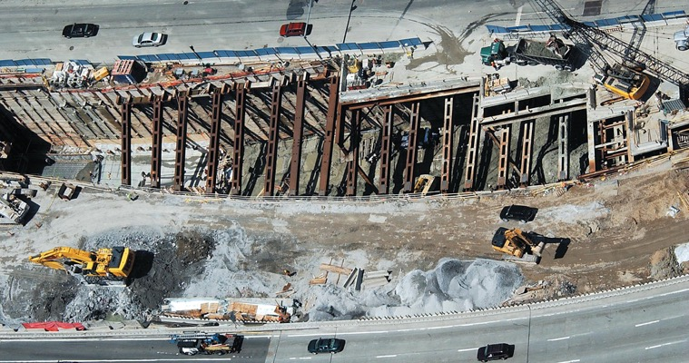
11.2
Big Dig
Notes:
Because claiming credit may be important for reelection, members of Congress rarely pass up the opportunity to increase federal spending in their state or district.
The Big Dig in Boston is an example of an expensive earmark for which members of Congress could claim credit.

Slide 22
Advantages of Incumbency
11.2
Position taking
Risky, but sometimes pays off
Must anticipate that constituents will agree with them
Notes:
But even though position taking is risky, sometimes members of Congress do take strong and public positions on certain issues when they believe they are certain how the majority of their constituents feel about the issue.
Another advantage for incumbents is the weakness of opponents, who lack the visibility and experience of incumbents. Incumbents have to raise a substantial sum to mount a realistic challenge. House campaigns typically more than a million dollars and the average Senate campaign costs ten times that. The candidate who spends the most money usually (but not always) wins, and incumbents outspend challengers two to one.

Slide 23
Advantages of Incumbency
11.2
Weak opponents
Good opponents are scared off b/c of the incumbency advantage
Parties don’t want to spend money on candidates that will probably lose
Notes:
But even though position taking is risky, sometimes members of Congress do take strong and public positions on certain issues when they believe they are certain how the majority of their constituents feel about the issue.
Another advantage for incumbents is the weakness of opponents, who lack the visibility and experience of incumbents. Incumbents have to raise a substantial sum to mount a realistic challenge. House campaigns typically more than a million dollars and the average Senate campaign costs ten times that. The candidate who spends the most money usually (but not always) wins, and incumbents outspend challengers two to one.

Slide 24
Advantages of Incumbency
11.2
Campaign spending
Incumbents have more to spend b/c they know more people (2010, incumbents for Congress outspent newcomers 2 to 1)
More spending usually wins, but not always
WWE CEO, Linda McMahon spent $47 million and lost
Notes:
But even though position taking is risky, sometimes members of Congress do take strong and public positions on certain issues when they believe they are certain how the majority of their constituents feel about the issue.
Another advantage for incumbents is the weakness of opponents, who lack the visibility and experience of incumbents. Incumbents have to raise a substantial sum to mount a realistic challenge. House campaigns typically more than a million dollars and the average Senate campaign costs ten times that. The candidate who spends the most money usually (but not always) wins, and incumbents outspend challengers two to one.

Slide 25
Role of Party Identification
11.2
Parties and districts
Drawn for one-party dominance – Gerrymandering
90% of voters who identify with a party vote for that party in each election
This is another incumbent advantage
Notes:
Congressional districts are usually dominated by one party, giving incumbents yet another advantage. When state legislatures redraw districts every decade, they look at the demographics of residents and draw the districts to ensure that they’re safe seats for one party or the other.

Slide 26
Defeating Incumbents
11.2
Challengers are naïve
But sometimes incumbents are vulnerable
Redistricting
Gerrymandering of the majority party can change the district lines to move incumbents into more competitive districts
Public mood
1994 Democrats lost 2 senators and 34 representatives
2006 Republicans lost 6 senators and 23 representatives
Notes:
Given the advantages of incumbency, why does anyone challenge incumbents? To be honest, challengers are often naïve about their chances of winning. And sometimes incumbents are vulnerable because of a scandal.
Every ten years, House districts are redrawn to reflect population shifts indicated by the census. Redistricting is done by the party in power in the state legislature, and new districts can put incumbents in districts dominated by incumbents who belong to the other party.
Sometimes the public can express its dissatisfaction with the economy or political scandals by defeating incumbents and changing the party in power in one or both chambers of Congress. This happens most often in midterm elections, and the party that holds the presidency almost always loses seats in both houses.

Slide 27
Open Seats and Stability and Change
11.2
Vacant seat = no incumbent running
Most turnover occurs here
Stability from incumbency
Development of expertise, influence
Term limits?
A way to get around the “safe seats” problem?
Notes:
Sometimes an incumbent will retire or not run for reelection for some other reason. It’s in elections with an open seat when the most turnover in congressional membership occurs.
It takes practice to get good at anything, and politics is no exception. Because incumbents usually win reelection, Congress is fairly stable. That has some disadvantages, but it does mean that members gain experience, which helps them to develop expertise.
Does this expertise outweigh the lack of responsiveness that results from career politicians in safe seats? Some people have proposed term limits for members of Congress. Do you think that’s a good idea?

Slide 28
Congressional Term Limits
11.2
Pro Term Limits
Some call it “lifetime tenure” b/c of incumbent advantage
Elitist viewpoint
Anti Term Limits
Loss of influential representatives for constituents
Why shouldn’t people be able to pick who they please?
Notes:
Congressional districts are usually dominated by one party, giving incumbents yet another advantage. When state legislatures redraw districts every decade, they look at the demographics of residents and draw the districts to ensure that they’re safe seats for one party or the other.

Slide 29
Congressional Term Limits
11.2
Big idea in the 1980s
Hard to pass though, because it requires a Constitutional amendment
Failed in 1995 and 1997
Today, most Americans support term limits, but those same idiots still re-elect incumbents 90% of the time
Notes:
Congressional districts are usually dominated by one party, giving incumbents yet another advantage. When state legislatures redraw districts every decade, they look at the demographics of residents and draw the districts to ensure that they’re safe seats for one party or the other.

Slide 30
Congressional Organization
370-375

Slide 31
American Bicameralism
11.3
Bills must pass both houses
A major check and balance
Result of Connecticut Compromise (Great Compromise)
A way to satisfy both large and small states
Notes:
Bicameral simply means that the legislature is divided into two houses, such as our House of Representatives and Senate. All state legislatures except Nebraska are also bicameral. If you recall from earlier chapters, the legislature is bicameral as a result of the Connecticut Compromise. A bill must pass both houses in identical form to become law, providing a check and balance in the system.
The House is more institutionalized than the Senate and party loyalty is more common in voting. The House has a Rules Committee that functions as a traffic cop for bills coming out of committee. It gives each bill a “rule,” which schedules the bill on the calendar, allots time for debate, and specifies what kind of amendments may be offered.
The Senate is less centralized and seniority-based. Even junior senators can get plum committee assignments since the chamber is smaller. One practice unique to the Senate is the filibuster. If a senator takes the floor in a debate, he can keep talking, for days if necessary, until the proponents of the bill give up. A filibuster can only be ended if 60 senators vote to halt it. This is called cloture. Filibusters are a weapon used by the minority party.

Slide 32
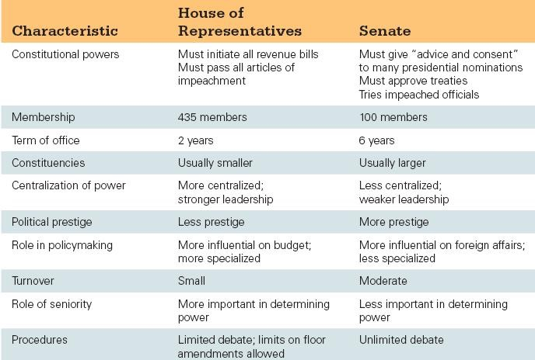
11.3
TABLE 11.2: House versus Senate: Some key differences
Notes:
What are the main differences between the two chambers?

Slide 33
The House
11.3
4 times the size of the Senate
More institutionalized and seniority-based
More party-line voting
Rules Committee – “traffic cop”
Only in the House
Sets rules for debate, time limit, and types of amendments for a bill
Usually controlled by the house majority, because they name members to the Rules Committee
Notes:
Bicameral simply means that the legislature is divided into two houses, such as our House of Representatives and Senate. All state legislatures except Nebraska are also bicameral. If you recall from earlier chapters, the legislature is bicameral as a result of the Connecticut Compromise. A bill must pass both houses in identical form to become law, providing a check and balance in the system.
The House is more institutionalized than the Senate and party loyalty is more common in voting. The House has a Rules Committee that functions as a traffic cop for bills coming out of committee. It gives each bill a “rule,” which schedules the bill on the calendar, allots time for debate, and specifies what kind of amendments may be offered.
The Senate is less centralized and seniority-based. Even junior senators can get plum committee assignments since the chamber is smaller. One practice unique to the Senate is the filibuster. If a senator takes the floor in a debate, he can keep talking, for days if necessary, until the proponents of the bill give up. A filibuster can only be ended if 60 senators vote to halt it. This is called cloture. Filibusters are a weapon used by the minority party.

Slide 34
The Senate
11.3
Made to protect the elite
House protects the masses
Filibuster
Only in the Senate
Senators can talk about a bill forever, never letting it get voted on
They can do this because there is no rules committee in the Senate
Cloture can be invoked by 60% of the Senate to stop the filibuster
Notes:
Bicameral simply means that the legislature is divided into two houses, such as our House of Representatives and Senate. All state legislatures except Nebraska are also bicameral. If you recall from earlier chapters, the legislature is bicameral as a result of the Connecticut Compromise. A bill must pass both houses in identical form to become law, providing a check and balance in the system.
The House is more institutionalized than the Senate and party loyalty is more common in voting. The House has a Rules Committee that functions as a traffic cop for bills coming out of committee. It gives each bill a “rule,” which schedules the bill on the calendar, allots time for debate, and specifies what kind of amendments may be offered.
The Senate is less centralized and seniority-based. Even junior senators can get plum committee assignments since the chamber is smaller. One practice unique to the Senate is the filibuster. If a senator takes the floor in a debate, he can keep talking, for days if necessary, until the proponents of the bill give up. A filibuster can only be ended if 60 senators vote to halt it. This is called cloture. Filibusters are a weapon used by the minority party.

Slide 35
More on the Filibuster
11.3
They can do this because there is no rules committee in the Senate
Cloture can be invoked by 60% of the Senate to stop the filibuster
Strom Thurman (R) SC – noted racist
Filibustered for 24 hours and 18 minutes against a civil rights bill in 1954
Read from the Bible the entire time
Filibusters allow a minority to kill the will of the majority, so why doesn’t the majority kill the filibuster?
Takes a constitutional amendment, which is tough
All senators will be in the minority sometime and they want to keep that power of a filibuster
Notes:
Bicameral simply means that the legislature is divided into two houses, such as our House of Representatives and Senate. All state legislatures except Nebraska are also bicameral. If you recall from earlier chapters, the legislature is bicameral as a result of the Connecticut Compromise. A bill must pass both houses in identical form to become law, providing a check and balance in the system.
The House is more institutionalized than the Senate and party loyalty is more common in voting. The House has a Rules Committee that functions as a traffic cop for bills coming out of committee. It gives each bill a “rule,” which schedules the bill on the calendar, allots time for debate, and specifies what kind of amendments may be offered.
The Senate is less centralized and seniority-based. Even junior senators can get plum committee assignments since the chamber is smaller. One practice unique to the Senate is the filibuster. If a senator takes the floor in a debate, he can keep talking, for days if necessary, until the proponents of the bill give up. A filibuster can only be ended if 60 senators vote to halt it. This is called cloture. Filibusters are a weapon used by the minority party.

Slide 36
Special Rules for Each
11.3
House
Gets to start all revenue bills
Taxing and spending
Because it is the voice of the “regular people”
Senate
Gets to ratify international treaties, confirm officials and impeach officials
Because they are the voice of the “state leaders”
Notes:
Bicameral simply means that the legislature is divided into two houses, such as our House of Representatives and Senate. All state legislatures except Nebraska are also bicameral. If you recall from earlier chapters, the legislature is bicameral as a result of the Connecticut Compromise. A bill must pass both houses in identical form to become law, providing a check and balance in the system.
The House is more institutionalized than the Senate and party loyalty is more common in voting. The House has a Rules Committee that functions as a traffic cop for bills coming out of committee. It gives each bill a “rule,” which schedules the bill on the calendar, allots time for debate, and specifies what kind of amendments may be offered.
The Senate is less centralized and seniority-based. Even junior senators can get plum committee assignments since the chamber is smaller. One practice unique to the Senate is the filibuster. If a senator takes the floor in a debate, he can keep talking, for days if necessary, until the proponents of the bill give up. A filibuster can only be ended if 60 senators vote to halt it. This is called cloture. Filibusters are a weapon used by the minority party.

Slide 37
Congressional Leadership in the House
11.3
Speaker of the House – Paul Ryan
Chosen by the majority party
2nd in line to be President
If different party than the President, the Speaker becomes the spokesman for their party
Presides over the House sessions
Assigns bills to committees or pigeon holes them
Majority/minority leader
Stepping-stone to be Speaker
Encourages votes for party platform bills
Whips
“whip” party members into shape
Ask them to vote on important bills
Makes sure everyone votes
Notes:
Leadership assignments in Congress are chosen by parties. The Speaker of the House, chosen by the majority party, has the key leadership role in the House of Representatives. The Speaker is third in line for the presidency, and presides over the House when it’s in session. He or she makes committee assignments and assigns bills to committee. Below the Speaker is the majority leader, who works with the party whips to persuade members to vote with their party on important bills. There is also a minority leader who fulfills the same function within the minority party.
The vice president is head of the Senate but only appears there to break tie votes. The de facto head is the majority leader, who works with majority whips to encourage party line voting.
Congressional leaders cannot force their fellow party members to vote with the party; their real power is limited. They can only offer them pork or other inducements to do so.

Slide 38
Congressional Leadership in the Senate
11.3
Vice president
Only official job is to lead and preside over the senate
Votes if there is a tie, but other than that, just sits there
Today, the VP is a policy spokesman and ambassador of the President to the Senate
Majority/minority leader
The real leader of the Senate
Same job as majority leader in the House
Notes:
Leadership assignments in Congress are chosen by parties. The Speaker of the House, chosen by the majority party, has the key leadership role in the House of Representatives. The Speaker is third in line for the presidency, and presides over the House when it’s in session. He or she makes committee assignments and assigns bills to committee. Below the Speaker is the majority leader, who works with the party whips to persuade members to vote with their party on important bills. There is also a minority leader who fulfills the same function within the minority party.
The vice president is head of the Senate but only appears there to break tie votes. The de facto head is the majority leader, who works with majority whips to encourage party line voting.
Congressional leaders cannot force their fellow party members to vote with the party; their real power is limited. They can only offer them pork or other inducements to do so.

Slide 39
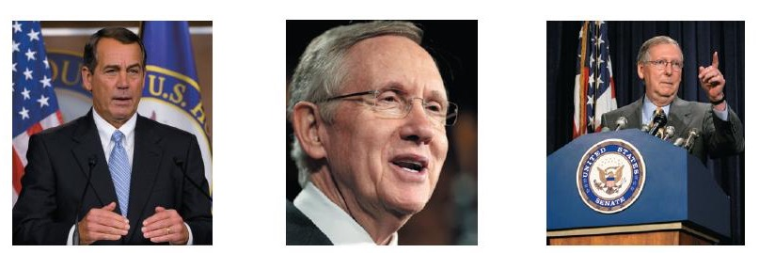
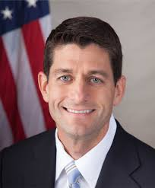
11.3
Congressional Leadership
Notes:
John Boehner of Ohio was elected Speaker in 2011. He is the most powerful member of the House of Representatives. Majority Leader Harry Reid of Nevada leads the Democrats in the Senate, but in the decentralized power structure of the upper chamber he must work and negotiate with Minority Leader Mitch McConnell of Kentucky.

Slide 40
Committees and Subcommittees
11.3
“Outside of traffic, there is nothing that has held this country back as much as committees.”
Most of the real work in congress is done in committees
Notes:
Committees control the congressional agenda and guide legislation. There are four types of committees.
Standing committees handle bills in different policy areas. Members of Congress each serve on several standing committees and subcommittees.
Joint committees between the two chambers exist in a few key policy areas, such as the economy and taxation.
Conference committees are created when the House and Senate need to reconcile different versions of the same bill.
Select committees are created to deal with a policy issue, such as deficit reduction, and may be temporary or permanent.

Slide 41
Committees and Subcommittees – Four Types
11.3
Standing committees – standing means always there (a standing appointment)
Handle common issues like education, war, energy
Joint committees – members from the House and Senate on the same committee
Pretty rare – usually taxes and the economy
Conference committees – to fix different bills passed by the House and Senate
Bills must be fixed before they go to the President to sign them
Select committees – usually temporary and for a specific reason
Debt, intelligence
Notes:
Committees control the congressional agenda and guide legislation. There are four types of committees.
Standing committees handle bills in different policy areas. Members of Congress each serve on several standing committees and subcommittees.
Joint committees between the two chambers exist in a few key policy areas, such as the economy and taxation.
Conference committees are created when the House and Senate need to reconcile different versions of the same bill.
Select committees are created to deal with a policy issue, such as deficit reduction, and may be temporary or permanent.

Slide 42
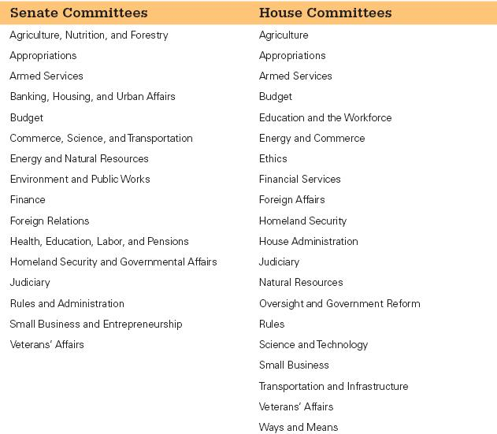
11.3
TABLE: 11.3: Standing committees in the Senate and in the House
Notes:
This table provides a list of the standing committees in each chamber.

Slide 43
Committees at work: Legislation
11.3
Speaker (House) or Majority Leader (Senate) sends a bill to a committee
Committees send them to the appropriate subcommittees
Subcommittees “mark up” (rewrite) the bill to make it more appealing
Bill is voted “yes” or “no” by the committee and then sent to the floor (whole House or whole Senate)
Then, committee members are “floor managers” for the bill, trying to get party members to support it
Notes:
Since more than 9,000 bills are submitted in each two-year period, Congress must divide and conquer to get through even a fraction of them. New bills are assigned to a subcommittee, where they usually die. If they are debated and passed, they move on to the full committee, where they have another good chance of never again seeing the light of day. If the bills pass out of committee, they move to the full floor of the chamber for debate and voting. They can also die there, if they’re never brought up.
Once a bill becomes law, committees remain involved in assigning budgets and monitoring the work of the executive branch agency responsible for implementing the law. This is known as legislative oversight.

Slide 44
11.4 Oversight, Committees, and Congressional Caucuses I’m so excited and I just can’t hide it!
375-381

Slide 45
Committees at work: Oversight
11.3
Legislative oversight (overseeing)– monitoring the executive branch and the bureaucracy. Making sure they are doing their job right.
Congress controls agencies’ budgets and how they implement the laws passed by Congress
This is a way that the legislative branch acts on behalf of the people to keep an eye on the executive branch (a type of check and balance)
Best example – Congressional hearings on The Department of Veterans’ Affairs
Notes:
Since more than 9,000 bills are submitted in each two-year period, Congress must divide and conquer to get through even a fraction of them. New bills are assigned to a subcommittee, where they usually die. If they are debated and passed, they move on to the full committee, where they have another good chance of never again seeing the light of day. If the bills pass out of committee, they move to the full floor of the chamber for debate and voting. They can also die there, if they’re never brought up.
Once a bill becomes law, committees remain involved in assigning budgets and monitoring the work of the executive branch agency responsible for implementing the law. This is known as legislative oversight.

Slide 46
More on Oversight
11.3
Committee members are specialists regarding the executive agencies they oversee
Oversight grew since the 1960s because:
People were worried about the executive branch getting too much power *cough* (Watergate) (Vietnam) *cough*
Budgets have gotten tighter (we need to keep the committees from overspending)
Conservatives get tons of credit for keeping spending down via oversight
Oversight fails:
FEMA oversight after Hurricane Katrina
Various agencies failed at predicting the 2008 economic collapse
Notes:
Since more than 9,000 bills are submitted in each two-year period, Congress must divide and conquer to get through even a fraction of them. New bills are assigned to a subcommittee, where they usually die. If they are debated and passed, they move on to the full committee, where they have another good chance of never again seeing the light of day. If the bills pass out of committee, they move to the full floor of the chamber for debate and voting. They can also die there, if they’re never brought up.
Once a bill becomes law, committees remain involved in assigning budgets and monitoring the work of the executive branch agency responsible for implementing the law. This is known as legislative oversight.

Slide 47
Problems with Oversight
11.3
Many executive agencies are overseen by numerous committees (which stinks)
Voters usually don’t vote based on effective oversight of incumbents
If Congress is the same party as the President, they will oversee less aggressively and vice versa
Because they don’t want to embarrass the President (the head of the executive branch and the bureaucracy)
This happened big time regarding intelligence during the War on Terror under W. Bush
Notes:
Since more than 9,000 bills are submitted in each two-year period, Congress must divide and conquer to get through even a fraction of them. New bills are assigned to a subcommittee, where they usually die. If they are debated and passed, they move on to the full committee, where they have another good chance of never again seeing the light of day. If the bills pass out of committee, they move to the full floor of the chamber for debate and voting. They can also die there, if they’re never brought up.
Once a bill becomes law, committees remain involved in assigning budgets and monitoring the work of the executive branch agency responsible for implementing the law. This is known as legislative oversight.

Slide 48
11.3
Committees and Subcommittees
Getting on a committee
Constituent needs
New congresspersons will ask to be on a committee that meets the needs of their constituents
Banking in NYC, Agriculture in Iowa
Appealing to leadership
The party leadership decides who goes to which committee
If you’ve been a good boy, the party will put you where you like
Remember: the majority party decides the chair and the majority of members in each committee
Notes:
New members of Congress want to get on committees that will help them achieve three goals: reelection, influence in Congress, and the opportunity to make policy in areas they think are important or that are important to their constituents.
A member from a farming state will try to get an Agriculture Committee assignment, whereas a member from an urban jurisdiction will prefer the Urban Affairs Committee. New members must appeal to party leaders for their preferred committee assignments.

Slide 49
11.3
Committee Chairs and the Seniority System
“If committees are the most important influences of the congressional agenda, committee chairs are the most important influences of the committee agenda.”
They schedule hearings (meetings) hire staff, assign people to subcommittees
How do I get to be a committee chair?
Before the 1970s, seniority ruled supreme
This led to drama when the chairs gained too much power
Today, congresspersons vote on who will be the chair, but they still stick with seniority for the most part
Notes:
New members of Congress want to get on committees that will help them achieve three goals: reelection, influence in Congress, and the opportunity to make policy in areas they think are important or that are important to their constituents.
A member from a farming state will try to get an Agriculture Committee assignment, whereas a member from an urban jurisdiction will prefer the Urban Affairs Committee. New members must appeal to party leaders for their preferred committee assignments.

Slide 50
Congressional Caucuses: Informal Organization of Congress
11.3
Don’t confuse these with Electoral Caucuses
Congress is dominated by caucuses – informal groups of congresspersons with similar interests
Interest groups within Congress
Usually from different parties and different houses
500 caucuses today
Bourbon Caucus, Black Caucus
Goal is to promote their interests
Notes:
The informal organization of Congress is as important as the leadership and committee structures we have been discussing. These networks spring mainly from friendship, ideology, and geography. They tend to operate through caucuses, which are essentially congressional interest groups.
Caucuses are formed by members who share a policy interest and work together to advance legislation they favor and oppose legislation that they don’t support. There are currently more than 500 congressional caucuses, including the Black Caucus, the Hispanic Caucus, and the Caucus for Women’s Issues.

Slide 51
Congressional Staff
11.3
Personal staff
Do casework (Social Security checks) for the congressperson
Answer emails, file paperwork
About ½ of staff are in the constituent's’ district, not in D.C.
Legislative functions
Can draft legislation, talk to lobbyists
“Indeed, members of both houses are now more likely to deal with each other through staff intermediaries than through personal interactions.”
Notes:
Congress has a lot of work to do, but it has plenty of assistance. More than 11,000 staff members serve Congress, and another 4,000 interns show up in the summer. Many staff members are assigned to casework and work in the member’s constituency, not in Washington. Other personal staff help with legislative functions, including drafting legislation, meeting with lobbyists and administrators, negotiating agreements on behalf of their bosses, writing questions to ask witnesses at committee hearings, summarizing bills, and briefing legislators.
The congressional committees have about 2,000 staff members who organize hearings, research legislative options, draft committee reports on bills, write legislation, and engage in legislative oversight.
Three staff agencies aid Congress in its work. The Congressional Research Service, administered by the Library of Congress, responds each year to more than 250,000 information requests from members of Congress. The Government Accountability Office handles legislative oversight, and the Congressional Budget Office analyses the president’s budget and makes economic projections.

Slide 52
Congressional Staff
11.3
Committee staff
2,000 member staff members in addition to the personal staff
Legislative oversight
They do a lot of the work of oversight and report back to the congressperson
Experts on exec agencies they watch and policies
Notes:
Congress has a lot of work to do, but it has plenty of assistance. More than 11,000 staff members serve Congress, and another 4,000 interns show up in the summer. Many staff members are assigned to casework and work in the member’s constituency, not in Washington. Other personal staff help with legislative functions, including drafting legislation, meeting with lobbyists and administrators, negotiating agreements on behalf of their bosses, writing questions to ask witnesses at committee hearings, summarizing bills, and briefing legislators.
The congressional committees have about 2,000 staff members who organize hearings, research legislative options, draft committee reports on bills, write legislation, and engage in legislative oversight.
Three staff agencies aid Congress in its work. The Congressional Research Service, administered by the Library of Congress, responds each year to more than 250,000 information requests from members of Congress. The Government Accountability Office handles legislative oversight, and the Congressional Budget Office analyses the president’s budget and makes economic projections.

Slide 53
Congressional Staff Agencies
11.3
Staff agencies (you must know these) (always on AP Exams)
Part of Congress, but not tied to parties or specific committees
Congressional Research Service (CRS)
A bunch of scholars that give non-partisan reports to congresspersons
Government Accountability Office (GAO)
Helps provide oversight by checking accounting practices, litigation and implementation of policies
Congressional Budget Office (CBO)
Analyses the president’s budget
Makes predictions about the future economy
Notes:
Congress has a lot of work to do, but it has plenty of assistance. More than 11,000 staff members serve Congress, and another 4,000 interns show up in the summer. Many staff members are assigned to casework and work in the member’s constituency, not in Washington. Other personal staff help with legislative functions, including drafting legislation, meeting with lobbyists and administrators, negotiating agreements on behalf of their bosses, writing questions to ask witnesses at committee hearings, summarizing bills, and briefing legislators.
The congressional committees have about 2,000 staff members who organize hearings, research legislative options, draft committee reports on bills, write legislation, and engage in legislative oversight.
Three staff agencies aid Congress in its work. The Congressional Research Service, administered by the Library of Congress, responds each year to more than 250,000 information requests from members of Congress. The Government Accountability Office handles legislative oversight, and the Congressional Budget Office analyses the president’s budget and makes economic projections.

Slide 54
11.5 How a Bill Becomes a Law

Slide 55
Congressional Process and Decision Making
11.4
Bill = proposed law
9,000 introduced in each house each year
Some are major, some are minor
Law-making is harder now since political polarization has grown during the 1980s
Notes:
Only members of Congress can introduce a bill for consideration; not even the president can do so. Most bills are quietly killed off early in the lawmaking process, and the ones that become law must negotiate a labyrinthine process of rules, which we demystify in this section.

Slide 56
Easier to Pass Bills in the House than in the Senate
11.4
Senators have more individual power than House members
Party control is greater in House than in the Senate
Making some party-sponsored bills in the Senate less likely to pass than the same bill in the House
They have the filibuster
Remember: The Senate matters more.
Notes:
Only members of Congress can introduce a bill for consideration; not even the president can do so. Most bills are quietly killed off early in the lawmaking process, and the ones that become law must negotiate a labyrinthine process of rules, which we demystify in this section.

Slide 57
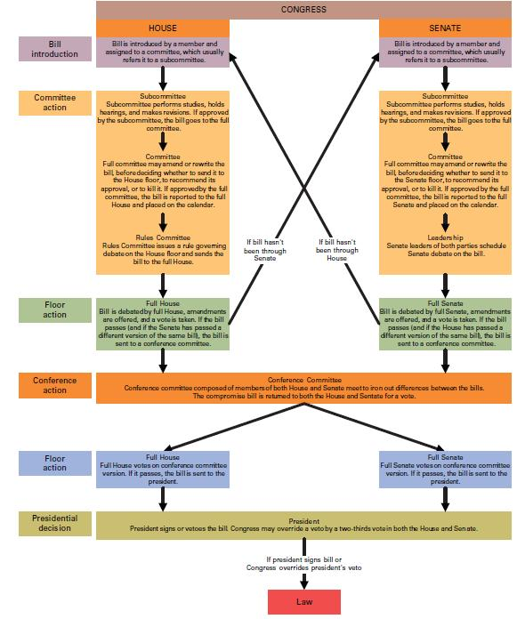
11.4
FIGURE 11.2: How a bill becomes a law
Notes:
This figure lays out two paths for how a bill can become a law.
Activity: As a fun introductory exercise, screen the School House Rock video “I’m Just a Bill” available on YouTube at http://www.youtube.com/watch?v=tyeJ55o3El0. For a more detailed assignment, ask students to prepare, either in the written form of “script” or an actual video, your own supplement that adds to the simple version presented your more sophisticated understanding of committees, congressional decision making, interest groups, and constituencies that actually fashion how bills become laws.

Slide 58
Unorthodox Lawmaking
11.4
Came around recently
Lawmaking where the House and Senate leaders push bills they like through the process
By putting the same bill in many committees
By making informal Senate/House groups instead of conference committees
By bypassing committees all together
By making “omnibus” legislation that covers a lot of different unrelated things
Forces members to support the entire bill just to get the benefits from part of it
Notes:
Only members of Congress can introduce a bill for consideration; not even the president can do so. Most bills are quietly killed off early in the lawmaking process, and the ones that become law must negotiate a labyrinthine process of rules, which we demystify in this section.

Slide 59
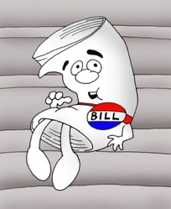
How a Bill becomes a Law (in 11 not so easy steps)

Slide 60
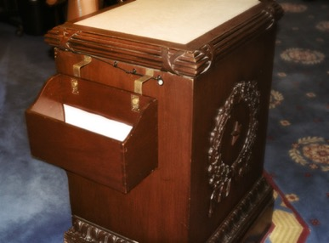
Step 1: Bill is Introduced
Bill is placed in the ‘Hopper’
The Bill is given a label
Bills in the House are labeled ‘H.R.’
Ex: HR117
Bills in the Senate are labeled ‘S’
Ex: S210

Slide 61
Step 2: Bill is assigned to a committee
Speaker of the House assigns the bill to a standing committee
Ex: a bill dealing with electric cars would be sent to the Energy and Commerce committee

Slide 62
Step 3: The bill is debated in Committee/Subcommittee
The majority party gets to chair the committee and will usually have a majority of the seats on the committee
The committee chair sends it to the appropriate subcommittee for markup (editing)
The subcommittee votes on the bill. If the majority likes it, they send it back up to the committee.
The committee acts as a filter, deciding which legislation makes it to the House floor
Bill can be recommended, pigeonholed, amended, or changed altogether
The vast majority of bills are ‘pigeonholed’: put away, never to be acted on
If the committee reports the bill favorably it goes to……..

Slide 63
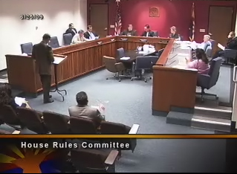
Step 4: The House Rules Committee
If the House Rules committee schedules the bill, it will be heard by the entire House
The Rules Committee sets ‘rules’ for the bill (ex: how long it can be debated, etc.)
If they don’t grant a rule for the bill, the bill dies

Slide 64
Step 5: The House votes on the bill
Types of votes:
Voice votes (Ayes and Nays)
Standing vote
Teller vote
Roll call: electronic
If the Nays win, the bill is dead
If the Ayes win………

Slide 65
Step 6: Bill is sent to the Senate
Bill goes first to the desk of the President Pro Tempore of the Senate

Slide 66
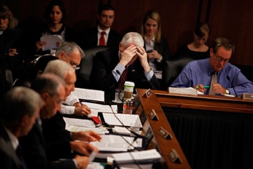
Step 7: Bill is assigned to a Senate Committee
As in the House, the Bill can be recommended, pigeonholed, amended, or changed altogether
If it makes it through the subcommittee and the committee majorities, it can be sent to the floor for a vote…

Slide 67
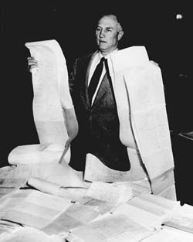
Step 8: The Senate votes on the bill
Watch out for the FILIBUSTER!
In the Senate, a Senator can talk as long as he or she wants to. This is usually done to stop the vote on a bill. It was used a lot during the Civil Rights movement by southern Senators
Senator Strom Thurmond of SC holds the record for longest single filibuster: 24 hours and 18 minutes to block a Civil Rights bill in 1957
If the Bill passes the Senate……..

Slide 68
Step 9: Bill is sent to Conference Committee
The Conference Committee is a JOINT committee of members of both the HOUSE and the SENATE. They have to work out the wording of the bill so that the House and Senate versions are EXACTLY the same
If they can’t agree, the Bill is dead
Once they have agreed, the bill goes back to both chambers for ANOTHER vote

Slide 69
Step 10: The Bill is sent to the President
The President can:
Sign it. It becomes law
Veto it. It goes back to the Congress for possible override
Do nothing. After 10 days, it becomes law
Pocket veto: If Congress adjourns in less than 10 days and the President hasn’t signed it, it dies.
If the President decides to sign it….

Slide 70
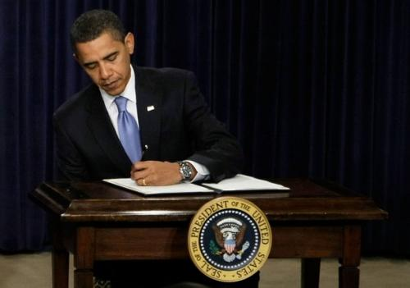
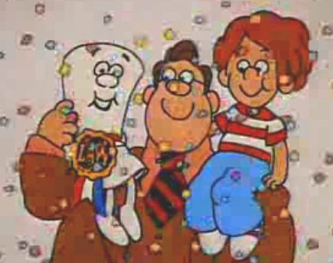
Step 11: The Bill is signed by the President…
Congratulations Bill………
now you’re a LAW!

Slide 71
11.6 The Effect of Party, Constituency and Ideology on Congress
384-387

Slide 72
Presidents and Congress: Partners and Protagonists
11.4
President AKA “The Chief Legislator” because he usually has a huge influence on which bills are presented
President’s legislative agenda
Persuade Congress
Usually indirectly by White House staff and other officials
They aren’t very successful pushing through legislation that isn't popular in Congress, but they are successful at stopping laws they don’t like
B/c its hard to override a veto
Notes:
The modern president usually has his own legislative agenda and is sometimes referred to as the chief legislator, a moniker that would have appalled the Framers. Presidents have to persuade Congress that their legislative agenda should be Congress’s priority.
Presidents don’t have time to serve as whips for their preferred policies and telephone members of Congress individually to urge them to vote for them; they leave this to staff, but they can speak to members of Congress at key moments on critical pieces of legislation to exert their influence.
Popular presidents usually win their legislative battles with Congress, but they lose or compromise often enough that we can safely say that Congress is truly independent, as the Framers intended.

Slide 73
The Influence of Party on Legislators
11.4
Parties control the way members vote by
Giving them political support
Changing committee assignments
Boosting members’ pet projects
Controlling funding (through party contributions to individual members)
Members usually vote with their parties, with some exceptions
Notes:
Presidents come and go during a legislator’s career. It’s his constituents, not his president, who give him his job and can fire him from it.
Party exerts a greater influence on members of Congress than it used to. Although not all votes are split strictly along party lines, this is increasingly the case as the parties become more polarized, especially on economic and social welfare policies. Republican legislators have become more conservative, and Democratic legislators more liberal. Redistricting has meant that representatives have fewer constituents of the opposite party in their districts.

Slide 74
Polarized Politics
11.4
Since the 80s, differences between party ideologies have grown (next slide)
Republicans have become more conservative and Democrats more liberal
Makes it more difficult to compromise and get things done
Why since the 80s?
Gerrymandering led House members to not worry about swing voters, because they didn’t have to
Leads House members to become less interested in compromise
“As the parties pulled apart ideologically, they also became more homogeneous internally.”
Notes:
Presidents come and go during a legislator’s career. It’s his constituents, not his president, who give him his job and can fire him from it.
Party exerts a greater influence on members of Congress than it used to. Although not all votes are split strictly along party lines, this is increasingly the case as the parties become more polarized, especially on economic and social welfare policies. Republican legislators have become more conservative, and Democratic legislators more liberal. Redistricting has meant that representatives have fewer constituents of the opposite party in their districts.

Slide 75
Polarized Politics
11.4
“members of Congress, especially in the House, hold more extreme political views than their constituents as a whole.”
“Barack Obama received few Republican votes for any of his proposals and not a single Republican vote for his health care reform plan.”
“Party loyalty among voters in congressional elections has increased.”
If congress becomes more polarized, it will get less done (gridlock)
Notes:
Presidents come and go during a legislator’s career. It’s his constituents, not his president, who give him his job and can fire him from it.
Party exerts a greater influence on members of Congress than it used to. Although not all votes are split strictly along party lines, this is increasingly the case as the parties become more polarized, especially on economic and social welfare policies. Republican legislators have become more conservative, and Democratic legislators more liberal. Redistricting has meant that representatives have fewer constituents of the opposite party in their districts.

Slide 76
Polarized Politics
11.4
Why since the 80s?
Gerrymandering led House members to not worry about swing voters, because they didn’t have to
The loudest supporters of each party are super lib/cons, so the candidates listen to them
Much fewer liberal Dems/conservative Reps
Basically, the “polarized” atmosphere of today makes everyone get in line to support their parties, even if it leads to gridlock
Notes:
Presidents come and go during a legislator’s career. It’s his constituents, not his president, who give him his job and can fire him from it.
Party exerts a greater influence on members of Congress than it used to. Although not all votes are split strictly along party lines, this is increasingly the case as the parties become more polarized, especially on economic and social welfare policies. Republican legislators have become more conservative, and Democratic legislators more liberal. Redistricting has meant that representatives have fewer constituents of the opposite party in their districts.

Slide 77
Constituency opinion versus member ideology
11.4
“Gentlemen: I have received your letter about the excise, and I am surprised at your insolence in writing me at all…may God’s curse light upon you all, and may it make your homes as open and as free to the excise officers as your wives and daughters have always been to me while I have represented your rascally constituency.” – Anthony Henry, British Parliament – 1714
Notes:
What if a member of Congress has a different preference on a policy than his constituents? The trustee model of representation says that legislators are elected to use their best judgment. They have access to information that their constituents don’t have and they should act in their best interests. The instructed delegate model of representation states that representatives must mirror the preferences of their constituents.

Slide 78
How should representatives represent the people?
11.4
Trustee Model – the people tell the representative what they think and the representative makes their own decision
Trustee = Trust me
Delegate Model – the representative votes how the people tell her or him without questioning it, even if the representative disagrees
How should a representative vote when their opinions differ from their constituents’?
“In short, when they have differences of opinion with their constituencies, members of Congress consider constituency preferences but are not controlled by them.”
Notes:
What if a member of Congress has a different preference on a policy than his constituents? The trustee model of representation says that legislators are elected to use their best judgment. They have access to information that their constituents don’t have and they should act in their best interests. The instructed delegate model of representation states that representatives must mirror the preferences of their constituents.

Slide 79
Single Issue Groups and Congress
Single Issue Groups can make a member of Congress stay quite on certain issues
Gun control, abortion, immigration
If the member takes a stand against them, the group will flood resources to their opponents

Slide 80
Questions a member of Congress will ask before supporting an issue
Does my party agree with it?
Do my constituents agree with it?
Will it make single interest groups angry at me?
Is it good/right?

Slide 81
Lobbyists and Understanding Congress

Slide 82
Lobbyists and Interest Groups
11.4
D.C. is crawling with lobbyists
12,000 of them
Spent $3 billion in 2011
Many are former members of Congress
How lobbyists persuade
Provide policy information
Provide promises of money
Ghostwrite legislation
Work closely with congress at the committee level
Status quo usually wins
Disclosure requirements
Notes:
As we learned in an earlier chapter, there are more than 12,000 lobbyists, representing as many organizations, in Washington, all trying to twist the arms of Congress. Lobbyists spent $3 billion in 2011 to influence Congress. Many lobbyists are former members of Congress who have the connections and knowledge of how the system works.
Lobbyists provide members of Congress with policy information and promises of money for their reelection campaigns. Lobbyists ghostwrite most legislation so it conforms to the preferences of the industry or interest affected by it. Lobbyists are more successful lobbying against change than for it.
Lobbyists are subject to disclosure requirements so that their influence is made public, but these requirements haven’t slowed them down at all.

Slide 83
Lobbyists and Interest Groups
11.4
How lobbyists persuade
Provide policy information
Provide promises of money and support from who they represent (especially PACs)
Ghostwrite legislation (more than a dozen on ACA debate)
Status quo usually wins
“Lobbying against change is usually more successful than lobbying for it.”
Disclosure requirements 1995
Notes:
As we learned in an earlier chapter, there are more than 12,000 lobbyists, representing as many organizations, in Washington, all trying to twist the arms of Congress. Lobbyists spent $3 billion in 2011 to influence Congress. Many lobbyists are former members of Congress who have the connections and knowledge of how the system works.
Lobbyists provide members of Congress with policy information and promises of money for their reelection campaigns. Lobbyists ghostwrite most legislation so it conforms to the preferences of the industry or interest affected by it. Lobbyists are more successful lobbying against change than for it.
Lobbyists are subject to disclosure requirements so that their influence is made public, but these requirements haven’t slowed them down at all.

Slide 84
Lobbyists and Interest Groups
11.4
Disclosure requirements 1995
Lobbyists must disclose
What they are lobbying for
How much the spend lobbying
Who their clients are
Also, they can’t give lavish gifts, meals, etc
Jack Abramoff (2006)– lobbyist for Native American casinos
Busted for spending $80 million of their bucks on gifts to congresspersons
Led to more restrictions on lobbyists
Notes:
As we learned in an earlier chapter, there are more than 12,000 lobbyists, representing as many organizations, in Washington, all trying to twist the arms of Congress. Lobbyists spent $3 billion in 2011 to influence Congress. Many lobbyists are former members of Congress who have the connections and knowledge of how the system works.
Lobbyists provide members of Congress with policy information and promises of money for their reelection campaigns. Lobbyists ghostwrite most legislation so it conforms to the preferences of the industry or interest affected by it. Lobbyists are more successful lobbying against change than for it.
Lobbyists are subject to disclosure requirements so that their influence is made public, but these requirements haven’t slowed them down at all.

Slide 85
11.5
Understanding Congress
Congress is unrepresentative
Members are the American elite
Leadership is chosen from within, not by the people
Probably the most important jobs in the US government are House and Senate leaders
Senate gives small pop states a big advantage over big ones (malapportionment)
Notes:
Members of Congress have conflicting incentives. They want to make sound national policy but they also want to be reelected. How does this problem affect democracy and the scope of government?

Slide 86
Congress and Democracy
11.5
Congress is too representative
It represents everyone having different needs, thus it gets nothing done (hyperpluralism)
Obstacles to good representation
Constituent service
Trying to keep everyone happy often leaves no one happy
Reelection campaigns
The top priority of congresspersons is to get re-elected. Your needs can get in line behind that.
Notes:
Direct democracy is impractical in a place as large as the United States so democratic government depends upon successful representation. But as we have seen in this chapter, Congress isn’t demographically representative of the American people. Its members are elites and, what’s more, its leadership is chosen by its members, not voters. The Senate represents each state equally, regardless of population, which undermines democratic representation.
There are other obstacles to good representation. Constituent service takes up a proportion of time that members of Congress could otherwise use for policy making. They also devote considerable time to their reelection campaigns.
But could Congress actually be too representative in some ways? Policies in the national interest often have short-term negative effects on certain constituencies. With each member of Congress fighting for his or her own constituency, no one in Congress is looking out for the national interest. Each member of Congress wants to please his own constituents, whose particular interests he or she has been elected to represent.

Slide 87
Congress and the Scope of Government
11.5
Does size of government increase to please public?
Pork barrel spending/casework
It is a priority, because it gets them re-elected
Tea Party candidates
Got name because colonists at the Boston Tea Party opposed unfair taxes
Against large government, spending programs
Still support spending for their constituents
Notes:
The desire to bring home the pork to their constituents tends to increase the size and scope of government. No member of Congress wants to cut a program that benefits his constituents, even if he—and his constituents—are advocates of smaller government. Americans have contradictory preferences in that they favor smaller government in general but oppose cutting individual programs. This puts Congress in an awkward position.

