Slide 1
C9 Noteguide 9.1 Intro
China! Yay! Future Overlords! Yay!

Slide 2
0.5 What was China like during Unit 3?
Even more powerful than in the Classical Era
Biggest cities in the world
Neighbors felt gravitational pull
Outsiders (through trade and conflict) start to influence it more
Made technologies that would change the world
Gunpowder
Printing

Slide 3
0.5.5 Dynasties
Shang, Zhou*, Qin, Han*;
Shang, Zhou, Qin, Han;
Sui, Tang, Song;
Sui, Tang, Song; Yuan, Ming, Qing, Republic;
Yuan, Ming, Qing, Republic;
Mao Zedong; Mao Zedong
*means warring states or no real dynasties

Slide 4
1. What are some of the causes that allowed Buddhism and Daoism to creep into China?
Collapse of Han made less national power and more power to local families.
Nomads from north became very Chinese and ruled parts of northern China.
Both things discredited Confucianism b/c it was tied to the national government.
Less Confucianism makes Daoism and Buddhism easier to “creep”.
p. 380

Slide 5
2. In what way did the Sui Dynasty unify China from 589-618?
Made an awesome 1,200 mile canal system that linked northern to southern China.
Brought lots of money due to trading.
p. 380

Slide 6
3. Discuss the ways in which the Tang and Song Dynasties were regarded as the “Golden Age of Chinese Achievement.”
Culturally – poetry, painting (landscapes), ceramics
Song – importance placed on scholarship brought Neo-Confucianism
Huge pop growth thanks to new rice growing methods
Huge cities (Hangzhou –capital – 1 million)
Politically—the Tang and Song dynasties built a state structure that endured for a thousand years.
Economically—became richest empire on earth.
Tons of industry (printing, gunpowder, shipbuilding)
Most commercialized place on earth (producing for the market, not self-use)
Demographically – biggest population of any country on earth (pop boom from Champa rice from Vietnam)
p. 382

Slide 7
Tang and Song Government
Starts the famous “Chinese Bureaucracy” that stands for 1000 years
Makes departments of army, justice, finance, public works
Invents the printing press (first books ever printed)
Brings back the Civil Service Exam
Colleges grow to prep men for the exams
Rich landowners keep their privilege
Given spots even if they fail exams
Some attempts to redistribute land to peasants, but they never last
Rich keep the power

Slide 8
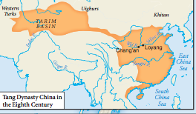

Slide 9
Tang and Song Cities
Most ‘modern’ cities ever
Restaurants, bars, “Luxuriant inns”, music schools
Fancier than 2015 Mount Vernon
Food came in from the countries on the canal system – 30K miles

Slide 10
Neo-Confucianism
A mix of old Confucianism with new Buddhism and Daoism

Slide 11
4. In what ways did women’s lives change during the Tang (618-907) and Song (960-1279) dynasties?
Tang - more freedoms thanks to influence of steppe nomads in north.
Song – China got richer and Confucianism came back.
Foot binding
Men take textile jobs (Why are these women outside anyway?)
Some become maids, cooks, shop-workers
Most upper-class women were concubines, entertainers, prostitutes or wives
Wife/Concubine situation – makes wife less powerful in negotiations with husband
Put women against each other
Some women were educated (only to better raise their sons)
pp. 384-385

Slide 12
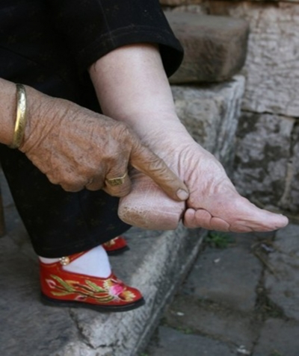
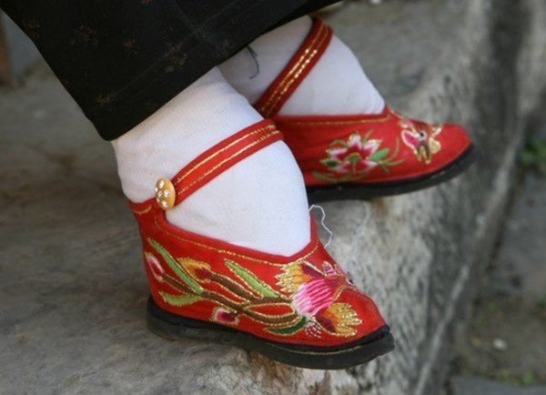
Foot Binding
Small feet = beautiful
Keeps women in the house (can’t walk)
Dads did it to girls to get more dowry from future husbands

Slide 13
9.1 Quiz A
What was the practice called where women’s feet were wrapped in ribbons?
Name one reason population grew during the Tang and Song dynasties.
Why are the Tang and Song dynasties called “the Golden Age”?

Slide 14
9.1 Quiz B
Why did the practice of foot binding begin?
Why are the Tang and Song dynasties called “the Golden Age”?

Slide 15
9.2 China and West/North

Slide 16
5. Why did the Chinese interact with their nomadic neighbors to the north?
China interacted mostly with the north
Nomads in the north grew in population.
Not agricultural, so got grain from China.
Leaders like luxury goods like silk and wine.
Chinese wanted horses from the nomads.
pp. 386-387

Slide 17
6. Even though China saw itself as “the center of the world,” why did it allow itself to deal with the “barbarians?”
“Middle Kingdom” literally the center of the universe
Didn’t really need anything from the barbarians.
Knew barbarians needed lots of Chinese stuff.
Also thought they could civilize the barbarians.
p. 387

Slide 18
7. Why did the Chinese government often give other states gifts that were in fact worth more than the tribute those states paid to China?
All foreigners had to kowtow and pay tribute (expensive stuff from their countries) to the Emperor.
This allowed the foreigners to trade in China.
Bestowals (gifts from China to the traders) were given.
Sometimes bestowals were worth more than tributes. This kept some strong neighbors near China from getting too aggressive.
Kind of like the mob and protection money.
pp. 387-388

Slide 19
8. Who were the Xiongnu, the Uighurs, the Khitan, and the Jurchen in relation to the Chinese?
Xiongnu– Nomads north of China during Han
Raided China and forced a reverse tribute system with China including grain, wine and princesses
Uighurs—(Turkic) from Turkic language. West of China.
actually rescued the Tang Dynasty from a serious internal revolt in the 750s.
In return, they gained one of the Chinese emperor’s daughters as a wife and long-term trade of bad horses for good silk.
Khitan Jurchen—When part of north China fell during the Tang, they took over the fallen land.
Forced Song to send them silk to stop threat of taking over more Chinese land.
pp. 388-389

Slide 20
9. Did the Chinese convert large numbers of the northern nomads to Chinese cultural ways? Why or Why not?
In the north, nomads didn’t really take on a lot of Chinese culture. Some elite did, but they remained “different” from the Chinese.
Major reason: Chinese agriculture was impossible
In the south, any group that was taken over generally became very incorporated culturally.
Founders of Sui and Tang had mixed barbarian and Chinese blood
Tang elite fad for dress and style like “western barbarians”
p. 389

Slide 21
9.3 Vietnam, Korea, Japan and their favorite colonizers - Chiner!

Slide 22
10. In what (political, economic, and social) ways did Korea, Vietnam, and Japan experience and respond to Chinese influence?
Korea and Vietnam became vassal states (had to pay tribute to China)
Japan was never conquered, but did participate as a vassal less than Korea and Vietnam.
All three borrowed Confucianism, Daoism, Buddhism, civil service system, art and literature from China.
Japan was different because it was separated by sea from China.
Only borrowed some things
Stopped tribute system in 900s and grew new culture independently.
Vietnam became “part of China” for 1000 years.
Became more Chinese than the other two.
Confucianism, agriculture techniques, Chinese language, hairstyle, clothing.
With Sources: pp. 390-397

Slide 23
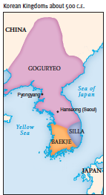
I want to learn a lot about Korea because it is awesome!
Korean rulers got power by being aligned with China
Modeled capital city after Chinese capital
Buddhist Koreans studied in China, brought back traditions
Korean students studied Confucianism in China and returned too
Elite took lots of Chinese culture
Peasants and slaves (1/3 of total pop) didn’t even notice Chinese changes
Hurt women, who used to have more freedoms
Used to raise kids in her parents’ house, divorce, inherit property
China said they couldn’t because China stinks

Slide 24
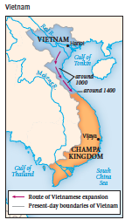
I want to learn a lot about Vietnam because it is awesomer!
Similar interaction with China like Korea
Adopted government and civil service system more than Korea
Writing based on Chinese
Women kept more power than in Korea
Female Buddha

Slide 25
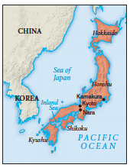
I want to learn a lot about Japan because it is awesomest!
Never conquered by China.
Everything they took from China was voluntary
Doesn’t touch China
Sent scholars to learn about China in 800s
Modeled capital cities after China’s
Never got unified government like China and Buddhism didn’t take hold like in Vietnam or Korea
Women escaped most Confucianist rules

Slide 26
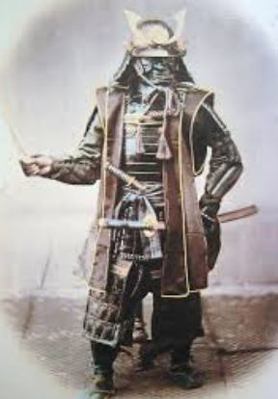
Bushido!
Japan become decentralized around 1000 CE
Local landlords gain power
Protected by samurai (warriors)
Follow bushido (way of the warrior)
Japan becomes more warrior based than China
“The educated men of the land,” wrote a Chinese minister in the eleventh century, “regard the carrying of arms as a disgrace.”
Leads women to lose status as “warrior culture” rises in importance

Slide 27
Shinto
Japanese religion
Worship kami (spirits of dead ancestors)
Blended well with Buddhism

Slide 28
11. What’s the significance of the Trung Sisters in Vietnam?
Dad was deposed by Chinese. One husband executed by Chinese.
Dressed in military clothes and addressed 30,000 Vietnamese soldiers.
Uprising crushed, sisters committed suicide instead of surrender.
Still viewed as heroes in Vietnam.
p. 393

Slide 29
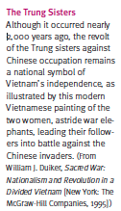
Trungggggg Sisterssssss!!!!!!!!

Slide 30
12. In what different ways did Japanese and Korean women experience the pressures of Confucian orthodoxy (practices, beliefs)?
Korean women faced Chinese Confucianism.
Japanese women kept cultural ways such as remarriage, big feet and going out in public.
Marriages were broken easily and sometimes men moved in with the family of the wives. What? Patriarchy no!
pp. 396-397

Slide 31
13. Why didn’t the Japanese succeed in creating an effective centralized and bureaucratic state to match that of China?
No one central government.
Japan had an emperor, but he lost power through the centuries.
Local rich families had their own ways and that grew to be their own cultures.
p. 395

Slide 32
9.4 China and the rest of Eurasia

Slide 33
14. What techniques or technologies did China export to other regions of Eurasia?
Salt by solar evaporation
Things that got support from Buddhist rewriting of texts
Papermaking
Printing
Movable type (invented by Bi Sheng)
p. 396

Slide 34
Why did China invent stuff, but left it to Europeans to make it better?
China didn’t have to compete with anyone
Made gunpowder, but cannons and guns were made in Europe because lords were competing for power
“Gunpowder revolution”
Invented the magnetic compass, but sailors from other countries used it on the Indian Ocean

Slide 35
14.5 What techniques or technologies did China import from other regions?
Major consumers of goods (spices) from around Asia
Because the pop was so huge
Cotton and sugar from India
New rice from Vietnam caused huge population boom
Printing came from Buddhism (from India)
Print pics of Buddha, short books
First printed book Diamond Sutra was Buddhist and found in China

Slide 36
15. Between 300 and 800 C.E., what helped to facilitate the acceptance of Buddhism in China?
After Han fell, chaos that followed discredited Confucianism.
Northern nomads liked Buddhism because it was foreign in China, like them.
Buddha was “barbarian god”
Elites paid for Buddhist temples and art.
Former officials fled to south China after Han fell.
Saw Buddhism as comfort as society crumbled
Safety and reassurance in time of chaos
Sui and Tang support Buddhism
Poor got help, literacy, seeds, shelter from monks
pp. 401-402

Slide 37
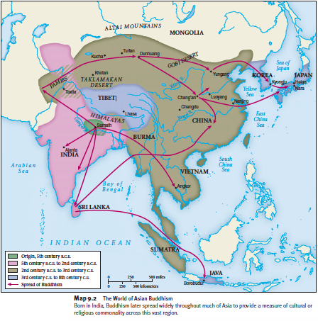

Slide 38
Buddhism me! China style!
Only large-scale cultural borrowing in China until communism (1950s)
Chinese thought Buddhists had powers
Mahayana <- big deal
Sui and Tang liked it (Wendi built monasteries)
Always tied to the government
Monk exams
Early Chinese Buddhists modified it to mesh better w/ Chinese ideas
“Husband supports wife” becomes “Husband controls wife”
Dharma becomes Dao
Monastaries became rich sometimes
Pawn shops, gold collecting, fancy art. You know, asceticism.

Slide 39
16. What were the major sources of opposition to Buddhism in China?
Some saw it as challenge to Emperor’s power.
Some resented it b/c of its wealth, it was foreign and offensive to Confucianists and Daoists.
Foreign = offensive (xenophobia)
Barbarian Buddha finger!
Maybe starts by An Lushan rebellion (led by foreign general)
Monks being celibate and withdrawn from society was against family focus of Confucianism.
p. 402

Slide 40
16.5 Okay, which one of you Chinese guys killed Buddha?
All the drama and rebellion leads to the government forcing 260,000 monks and nuns to stop monking and nunning
Temples destroyed or converted
No precious metals or gems allowed in Buddhist art
Buddhism drops, but stays around and remains one of many popular ideologies along w/ Daoism, Confucianism
Not like Europe where one religion trumps all others

Slide 41
Change in China Review
Internal
Warring states brought Confucianism and Daoism
Qin Shihuangdi brought Legalism
Canals brought stability in trade
Inequality/weather brought uprisings
External
Buddhism from India
“Radiating civilization” w/ Vietnam, Japan, and Korea
Spices from India and spice islands
Horses from Xiongnu

Slide 42
9.3 Quiz A
The biggest problem the Chinese had with the Buddha was that he was __________.
Which Chinese Emperor embraced Buddhism?
List one invention from China that diffused to Eurasia from the reading.

Slide 43
9.3 Quiz B
Which group in the reading did not have to pay taxes in China?
What invention from China was possibly stolen by Gutenberg in Europe?
Name one way Buddhism was changed to better fit Chinese culture.

