Slide 1
Roman Roots and Great Schism
425-434

Slide 2
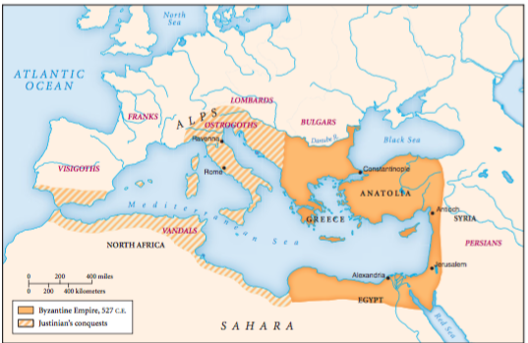
Popey
Greecy

Slide 3
1. In what respects did Byzantium continue the patterns of the classical Roman Empire? In what ways did it diverge from those patterns?
Continued Patterns p. 427 and p. 432
Byzantium’s roads, military, centralized bureaucracy, laws
Continued fighting with Persia and later Muslims
Divergences pp. 428-429
New government system that let individual generals raise their own armies to protect land
New idea of caesaropapism combined the head of the Church and the state.

Slide 4
1A How were the Byzantine Church and Roman Catholic Church different?
Byzantine was connected with the government, Catholic was independent
Byzantine was more urban

Slide 5
1B What was the Byzantine Empire (Greece, Balkans, Anatolia)
Began when Constantine founded Constantinople and split Rome
Stayed together even after Rome (West) fell in 400s
Map in book p.428
Advantages over west
Richer, more urban
Access to Black and Mediterranean Seas
Better army
Smaller and therefore easier to rule
Tight political authority
Emperor was rep for God
All about collecting taxes and keeping order (not conquest)

Slide 6
Justinian: The Only Byzantine Guy You Gotta Know
Byzantine Emperor
Tried to reunite the entire Roman Empire (Mediterranean) (like Constantine)
Failed
Codified laws into…wait for it...Justinian Code

Slide 7
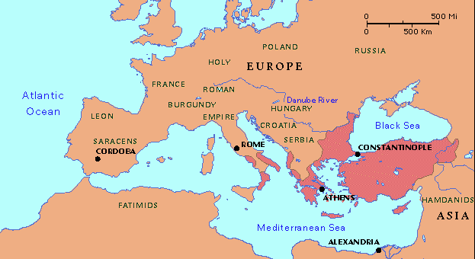
2. What happened to the Byzantine Empire?
Shrank after the Great Schism because it was invaded by Catholic Crusaders and Turkic Muslims
1453 – Constantinople finally fell to the Ottoman Empire
‘sword of Islam’
Renamed Istanbul
Major turning
point in history
p. 429

Slide 8
Constantinople is now Istanbul

Slide 9
3. How did Eastern Orthodox Christianity differ from Roman Catholicism?
Catholic Church was mostly independent from political authority.
Byz emperor was “The Caesar”, the pope and head of state
Church became part of the government and The Caesar could do with it what he wished.
In the West, the Church was only a church
The government was a bunch of dippin’ dots (Feudal System)
In the Eastern Orthodox Church, Greek became the language of religious practice instead of the Latin used in the Roman Catholic Church.
More so than in the West, Byzantine thinkers sought to formulate Christian doctrine in terms of Greek philosophical/science concepts.
West saw science as evil

Slide 10
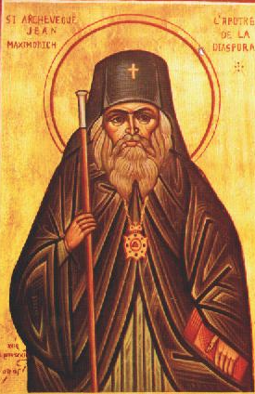
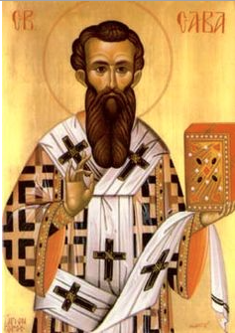
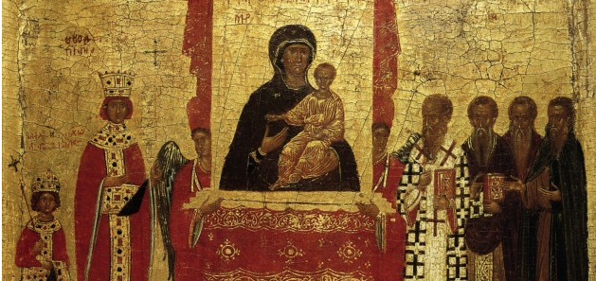
3. How did Eastern Orthodox Christianity differ from Roman Catholicism?
EO loved them some icons (holy paintings of Jesus and friends)
EO priests had long hair and beards and could marry. Catholic priests couldn’t marry, shaved their heads and remained celibate.
EO didn’t think the Pope in Rome was over all Christians.
EO were more ‘chill’
as the kids say.
429-431

Slide 11
4A What led to the 1054 Schism?
Byzantine Emperor rivaled Pope for power
Byzantine Empire and western Europe were different countries competing against each other
Two cultures were very different
Language, philosophy, church practices
Crusades pressing on Constantinople
Catholic Church even takes over Constantinople for fifty years at one time

Slide 13
Western Europe
Byzantine Empire
Gov and Church separate
Decentralized
Latin language
Rome capital
Catholic Church
No icons
Celibate priests
Crappy at holding back invaders
Gov and Church the same
Centralized
Greek language
Constantinople capital
EO Church
Icons
Married priests
Good at holding back invaders

Slide 14
4. In what political, economic, and cultural ways was the Byzantine Empire linked to a wider world?
Political— long-term struggle with Persia and then Muslims
Economic— middle-man on the Silk Roads. Linked East and West.
Figured out how to make silk, took business away from the Chinese
Cultural—Preserved ancient Greek traditions. Brought Muslim science to the West
Cyrillic alphabet – Balkan alphabet based on Greek
Balkan = Black Sea
Military – Greek fire – flame thrower oil and sulfur
Keeps out Muslims
Muslims take Constantinople in 1453
p. 432

Slide 15
6. Why did Prince Vladimir reject Islam and adopt Eastern Orthodox Christianity?
Considered EO, Catholocism and Islam.
He rejected Islam because it prohibited alcoholic drink and “drinking is the joy of the Ruses.”
p. 433

Slide 16
Kievian Rus
Kiev (now the capital of Ukraine)
Birth of the Russian culture (first Russians)
Spreads up to Moscow (western Russia)
Becomes EO
Borrows a lot from Byzantine Empire
p. 433

Slide 17
8. Why did Russian leaders proclaim the doctrine of a “third Rome?”
First Rome betrayed Christianity
Second Rome, Constantinople was sacked by Muslims
Third Rome, Moscow, would be the final protector of the correct “Orthodox” Christianity.
We call this the “Russification” of Eastern Orthodoxy.
(Making it Russianier)
p. 434

Slide 18
10.1 Quiz A
Why did the Russian leader not choose Islam as the official religion?
What was the name of the official church of the Byzantine Empire?
Which city was sacked by the Muslims in 1453? It was later renamed to Istanbul.

Slide 19
10.1 Quiz B
Which city is being talked about here:
“O city, head of all cities, center of the four corners of the world, pride of the Romans, civilizer of the barbarians....Where is your beauty, O paradise...? Where are the bodies of the Apostle of my Lord?”
2. Which city became known as the “Third Rome”?
3. The eastern part of the Roman Empire became known as the ___________ Empire.

Slide 21
9. What happened to trade in Western Europe after the collapse of the Roman Empire in 476 C.E.?
Trade dried up – Roman roads deteriorated
Decline in literacy
Pop drop 25%
1 million to 10 thousand in the city of Rome
More rural
p. 435

Slide 22
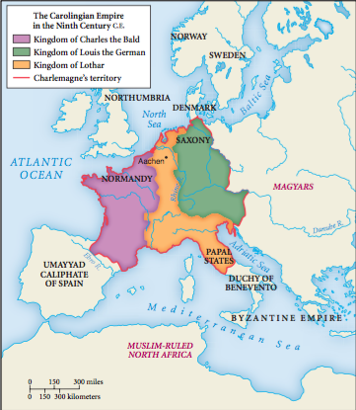
10. What replaced the Roman order in Western Europe?
Regional kingdoms and warlords.
Kept many Roman laws
Some tried to get something like the Roman Empire again like Charlemagne (Carolingian)
The Feudal System took hold in Western Europe
Vassals (knights) got land from kings if they promised to protect it
They didn’t want to work the land (they’re knights, not ratchet-headed farmers), so they make a deal with the peasants (serfs)
Serfs work the land, give the crops to the vassals to sell and use in exchange for the privilege to live on the land
Roman slavery influenced this system.
Sort of a “trust the slaves” mentality…
pp. 435-438

Slide 23
10A Chalewhaaaa?!
Charlemagne, first Holy Roman Emperor
Means Charles the Great
Coroneted (made emperor) on Christmas Day, 800
United parts of France, Germany and Italy
Errbody thought it was the new Roman Empire, but it soon split and such

Slide 24
11. What were some similarities between the Roman Catholic Church and the Buddhist establishment in China?
Like China, RCC got wealthy and people said it lost its way.
Citizens follower their rulers into the Church, like Buddhism.
Spread due to stories of miracles like Buddhism.
Healing, rainfall, fertility, and victory in battle.
p. 437

Slide 25
12. How did the Roman Catholic Church deal with the considerable range of earlier cultural practices, with regard to the conversion of Western Europe to Christianity?
They adapted a lot of things to fit in with pagan ideas.
Amulets and charms got pictures of Jesus and Mary on them.
Put churches on sacred pagan places to make pagans see the churches as holy.
December 25th was chosen for Christmas to keep pagans from partying on the Winter Solstice in the 300s
The spreading Christian faith, like the new political framework of European civilization, was a hybrid.
pp. 437-438

Slide 26
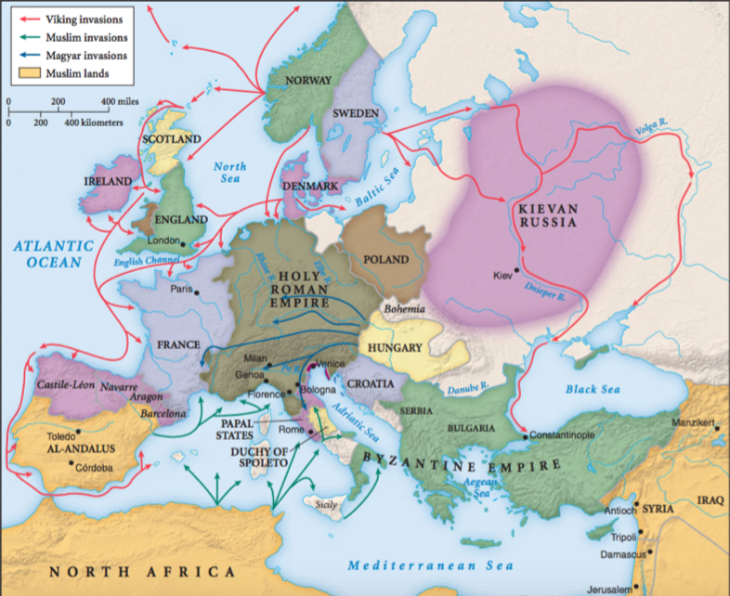
Invasions in Europe (Stop after 1000)

Slide 27
13. In what ways did European civilization change after 1000, during the High Middle Ages?
Pop pop (population increase)
More long-distance trade
Trading centers like in Champagne region of FrAHNce
Towns grew back strong with merchants, doctors, scholars (urbanization)
Guilds began to form. (local organizations of workers with a goal to promote the profession to the government and the community)
pp. 438-440

Slide 28
14. In what ways were women offered new opportunities between the 11th and 13th centuries?
They wove, brewed, milled, mid-wifed, laundered clothes, and, of course, prostituted.
And nuns, they could be nuns too.
p. 440

Slide 29
15. What was a reason offered for the change in women’s opportunities by the 15th century?
Women’s guilds were gone and they couldn’t join men’s guilds.
Men even ran the brothels! Come on!
Lost a lot of work to technology.
Animal grain mills
Large looms too heavy for women
Like China with the silk industry, yes??!?!?!
pp. 440-441

Slide 30
10.2 Quiz A
After the Roman Empire fell, population began to __________.
Name one reason why the ‘High Middle Ages’ began.
What system began in the Middle Ages in Europe that consisted of peasants being tied to their lords’ land? It was characterized by a system of trading security for crops and allegiance.

Slide 31
10.2 Quiz B
Which leader tried to reunite the Roman Empire? He was the first Holy Roman Emperor.
List one way the Catholic Church adapted its practices to accommodate the pagans it was trying to convert.
List one way women lost power as the High Middle Ages began.

Slide 32
Why does Western Europe start to expand?
Vikings chilled out on them
Got on boats, discovered America (Newfoundland), Greenland, Iceland
Byz was shrinking due to Muslim and Catholic pressure

Slide 33
16. What was the impact of the Crusades on European economies?
Led to Europe becoming globally aware.
Missionaries, travelers, merchants traveled as far as India, China and Mongolia by 1300s.
Led them to some limited but prolonged global trade.
p. 442

Slide 34
16A What’s a crusade, anyway?
Crusade = war that God told me to fight
Pope authorized it and gave indulgences (get out of part of purgatory free cards)to fighters
They could use indulgences for themselves or dead people they liked
Strayer asado - “Crusading drew upon both Christian piety and the warrior values of the elite, with little sense of contradiction between these impulses.”
“The seizure of Jerusalem in 1099 was accompanied by the slaughter of many Muslims and Jews as the Crusaders made their way, according to perhaps exaggerated reports, through streets littered with corpses and ankle deep in blood to the tomb of Christ.”

Slide 35
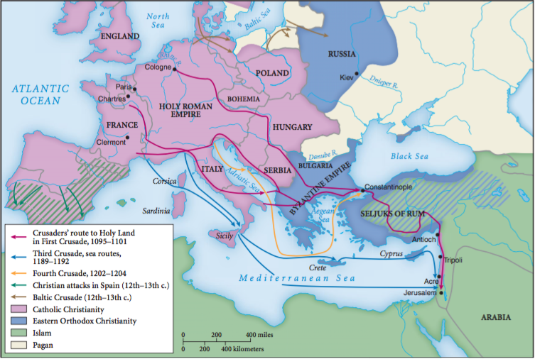

Slide 36
17. What were the most famous Crusades aimed at doing?
They were aimed at taking back Jerusalem and the holy places associated with the life of Jesus from Islamic control and returning them to Christendom.
Won back four small Christian areas in Israel, Turkey, but lost them pretty quick.
p. 443

Slide 37
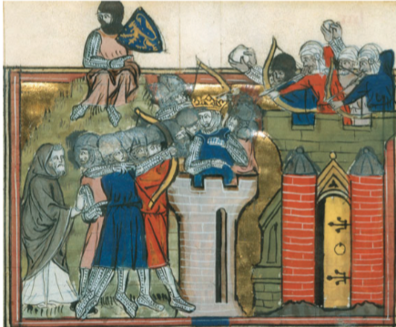
17A Other Crusades for my face?
Spain (Iberian Peninsula)
Constantinople/Istanbul (Turkey)
Against Jews (anti-Semitism)
Russia
Didn’t really change Middle East
AKA Christians lost the
crusades

Slide 38
17B My face hurts from all of that Crusaden’. So, how did the Crusades change Western Europe?
Gave popes super-control
Made cultural barriers stronger
Opened Europe’s contact with the larger world
Took scientific, philosophical and mathematical concepts from Arabs, Greeks and India
Found old Greek texts that Arabs had preserved
Got paper, gunpowder, horse use and more from China (indirectly-through Arabs)
They learned how to make sugar from Arabs, then started slave plantations in Eastern Europe
Move those plantations to Western Hemisphere in 1500s
Caught Europe up with the rest of the world by 1500s
(They’ll spend the next 500 years taking over the world)

Slide 39
History of Middle East v. West
Greco Persian Wars
Good, democratic Greeks v. bad, dictatorial Persians
Crusades
Good Christian whites v. bad Muslims browns
20th Century
Good Christian whites wanting bad Muslim browns’ oil

Slide 40
18. In the long term, the crusading movement by Western Europeans did not bring the Eastern Orthodox and Roman Catholic Christian churches closer together, but the crusading notion was used by the Europeans later to do what?
European empire building, especially in the Americas, continued the crusading notion that “God wills it.”
Leaders can get anything they want if God said it was “aiight”.
p. 445

Slide 41
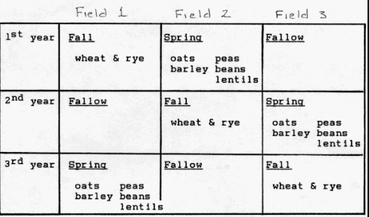
19. By 1500, Europe had caught up with and, in some areas, surpassed China and the Islamic world. What were some technological breakthroughs in agriculture and the arts of war/sea?
Agriculture - Heavy-wheeled plow, horseshoes, horse collar, three-field crop rotation
Arts of War/Sea - Got gunpowder from China, first to use it for cannons.
Magnetic compass and stern-post rudder (CHN), lateen sail (triangle) (Arabs)
pp. 446-448

Slide 42
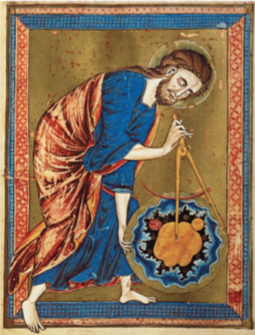
19a. Characterize European industry in the late Middle Ages.
Windmills and watermills
Complex cranks and gearing mechanisms
Move away from human (slave) power and animal power to wind and water power
Engineering becomes a big deal

Slide 43
20. Why was Europe unable to achieve the kind of political unity that China experienced? What impact did this have on the subsequent history of the European multi-centered political system?
Geographic barriers
Ethnic and linguistic diversity
Shifting power from different states rising and falling
Not a strong empire like China
Tons of conflicts among states
p. 448

Slide 44
10.3 Quiz A
Who lost the Crusades?
How were Jews treated by Christians during the Crusades?
List one invention or technique of Western Europeans that increased crop yield.

Slide 45
10.3 Quiz B
List one effect the Crusades had on Europe.
What people are being discussed by the quote from an Arab geographer below?
“their bodies are large, their manners harsh, their understand- ing dull, and their tongues heavy. . . .Those of them who are farthest to the north are the most subject to stupidity, grossness and brutishness.”
List one group other than Muslims who were attacked during the Crusades.

Slide 46
18. In the long term, the crusading movement by Western Europeans did not bring the Eastern Orthodox and Roman Catholic Christian churches closer together, but the crusading notion was used by the Europeans later to do what?
European empire building, especially in the Americas, continued the crusading notion that “God wills it.”
Leaders can get anything they want if God said it was “aiight”.
p. 445

Slide 47
19. By 1500, Europe had caught up with and, in some areas, surpassed China and the Islamic world. What were some technological breakthroughs in agriculture and the arts of war/sea?
Agriculture---Heavy-wheeled plow, horseshoes, horse collar, three-field crop rotation
Arts of War/Sea—Got gunpowder from China, first to use it for cannons.
Magnetic compass and stern-post rudder (CHN), lateen sail (triangle) (Arabs)
pp. 446-448

Slide 48
20. Why was Europe unable to achieve the kind of political unity that China experienced? What impact did this have on the subsequent history of the European multi-centered political system?
Geographic barriers
Ethnic and linguistic diversity
Shifting power from different states rising and falling
Not a strong empire like China
Tons of conflicts among states
p. 448

Slide 49
21. How did the struggle among the elites elevate the European urban-based merchant class? How does this compare with China?
In Europe, since kings, warrior aristocrats and the Church were always fighting, merchants got a lot of power without a lot of fight.
Made laws and appointed officials in cities w/o kings even knowing it
This independence led the merchants to get richer and more powerful and it a reason capitalism comes around in the 1700s
In China, landowners and officials were much more important than merchants.
The government controlled the salt and iron industries
Also limited most things the merchants did
p. 449

Slide 50
21a. How were cites different in Europe and China after 1100 CE?
China – cities were larger, but were controlled by the state
State liked landowners more than merchants
Europe – smaller, but really independent
Venice and Milan (ITL)
State liked merchants and landowners equally

Slide 51
22. Characterize the growth of the intellectual community in late Middle Ages Europe.
Scholarly studies began in the Catholic Church.
Monks and churches run the first universities.
Scholars began to use Greek (Aristotle) reason and Arab science to understand the world as a complement to religion
Arabs found Aristotle’s books and others
Shared with Europe
Aristotle’s view of logic and reason was foundation of the universities
The humanities (literature, philosophy and history) and natural science become the foundation for modern education
p. 451

Slide 52
22A How did the Byzantines and the Muslims handle all that Aristolteism?
Byzantium focused mainly on antiquity works of humanities, not philosophies
Didn’t really trust the pagan ancient Greeks
Muslims were really into it, but it challenged their faith and as they grew more powerful, they dropped Greek philosophy all together
But not before getting a lot of medical and scientific achievements because of it

Slide 53
23 How is Middle Ages Europe still a thing today?
Crusades leads to exploration/missionaries
Love of merchants leads to exploration
Competition/militarism of countries leads to WWI
Cath/Byz drama
Science and faith

Slide 54
Conversion of Clovis (Intro)
Franks (become French) – strong empire under king, Clovis
Spread Roman Catholicism that was based on the Trinity, not Arianism (Jesus is below God)
Took over Frankish paganism

Slide 55
History of the Franks
Clovis was polytheistic
Wife was Christian
Son dies after baptism
Wife is cool with this
Clovis is angry
Clovis finally converts when Germans are about to finish off his army
Germans retreat
3000 of his army was baptized too

Slide 56
Advice on Dealing with “Pagans” (intro)
Pagan = non-Christians
Pope told English bishop to compromise with Anglo-Saxons (where the word English comes from)
Written by a famous monk/historian, The Venerable Bede

Slide 57
Advice to the English Church
Don’t destroy the temples of the old gods, just turn them into churches
“it is requisite that they be converted from the worship of devils to the service of the true God.”
The people will be cool with this
Turn animal sacrifice to the Devil into a feast for God
Baby-step them into being Christians

Slide 58
Charlemagne and the Saxons (intro)
Charlemagne was a Frankish (French) king who became HR Emperor
Made everyone Christian when he conquered them
Saxons (Germans) resisted
Capitulary = set of rules and punishments

Slide 59
Capitulary on Saxony
Churches should be nicer than the pagan temples
If you steal from a church or burn it down, you will die for it
Break Lent? Die
Kill a bishop or priest? Die
Cannibalism? You are a witch and you die
Burn a corpse? Die
Conspire against the Church? Die
Must give tithe
Don’t work on Sunday
Baptize all infants within a year
If you do pagan rituals, you have to pay a fine based on what class you are.

Slide 60
The Persistance of Tradition (intro)
Germanic people kept a lot of their old pagan traditions even after converting

Slide 61
Life of Boniface
Some Catholic converts secretly or openly kept old traditions
Entrails inspection, magic tricks, spells
Boniface cut a tree the pagans worshipped and God burst it into four equal parts
Pagans converted because of this
Built a place of prayer out of the lumber

Slide 62
The Leechbook
Put a bunch of herbs in a cup and pray over it to keep away elves and ‘nightgoers’ and people who have intercourse with the Devil
Elf disease? Use a bunch of stuff and pray and sing over it and you’ll be fine
Possessed by the Devil? Crazy? Bunch of stuff and prayers/singing and you’ll be fine
Same for temptation by the Devil

Slide 63
Jesus Sutras in China (intro)
A Tang emperor was cool with outsider religions in Chang’an
Christianity doesn’t flourish in China, but it stays around for a while
Sutra means holy text
In western China
Combined Christianity with Daoism and Buddhism
Cloud with lotus flower and cross

Slide 64
The Jesus Sutras
Coming of Christianity to China
Emperor was chill
Christian monastery was built
100 temples built
Story of Jesus
Cool wind to Mo Yen
New star
Jesus found ppl with bad karma
The scribes who drank liquor and ate meat and served other gods

Slide 65
The Jesus Sutras
Four Laws of Dharma
No desire – desire cuts us off from peace
No action – don’t focus on unimportant things
No virtue – don’t try to be famous for doing good deeds
No truth – don’t judge
God, Humankind and the Sutras
God is like a wind that blows over everything
God created everything, even Buddha
Plant good seeds in this life for the afterlife
You are a boat, God is the wind and heaven is the destination

