Slide 1
Global Trade: A study in Cultural Diffusion
Unit 6

Slide 2
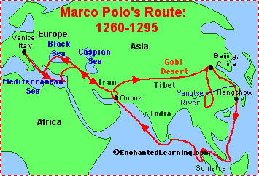
Motivation for Exploration
Marco Polo – 1200s, traveled to China
  Writings inspired more explorers
Three reasons for exploration
  God (spread Christianity)
  Glory (Become famous)
  Gold (Make money)
Technology
  Astrolabe and cartography from Muslims

Slide 3
Portugal is First
Prince Henry the Navigator of Portugal sponsored sea exploration
Looking for sea route to Asia to find spices
  Preserve food and flavoring
Found gold in southern tip of Africa
1488 Bartholomeu Dias rounded tip of Africa, “Cape of Good Hope”

Slide 4
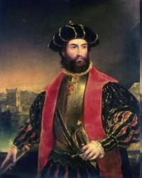
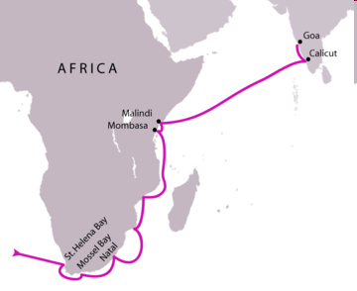
Vasco da Gamma
Sailed around cape to India
Lost half of ships and crew; hunger, thirst, scurvy
1000% profit
After Gamma
Portugal returned, destroyed Muslim trade
Trade empire, world power

Slide 5
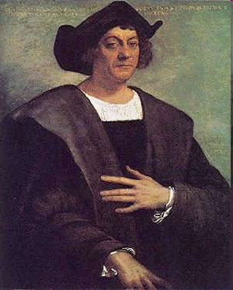
Explorers: Columbus
From Italy but Spain paid for him to explore
Aware the Earth was round; didn't know Americas were there

Slide 6
Explorers: Columbus
1492
Thinking he was in India called native people of Caribbean “Indians”
  Dark skin
  Other language
  Why do we still call these people Indians?
Columbian Exchange – new plants and animals to America from Europe and vice versa
  From America – Tomatoes, potatoes, tobaccoes
  From Europe – Horses, disease, slaves

Slide 7
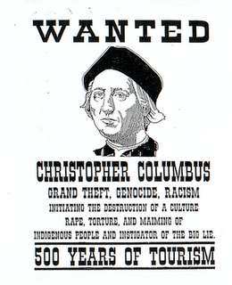
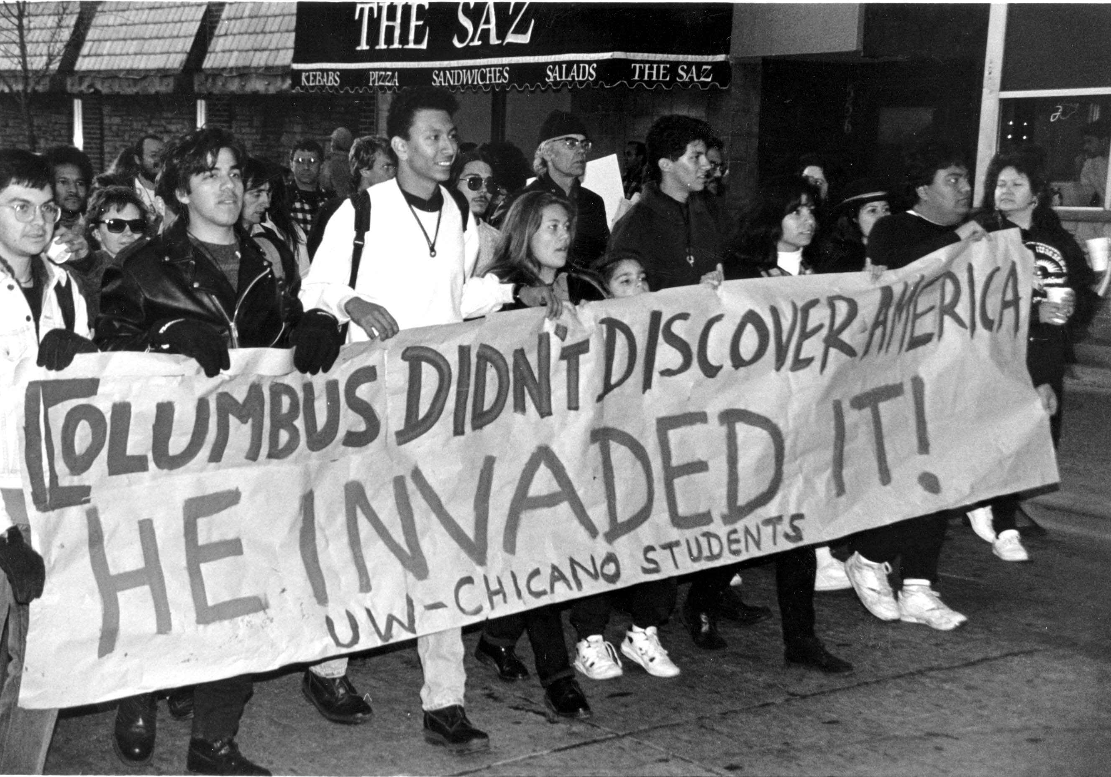

Slide 8
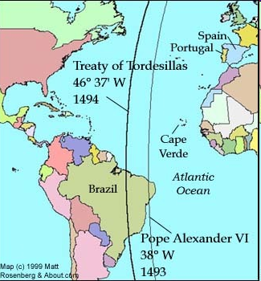
Line of Demarcation
  created by Pope
  Divided world between Spain, west of line, and Portugal, east
Treaty of Tordesillas
  1494
  Spain and Portugal
What language do most Brazilians speak today?

Slide 9
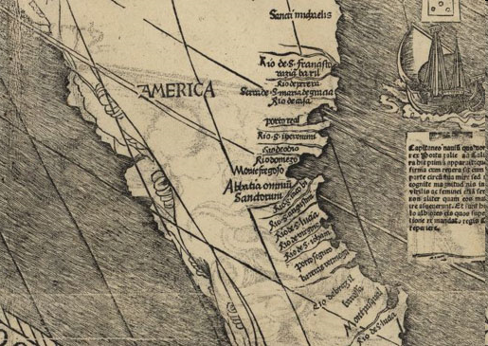
Cabot and Vespucci
John Cabot
  Venetian
  Explored New England for England
Amerigo Vespucci
  Italian
  Explored Brazil
  German cartographer used Amerigo’s account to create a map; labeled region “America”

Slide 10
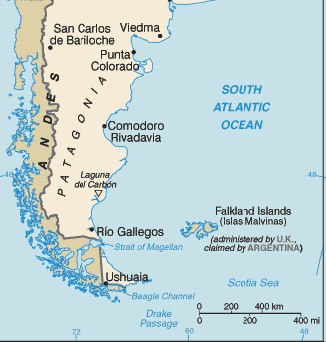
Magellan
Ferdinand Magellan, 1519, sought water way to Pacific
  found in 1520; named Straight of Magellan
Crew first Europeans to circumnavigate the world; Magellan died on journey

Slide 11
Guns, Horses, and Disease
Spanish conquistadors pillaged Native Americans for gold
  Forced labor
  Forced Christianity
Conquered Aztec and Inca empires
Europeans
  superior weapons
  Horses
  Disease
Native Americans
  no natural immunities for European diseases
  90% died from disease
  small pox, syphilis, influenza, and measles

Slide 12
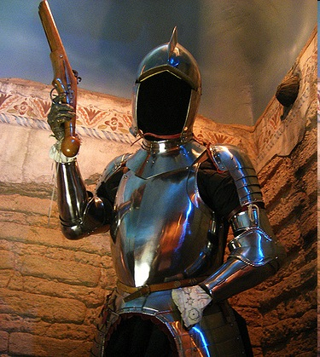
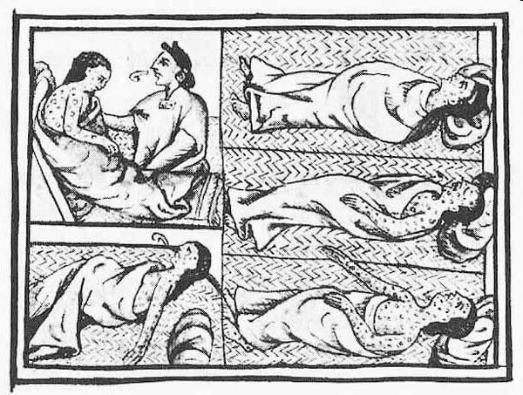
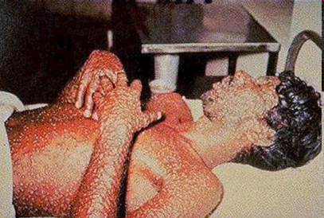

Slide 13
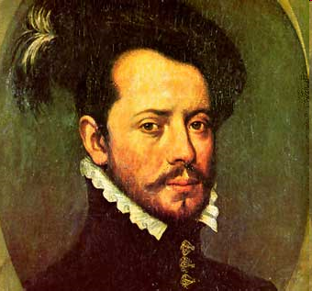
Hernan Cortes and Mocteczuma
Hernan Cortes looking for gold
  1519 landed in Mexico
  Found gold and Mayans
Cortes’s arrival forced Moctezuma (Aztec chief) to sign over capitol city
Disease
  most effective weapon

Slide 14
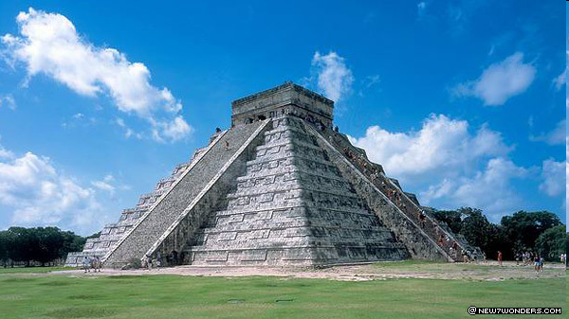
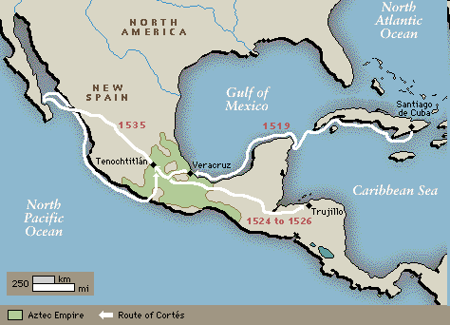

Slide 15
Malinche
Malinche, became Cortez’s interpreter and mistress
Was won in the war
Learned Spanish from missionary
Considered mother of Mexico
First ever Mestizo (European/Native mix) son
Celebrated as the Mother of Mexico

Slide 16
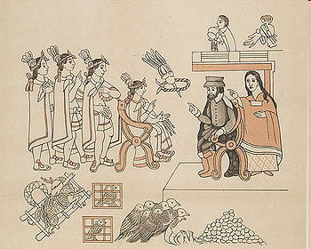

Slide 17
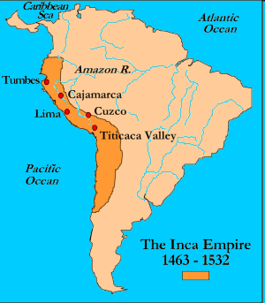
Francisco Pizarro
Pizarro
  Peru in 1532
  Incan empire divided in civil war
  Captured and killed Incan emperor
  Defeated Incans
Just like the Spanish
  superior weaponry
  deadly diseases

Slide 18
Consequences
Millions of native people and advanced cultures exterminated
  Those left turned to Christianity
  Mix of Spanish and native culture
Gold and silver mines funded European exploration in Pacific and Africa

Slide 19
What is a Latin American?
The English brought their families to the New World, so they didn’t blend with the natives.
The Spanish came as single explorer dudes.
They “dated” the natives.
This made a new Latin American or Mestizo (Spanish/Native mix) culture
Most Latin Americans today are to a certain degree Mestizo

Slide 20
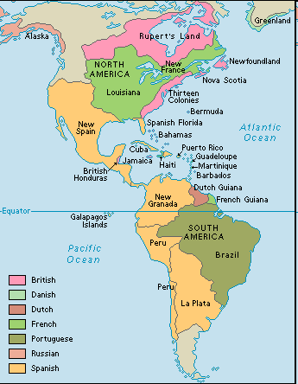

Slide 21
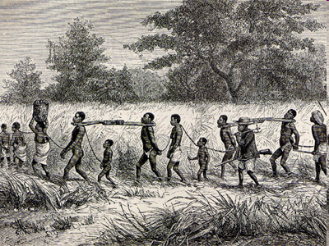
African Slave Trade
1600s- slaves most valuable commodity in Africa
  started by Portuguese traders
  other nations follow

Slide 22
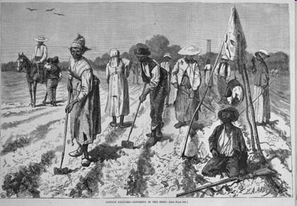
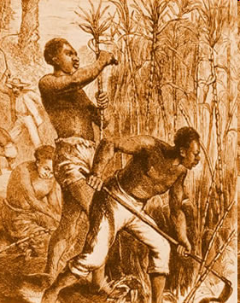
African Slave Trade
Plantations in Americas needed cheap labor
African rulers traded slaves for European goods
  Considered property
  No rights

Slide 23
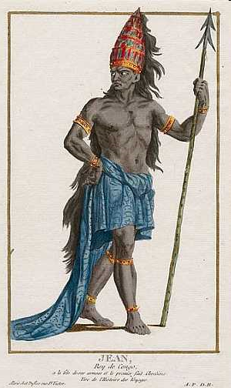
Africa’s Resistance
Some African leaders resisted
Affonso I, ruler of the Kongo, resisted
African leaders attempted to ban the trade

Slide 24
Triangular Trade
Triangle Trade
  network of trade linking Europe, Africa, Americas
First leg
  Europe to Africa
  guns, cloth, money for slaves
Second leg, Middle Passage
  Africa to Americas
  slaves for raw goods, sugar, cotton, firs, molasses
Third leg
  Americas to Europe
  raw goods to manufacturers
  Port cities prospered and new cities built

Slide 25
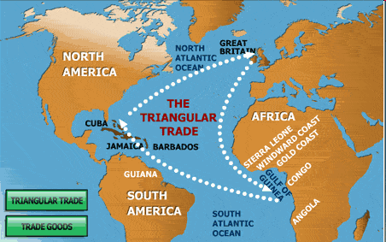

Slide 26
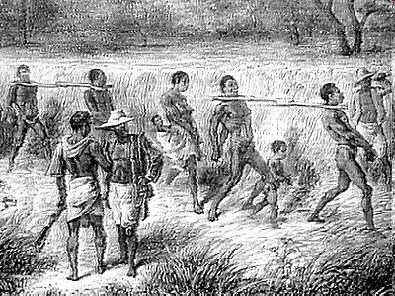
The Middle Passage
Captive African slaves crossed hundreds of miles to African coast
Held in warehouses in coastal ports to await transport to the Americas
1 in 8 died in the middle passage

Slide 27
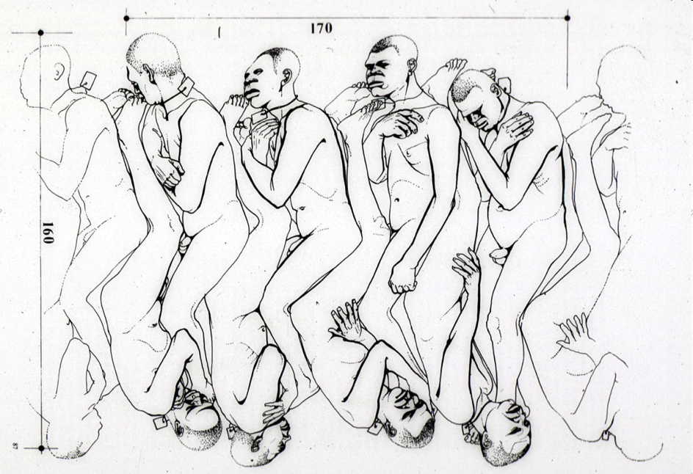
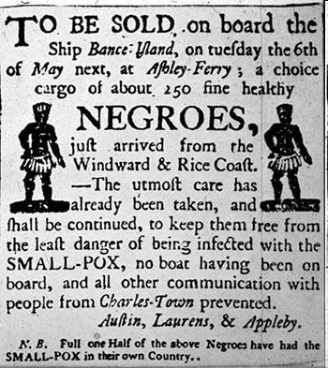

Slide 28
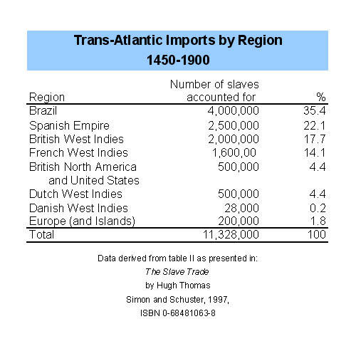
Sugar Plantations Imported the Most Slaves

Slide 29
Impact of the Atlantic Slave Trade
Colonies and cities in Europe gained enormous wealth
African communities, families, and individuals destroyed
Around 10 million enslaved
Around 2 million died in the middle passage

Slide 30
Europeans in Asia
First was Portugal
  Gained control of trade in India
Dutch took power in India
  Dutch East India Company
  Then they began trading in China
  Lose influence to England and France

Slide 31
Spain in Asia
Spain- 1500s, took Philippines
Made people convert
Many Filipino people today are Catholic
Funded trade in Asia with silver from colonies in Mexico and Peru

