Slide 1
Images of AP World

Slide 2
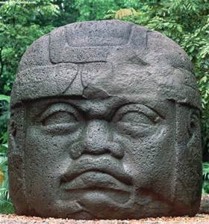
AP says YOU need to know
What society/culture is this from?
Where is that society located?
What does it represent?
When was it created?

Slide 3
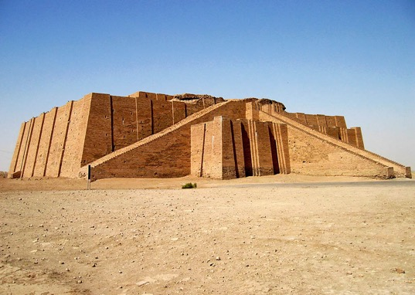
AP says YOU need to know
What society/culture is this from?
Where is that society located?
What does it represent?
When was it created?

Slide 4
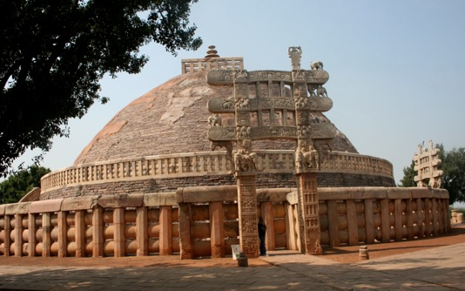
AP says YOU need to know
What society/culture is this from?
Where is that society located?
What does it represent?
When was it created?

Slide 5
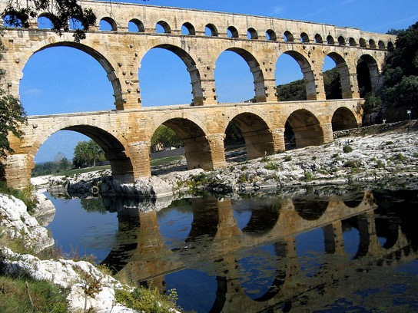
AP says YOU need to know
What society/culture is this from?
Where is that society located?
What does it represent?
When was it created?

Slide 6
AP says YOU need to know
What society/culture is this from?
Where is that society located?
What does it represent?
When was it created?

Slide 7
AP says YOU need to know
What society/culture is this from?
Where is that society located?
What does it represent?
When was it created?

Slide 8
AP says YOU need to know
What society/culture is this from?
Where is that society located?
What does it represent?
When was it created?

Slide 9
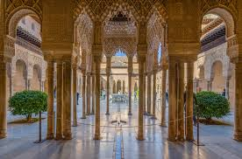
AP says YOU need to know
What society/culture is this from?
Where is that society located?
What does it represent?
When was it created?

Slide 10
AP says YOU need to know
What society/culture is this from?
Where is that society located?
What does it represent?
When was it created?

Slide 11
AP says YOU need to know
What society/culture is this from?
Where is that society located?
What does it represent?
When was it created?

Slide 12
AP says YOU need to know
What society/culture is this from?
Where is that society located?
What does it represent?
When was it created?

Slide 13
AP says YOU need to know
What society/culture is this from?
Where is that society located?
What does it represent?
When was it created?

Slide 14
AP says YOU need to know
What society/culture is this from?
Where is that society located?
What does it represent?
When was it created?

Slide 15
AP says YOU need to know
What society/culture is this from?
Where is that society located?
What does it represent?
When was it created?

Slide 16
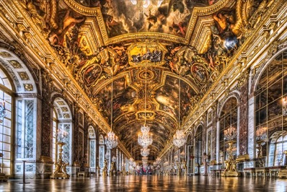
AP says YOU need to know
What society/culture is this from?
Where is that society located?
What does it represent?
When was it created?

Slide 17
AP says YOU need to know
What society/culture is this from?
Where is that society located?
What does it represent?
When was it created?

Slide 18
AP says YOU need to know
What society/culture is this from?
Where is that society located?
What does it represent?
When was it created?

Slide 19
AP says YOU need to know
What society/culture is this from?
Where is that society located?
What does it represent?
When was it created?

Slide 20
AP says YOU need to know
What society/culture is this from?
Where is that society located?
What does it represent?
When was it created?

Slide 21
AP says YOU need to know
What society/culture is this from?
Where is that society located?
What does it represent?
When was it created?

Slide 22
AP says YOU need to know
What society/culture is this from?
Where is that society located?
What does it represent?
When was it created?

Slide 23
AP says YOU need to know
What society/culture is this from?
Where is that society located?
What does it represent?
When was it created?

Slide 24
AP says YOU need to know
What society/culture is this from?
Where is that society located?
What does it represent?
When was it created?

Slide 25
AP says YOU need to know
What society/culture is this from?
Where is that society located?
What does it represent?
When was it created?

