Slide 1
8.1 Parties Intro
Edwards 259-270

Slide 2
Political Party
A group of citizens who organize to
Win elections
Hold offices
Parties have three parts
Voters in the party
The party as an organization (official)
Gov members in the party
Three levels of political parties
National
State
Local

Slide 3
Functions of a political party
Recruit nominees for office
Run campaigns
Tell voters how to vote (based on party)
Create and promote party platforms
Created at the National Party Convention every four years
MOST IMPORTANT FUNCTION:
BE A LINKAGE INSTITUTION!
Being a link between citizens and the government
Giving info to voters about candidates
Getting people to vote
Raising money for candidates

Slide 4
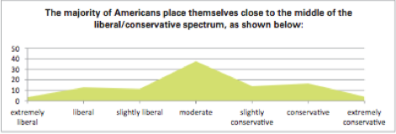
The Downs Model
“Rational-choice theory”
Voters want the policies they want to be adopted
Candidates want to win office
Thus, parties that want to win will choose the most popular policies
And, to get as many votes as possible, they will stay close to the center

Slide 5
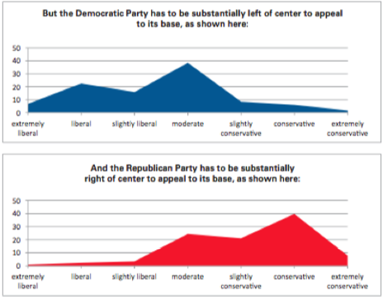

Slide 6
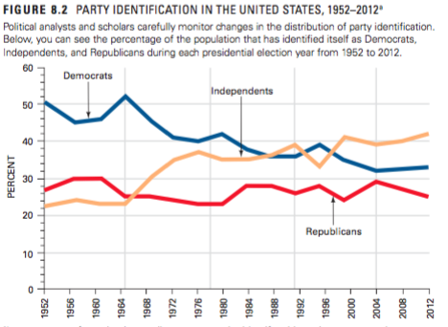
Party Identification-which party are you?

Slide 7
Voting and Parties
Ticket – the ballot
Straight ticket voting – clicking one button to choose all republicans or all democrats
Ticket splitting – voting for democrats in one race and republicans in another
Happens more today because there are more independents
Also because we are more focused on the individuals than the parties or policies
Young people are more likely to be independent and thus split tickets

Slide 8
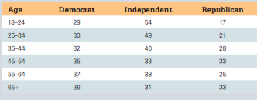
Age and Party Identification

Slide 9
How parties are organized
Really decentralized and fragmented
The official party heads don’t really have any power
Candidates can get elected without them

Slide 10
Local Parties
Used to be known as party machines
Local government ppl would give gov jobs to ppl who promise to make 10 ppl vote for them and 5% of their salaries to the party as a donation
Called the patronage system
Now gov jobs are based on merit and local party machines are pretty much dead

Slide 11
The 50 State Party Systems
Widely vary from state to state
Some are really influential and rich
Some aren't
Choose when primaries are held (frontloading), should they be open or closed

Slide 12
Open or closed primaries?
Open primaries – anyone can vote in that party’s primary
Lets independents “join” the party early
Leads candidates to be more middle-of-the-road in primaries as well as general elections
Con is that the other party can spoil a primary by picking the worst candidate
Closed primaries – only registered party members can vote in that party’s primaries
Gives parties info on how many ppl register for each party
Ensures them ppl making primary decisions agree with the party ideology

Slide 13
National Party Organization
National convention – the supreme power of the party
Meets every four years in the summer before the presidential election
Must write the official party platform, nominate the president and the vp
National committee – runs things between the national conventions
Made up of party leaders from each state

Slide 14
8.2 Party Eras
Edwards 270-276

Slide 15
Party Eras in History
Party era – a time dominated by one party
Critical election – an election where a national crisis changes voters’ stances
Usually leads people to change party loyalty
Party realignment –
Caused by a critical election
Majority party is replaced with minority party

Slide 16
The First Party System 1796-1824
Hamilton led the Federalists
Strong national government, national bank
Favored wealthy, business owners, manufacturers
Thomas Jefferson and James Madison led the Democratic-Republicans (anti-Federalists)
Weak federal government and no national bank
Favored farmers, shopkeepers and laborers
Jefferson defeats Federalist Adams in 1800
First time a party gave up power peacefully after losing an election

Slide 17
Jackson and the Democrats 1828-1856
Jackson led the democrats through a lot of the 1800s
Supported suffrage for all white males
Debtors supported him
Was supported by poor, pioneers and small farmers
Whigs took power toward the end of the Jacksonian Era
Supported national bank, high tariffs (import taxes)
Supported by bankers, plantation owners, industrialists
Only two presidents (Harrison and Taylor)

Slide 18
Republican Era 1860-1928
Slavery is a big deal in 1850s
Split Democrats and Whigs, left an opening for a new party
Lincoln leads a minor new party, Republicans
Anti-slavery
Only part to jump from minor to major in one election
Democrats survive by becoming the “Southern” party
AKA “Solid South” rules in south for next 100 years

Slide 19
After the Civil War, Democrats become the “little man” party (farmers, poor, labor unions)
Republicans morph into the “industrialization” party thanks to William McKinley
Gets backing from industrialists, small business owners, financial institutions
Keep power until the Great Depression

Slide 20
FDR and the New Deal Coalition 1932-1964
1932 – Great Depression
Stock Market drops, ppl panic and withdraw money from all banks
Banks have no money to invest
Most ppl lose a lot
Families starve, bread lines, soup kitchens
Things were so bad that for the first time MOST AMERICANS THOUGHT THE GOVERNMENT HAD A RESPONSIBILITY TO HELP PEOPLE FINANCIALLY

Slide 21
FDR gathered groups to make up the New Deal Coalition
New Deal – plan to get back on track after the Great Depression
Created Social Security – forced retirement payments by citizens invested in the stock market and repaid upon retirement
Created the WIA (Works Progress Administration)
Citizens hired by government to do public works in hopes of boosting the economy
Parks, highways, schools, dams
THE IDEA OF THE NEW DEAL WAS TO PROTECT CITIZENS FROM THE VOLITILE STOCK MARKET

Slide 22
Members of the New Deal Coalition
Urban poor
Labor unions
Catholics
Jews
Southerners
African Americans
Before, African Americans were almost all Republican (because of Lincoln/slavery)
This change to Democrat is something that still matters today
KNOW THAT THE NEW DEAL FAVORED REGULAR PEOPLE, NOT BUSINESS LEADERS AND INDUSTRIALISTS

Slide 23
More about The New Deal
Based on ideas of economist John Maynard Keynes
Thought that government spending would bring the economy back
Used what are now called the “Alphabet Agencies”
FDIC – Federal Deposit Insurance Corporation – insured individual’s bank deposits up to $5000
FERA – Federal Emergency Relief Administration – bailed out bankrupt local and state governments
AAA - Agricultural Adjustment Administration – bailed out farmers and controlled prices to help farmers
TVA – Tennessee Valley Authority – hired unemployed workers to build dams to help get cheap electricity to the south

Slide 24
Divided Government 1968-today
Republicans controlled the Whitehouse from 1968-1993 (minus one term for Carter in the 70s)
1968 – Republican start the “Southern Strategy” to win conservative southerners
Republicans became anti-civil rights, anti-hippie, pro-gun
BIG DEAL B/C REMEMBER, LINCOLN AND THE REPUBLICANS SCREWED UP THE SOUTH IN THE FIRST PLACE!
Today, the Republicans control the south

Slide 25
Nixon is a great example of divided government
He was the first president to enter the White House with a House and Senate of the opposition party
Since Nixon, the House, Senate and Presidency have usually been divided
Today, the Republicans have the House and the Democrats have the Presidency and the Senate

Slide 26
Effects of a divided government:
More partisanship (only working with your party, not working together)
Makes it more difficult to get things done
Slowed confirmations for courts and executive offices
Creating gridlock

Slide 27
Increased public frustration
Lessened political efficacy and participation
Less people identify as Republican or Democrat, more say they are independent
More split ticket (voting for both parties on a ballot) voting
People leaving the parties is called “party dealignment”

Slide 28
8.3 Third Parties
Edwards 276-282

Slide 29
Third Parties
Any party other than Dem or Rep
Generally, the US is a two-party system
Third parties are common, but they hardly ever win
Three types of third parties
Single issue
Prohibition, socialism, environment (Green Party)
Offshoots of a major party
States rights (from Rep), Tea Party (from Rep)
Based on an individual candidate
Ross Perot, Donald Trump

Slide 30
Minor Parties you Gotta Know
Bull Moose Party– early 1900s
Started by Teddy Roosevelt
AKA Progressive Party
Split the Republicans, enabling the Democrats to take the White House
American Independent Party – 1960s
Started by George Wallace (shocker)
Anti-civil rights
Free Soil Party – 1860s (Civil War)
Opposed slavery

Slide 31
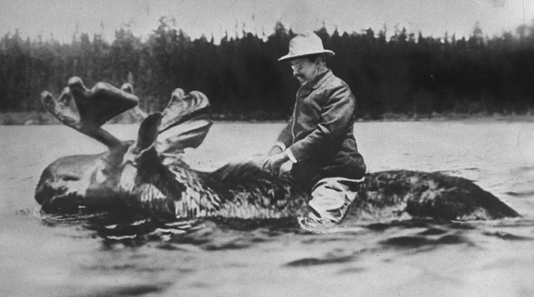
#bullmooseprobz

Slide 32
Know Nothing Party – 1850s
Opposed Irish-Catholic immigration
*Here’s your racism against white people*
Right to Life Party
Anti-abortion
Socialist Party – 1901-today
Move US towards socialism/communism
On the ballot for most presidential elections
Libertarian Party – 1970s-today
Minimal governmental involvement
Private education, healthcare, toll roads
Ultimate freedom of individuals

Slide 33
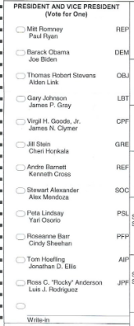

Slide 34
Obstacles for Minor Party Candidates
Winner-take-all elections in all elections
No rewards for second and third-place
So, to win elections, smaller parties must merge with the major parties
We could have proportional representation (like most of Europe)
If your party gets 15% of the votes, it gets 15% of the seats in congress
Winner-take-all electoral college in all states but ME and NE
1992 Ross Perot wone 19% of the vote but no electoral votes
Minor party candidates usually don’t get to do televised debates

Slide 35
Importance of Minor Parties
Push major parties to accept their ideas
Can “spoil” elections
Ralph Nader’s Green Party took votes away from Al Gore in 2000 leading to GW Bush to win

Slide 36
What if we had more parties?
More people would be represented
Their voices would be heard and not ignored by the two parties involved
Religious party
Black party
Environmental party
Union party

Slide 37
Why our party system stinks
The actual party doesn’t have any control over the candidates
Many get elected on their own, without party help
The party can’t punish them if they don’t like what they’re doing (like they can in Europe)
If the candidate has to decide between towing the party line and protecting themselves, what do you think they’ll choose?
Blue Dog Democrats – yellow dogs who have been squeezed so much by liberals, they’ve turned blue
Anti-spending Democrats

Slide 38
Parties and the scope of government
Hard to get everyone to vote to spend a lot of money
Healthcare pushed by Truman, Clinton and Obama failed
Hard to get everyone to vote cut a lot of spending
Basically, parties maintain the status quo because they can’t agree on anything
America

