Slide 1
Chapter 15

Slide 2
Major commerce things in Unit 4
Slave trade was major, but also…
Indian Ocean spice trade
Continued from earlier times
Now dominated by Europeans
Fur trapping and trading in North America and Siberia
Transformed land and societies in those areas
Silver in Americas traded for stuff in East
By wealthy Europeans
Commerce was global in many areas, not just on the Atlantic

Slide 3
Strayer is a frickin’ poet.
“Thus commerce joined empire as the twin drivers of globalization during these centuries. Together they created new relationships, disrupted old patterns, brought distant peoples into contact with one another, enriched some, and impoverished or enslaved others.”

Slide 4
What motivated European involvement in the world of Asian commerce?
Sea routes to Indian Ocean
Columbus, da Gama
Desire for spices, silk, cotton
European civ recovered after the Black Death (1400s)
New Eur pop growth
Resentment of Muslim monopoly of Indian Ocean products
Resentment of Venice (Italy) as a middle man
to continue the Crusades by joining with the mysterious Christian monarch Prester John
the need to get gold and silver to pay for the Asian spices and textiles they desired
(Original: p. 434-435; With Sources: pp. 674-675)

Slide 5
To what extent did the Portuguese realize their own goals in the Indian Ocean? (What did they create? Did they get to their goal? What was the outcome?)
Couldn’t trade, didn’t have good stuff to trade
Goal was to control trade by force (cannons and good boats)
Took over port cities and charged ppl to trade there (TRADING POST EMPIRE)
Portuguese king called himself “Lord of the Conquest, Navigation, and Commerce of Ethiopia, Arabia, Persia, and India.”
Controlled 50% of trade by 1600, then declined
Due to resistance of Mughals and Oman and competition with Spain and England
(Original: p. 437; With Sources: p. 677)

Slide 6
Spain and the Philippines
Named after King Phillip
Spain was first to challenge Portugal’s dominance in Asian trade
Took full control and kept it until 1898 when the US took control after the Spanish American War
1550-1900
Missionaries made it the only major Christian outpost in Asia
Much more missionary than Portugal was
Forced labor, taxes, tribute system were implemented
Women lost ritual and healing roles, replaced by male Catholic priests
Stopped revolts by Chinese population by using massacres

Slide 7
Dutch and British East India Companies
Charted by their country’s government (Chartered companies)
Could not only make money off the people, but wage war and govern them
Monopolies (only they could trade)
Joint stock companies – ppl back home bought stock in the ships and got part of the profits
Beginning of modern stock-based economics
Both pushed out the Portuguese
East India Companies
Dutch = Indonesia
English = India
West India Companies
Both = Caribbean

Slide 8
To what extent did the Dutch trading company change the societies they encountered in Asia?
The Dutch controlled—shipping, production and trade of mostly spices.
Lots of bloodshed.
On one group of islands—the Dutch killed, enslaved, or left to starve virtually the entire population and then replaced them with Dutch planters, using a slave labor force to produce nutmeg.
Monopoly let them charge 14 to 17 times the original price to Europeans
End result? Local economy shattered, people impoverished.

Slide 9
To what extent did the British trading company change the societies they encountered in Asia?
Asked for right to trade in India from the Mughals.
Couldn’t “trade by force” like Dutch did on the small islands b/c Mughals are too strong
Almost got shutdown for pirating a Mughal ship
Took India b/c it was all that was left
Spain and Dutch had the islands
Focused mainly on cotton, not spices.

Slide 10
How did trading end up in Indonesia (Dutch) and India (British)?
Both started trading more bulk items as opposed to luxury goods
Both ended up officially ‘colonizing’ their hosts

Slide 11
15.1 Quiz A
What island nation in the Indian Ocean was taken over by Spain?
List one way the Dutch and the British were different in their control of trade in the Indian Ocean.
What product eventually became the main focus on British traders in India?

Slide 12
15.1 Quiz B
What island nation in the Indian Ocean was taken over by Portugal?
Of the European countries controlling trade in the Indian Ocean, which was the least invasive on the native cultures and economies?
Which two countries had “East India Companies”?

Slide 13
15.2 Asia and Silver
681-688

Slide 14
Dutch and British East India Companies
Charted by their country’s government (Chartered companies)
Could not only make money off the people, but wage war and govern them
Monopolies (only they could trade)
Joint stock companies – ppl back home bought stock in the ships and got part of the profits
Beginning of modern stock-based economics
Both pushed out the Portuguese
East India Companies
Dutch = Indonesia
English = India
West India Companies
Both = Caribbean

Slide 15
To what extent did the Dutch trading company change the societies they encountered in Asia?
The Dutch controlled—shipping, production and trade of mostly spices.
Lots of bloodshed.
On one group of islands—the Dutch killed, enslaved, or left to starve virtually the entire population and then replaced them with Dutch planters, using a slave labor force to produce nutmeg.
Monopoly let them charge 14 to 17 times the original price to Europeans
End result? Local economy shattered, people impoverished.

Slide 16
To what extent did the British trading company change the societies they encountered in Asia?
Asked for right to trade in India from the Mughals.
Couldn’t “trade by force” like Dutch did on the small islands b/c Mughals are too strong
Almost got shutdown for pirating a Mughal ship
Took India b/c it was all that was left
Spain and Dutch had the islands
Focused mainly on cotton, not spices.

Slide 17
How did trading end up in Indonesia (Dutch) and India (British)?
Both started trading more bulk items as opposed to luxury goods
Both ended up officially ‘colonizing’ their hosts

Slide 18
What was Japan’s response to the Europeans whom they saw as a threat?
Japan was divided by conflict among the daimyos (rich families)
European weapons, ships and technology were attractive to Japanese and used in warring states
Later, Japan saw Europeans as a threat to a recent unity brought by Tokugawa Shogunate
Expelled/tortured/executed Christian missionaries
Suppressed Japanese Christianity
Ban all Europeans except Dutch (they apparently are heathens)
Japan becomes closed to Europeans from 1650 until 1850
(Original: p. 441; With Sources: p. 681)

Slide 19
Why was the silver trade so historically important?
First commodity to be exchanged on a global scale
Made a direct link between the Americas and Asia (through Europeans)
(Original: p. 442; With Sources: p. 682)

Slide 20
More about silver
Huge deposit (85% of world total) found in Bolivia
Made Potosi the largest city in the Americas
Also big deposit in Japan found at the same time
China made taxes only payable in silver, brought silver value up
Led to foreigners buying more Chinese stuff for lower prices
Silver drain – most of the world’s silver ended up in China b/c they only took silver as payment and rarely bought

Slide 21
What impact did the discovery of the world's largest silver mine at Potosi have on the Native American miners?
The city’s miners worked in conditions so horrendous that some families held funeral services for men drafted to work the mines.
Potosi was a portrait of hell.
(Original: p. 443; With Sources: p. 683)

Slide 22
More on Potosi
"Some four years ago, there was discovered a mouth of hell, into which a great mass of people enter every year and are sacrificed by the greed of the Spaniards to their ‘god’.”
“The Indians enter these infernal pits by some leather ropes like staircases ... Once inside, they spend the whole week in there without emerging. If 20 healthy Indians enter on Monday, half may emerge crippled on Saturday.”
“Many Andeans experienced mercury poisoning from the mercury used in the refining process. Hundreds of thousands, mostly native Andean miners and their families, were poisoned and killed by use of mercury at Potosi. Before the Spaniards arrive, the Incas had already banned the use of mercury for being too toxic.”

Slide 23
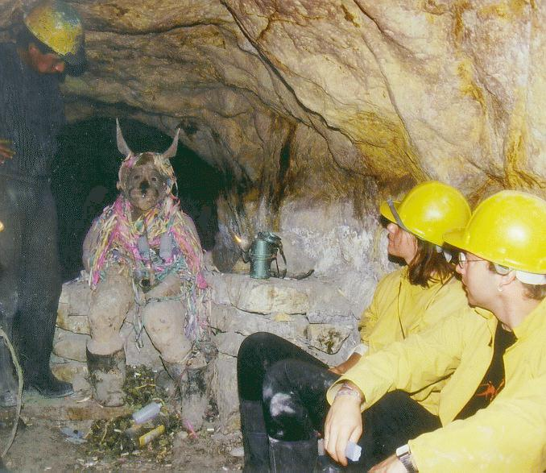
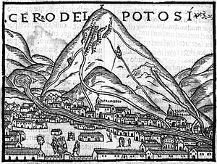
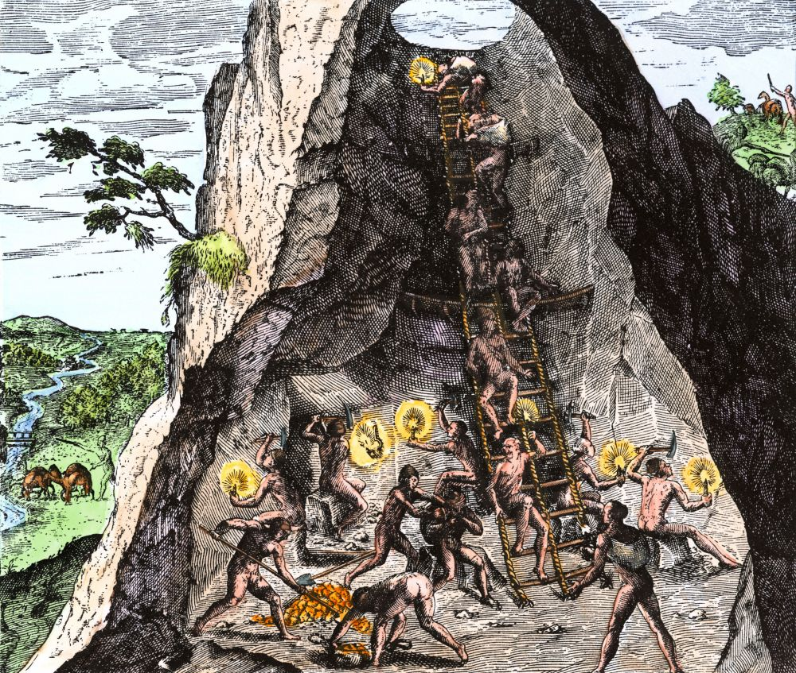
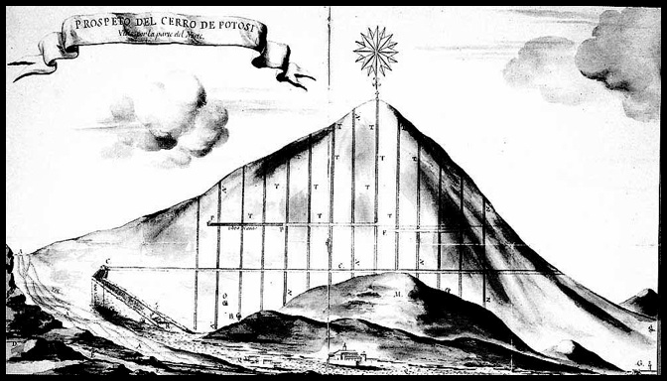

Slide 24
How did the discovery of the vast silver mines in South America affect Spain's position in Europe?
Made Spain the most powerful European country.
Let Spain pursue military and political growth.
Abundance of silver caused inflation in Spain and caused the empire to fall when the price of silver dropped worldwide
(Original: p. 443; With Sources: p. 683)

Slide 25
In what ways did the Chinese response to the global silver economy differ from the Japanese response?
*Economic changes resulted in ecological devastation in China, but not in Japan.
Japan:
The shoguns allied with the merchant class to develop a market-based economy and to invest heavily in agricultural and industrial enterprises.
Local and state authorities acted to protect and renew forests.
Families practiced late marriages, contraception, abortion, and infanticide.
Outcome was Japan becoming commercialized and ready for the Industrial Revolution.
(Original: p. 444; With Sources: p. 684)

Slide 26
China:
In southern China, this surging economic growth resulted in the loss of about half the area’s forest cover as more and more land was devoted to cash crops.

Slide 27
15.2 Quiz A
What did families do when they learned that a man from the family had been drafted to work in the silver mines in Potosi?
Where did most of the world’s silver end up?
How did Japan and China differ in their interaction with the environment regarding the new influence of silver in Asia?

Slide 28
15.2 Quiz B
What did families do when they learned that a man from the family had been drafted to work in the silver mines in Potosi?
Which country oversaw the mining of the silver in Potosi?
Name one reason demand for furs went up after 1500.

Slide 29
Furs and Slave Trade Part 1
685-692

Slide 30
What may have increased the demand for furs in the early modern era?
cooling temperatures and harsh winters known as the Little Ice Age
Ag expansion made less wild land for furry animals
(Original: p. 445; With Sources: p. 685)

Slide 31
North American Fur Trade
Natives did the trapping, Europeans bartered for the furs
France was the biggest fur trading country
Forced natives to take sides in wars between France and England
Called “soft gold”
American gold and silver traded by Europeans to Russians for furs

Slide 32
Describe the impact of the fur trade on North American native societies.
Positive:
Natives could trade of pelts for goods of real value.
It enhanced influence and authority for some Native American leaders.
Kept fur trading natives safe from extermination/enslavement that others encountered
(Original: p. 447 With Sources: p. 687)

Slide 33
Negative:
Diseases
Intertribal warfare over control of fur trade
Almost made beavers and other furry critters extinct
It left Native Americans dependent on European goods (guns, tools, pots, textiles) without a corresponding ability to manufacture the goods themselves.
Lost traditional craft making
It brought alcohol into Indian societies, often with destructive effects.
Fire water
Still a problem in US today

Slide 34
In short, it was not so much the fur trade itself that decimated Native American societies, but all that accompanied it—disease, dependence, guns, alcohol, and the growing encroachment of European colonial empires.

Slide 35
How did the North American and Siberian fur trades differ from each other? What did they have in common?
North American:
Several European nations competed
Furs got through bartering with natives
Siberian:
Russian government made ppl in Siberia pay their taxes in furs
Also private fur trappers competing with citizens
Both:
Driven by the world market
Got new diseases
Became dependent on Europeans goods they got in exchange for furs
(Original: p. 449; With Sources: pp. 685-688)

Slide 36
More about the Atlantic Slave Trade
1450-1850 = 11 million people moved from Africa to Americas
Millions more died (1 in 5)
Changed everyone involved
African diaspora created new societies in Americas
Made many people rich
Becomes a metaphor or social oppression
Original sugar slaves were Slavic ppl in the Mediterranean (Slaves)

Slide 37
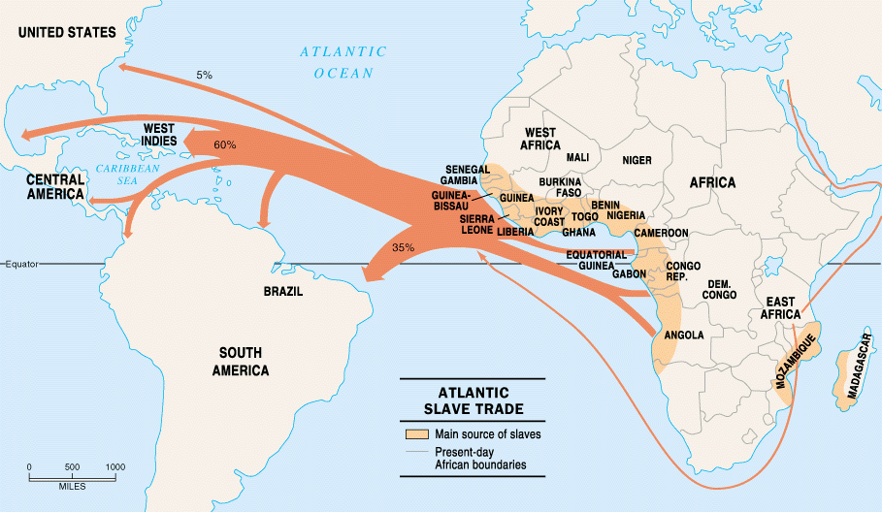

Slide 38
Review of Slavery so far
Most human societies have had slaves
Africans had practiced slavery and sold slaves for centuries
trans-Saharan trade took slaves to the Mediterranean world
East African slave trade
Slavery took many forms, depending on the region and time period
slaves were often assimilated into their owners’ households
children of slaves were sometimes free, sometimes slaves

Slide 39
What was slavery like in the Islamic world?
Mostly women
Atlantic was mostly men (to work plantations)
Some slaves gained status
Worked in households
Less doing hard labor
.(Original: p. 450; With Sources: p. 690)

Slide 40
What was distinctive about the Atlantic slave trade in the Americas?
the immense size of the traffic in slaves and its centrality to the economies of colonial America
New World slavery was largely based on plantation agriculture and treated slaves as a form of dehumanized property, lacking any rights in the society of their owners.
Slave status throughout the Americas was inherited across generations, and there was little hope of eventual freedom for the vast majority.
most distinctive was the racial dimension—slavery came to be identified wholly with Africa and with “blackness.”
(Original: p. 450; With Sources: pp. 690-691)

Slide 41
“Nowhere else, with the possible exception of ancient Greece, was widespread slavery associated with societies affirming values of human freedom and equality.”
“Did Muslims start the black=slave system or Europeans?”
Europeans were better able to tolerate their brutal exploitation of Africans,” writes a prominent world historian, “by imagining that these Africans were an inferior race, or better still, not even human.”

Slide 42
What caused the Atlantic slave trade to grow? Why was slavery a source of labor?
The demand for sugar as a sweetener
Few wage laborers/serfs
Job was tough/dangerous
New tech to manufacture sugar
New huge markets to sell to
Christians were ‘exempt’ from slavery
(Original: p. 451; With Sources: p. 691)

Slide 43
15.3 Quiz A
What people in the Mediterranean may have been the basis for modern sugar slavery? Their name became the basis for the word “slave” in English.
What percentage or number of African slaves died in the transport to the Americas?
What is one way that the Atlantic slave trade was different from the slave trades before?

Slide 44
15.3 Quiz B
Other than trading furs, what was one thing the North American and Siberian fur trades have in common?
What is one way the Islamic slave trade was different than the Atlantic slave trade?
What is one reason for the rise of the Atlantic slave trade?

Slide 45
Slave Trade 2
692-698

Slide 46
In what different ways did the Atlantic slave trade transform African societies?
slowed Africa’s population growth while Europe and China were growing
led to economic stagnation.
led to political disruption and warfare
Some authorities took advantage of the slave trade to increase power
Benin
(Original: p. 455-456; With Sources: pp. 695-696)

Slide 47
What are the origins of the Atlantic Slave Trade?
Sugar production (first modern industry)
Major capital (money) investment, technology, skilled workers, world market)
Work was dangerous (ideal for slaves)
First was Slavs from Black Sea for Mediterranean sugar plantations
Then came West Africans

Slide 48
What role did the Europeans play in the unfolding of the Atlantic slave trade?
From the African coast to the Americas
Europeans needed slaves for plantations (sugar)
Tried to capture their own slaves, but gave up
Too hard, diseases
Easier to trade guns and products to African leaders for POWs
Guns lead to more slaves being captured by those tribes
First Portugal (but small percentage), then Spain, Netherlands and England
(Original: p. 452; With Sources: p. 692)

Slide 51
What role did the Africans play in the unfolding of the Atlantic slave trade?
From the initial capture to the coast
Elites and merchants sold POWs and debtors
Africans who were transported as slaves also played and unwilling and tragic role in the trade.
(Original: p. 452; With Sources: p. 693)

Slide 52
One European engaged in the trade noted that “the negroes are so willful and loath to leave their own country, that they have often leap’d out of the canoes, boat, and ship, into the sea, and kept under water till they were drowned, to avoid being taken up and saved by our boats.”

Slide 53
Why did Africa become the primary source of slave labor for plantation economies of the Americas?
Ottoman Empire now controlled the Slavic people and wouldn’t sell them
Natives died from disease and escaped
Christians were exempt from slavery
Africans had immunity and could farm
Easy to buy on the coast of Africa
(Original: p. 451; With Sources: p. 691)

Slide 54
Who were enslaved?
people from West Africa (present-day Mauritania to Angola)
Started on the west coast and went inland as demand picked up
mostly people from marginal groups (prisoners of war, debtors, criminals)
Africans generally did not sell their own peoples

Slide 55
Conclusion
“By the eighteenth century, many Europeans dined from Chinese porcelain dishes called “china,” wore Indian-made cotton textiles, and drank chocolate from Mexico, tea from China, and coffee from Yemen while sweetening these beverages with sugar from the Caribbean or Brazil.”
“Those three centuries reveal much that is familiar to people of the twenty-first century—the global circulation of goods; an international currency; production for a world market; the growing economic role of the West on the global stage; private enterprise, such as the British and Dutch East India companies, operating on a world scale; national governments eager to support their merchants in a highly competitive environment.”

Slide 56
15.4 Quiz A
List one way the slave trade impacted African economies.
What did some slaves do when they were captured and put on boats in Africa?
Other than guns and gunpowder, what other products were traded for slaves in Africa?

Slide 57
15.4 Quiz B
List one the slave trade effected African rulers.
List one reason why Africans became the primary source of slaves for Europeans in the Americas.
Why didn’t the Europeans go into Africa themselves and capture slaves?

Slide 58
Docs

Slide 59
The Interesting Narrative of the Life of Olaudah Equiano

Slide 60
The Interesting Narrative of the Life of Olaudah Equiano
Firsthand account of a captured slave
Taken in a slave raid
Treated well by African slave owners
Slave ship was first look into Atlantic slave trade
Smell, beaten for not eating
White man was flogged to death
Crammed so tightly he almost suffocated
Sickness killed a lot of them

Slide 61
“and the filth of the necessary tubs, into which the children often fell, and were almost suffocated”
“We thought by this we should be eaten by those ugly men, as they appeared to us”

Slide 62
A Journal of a Voyage Made in the Hannibal of London

Slide 63
A Journal of a Voyage Made in the Hannibal of London
Had to meet with the king, take king’s slaves first
Africans knew tricks to get the highest prices for slaves
Competition among slave ships
Shaving their heads so no gray hair is seen
Europeans brought doctors to examine the slaves before purchase
Branded the slaves on the breast or sholder
“little pain”
Cowries (shells) traded for slaves, and brass for bracelets
Delivered 372 of 700 slaves purchased to Barbados (Caribbean)

Slide 64
Letters to King Jao of Portugal from King Affonso I

Slide 65
Letters to King Jao of Portugal from King Affonso I
Affonso was a Christian convert
Because Europeans are here trading cool stuff for slaves, Africans are kidnapping ppl and selling them for stuff
Even nobles
King, help us by only letting priests and teachers into Kongo
Also, send us drugs and doctors

Slide 66
Conversations with Joseph Dupuis – Osei Bonsu
Bonsu is not happy that England doesn’t want to trade slaves now
Stopped around 1810 due to abolitionist movement
He sees Muslims and Christians as the same and said that Muslims still trade slaves
Wants England to start trading slaves again

