Slide 1
5.4 and 5.2
Two key concepts for the price of one!

Slide 2
Key Concept 5.4. Global Migration
I. Migration in many cases was influenced by changes in demography in both industrialized and unindustrialized societies that presented challenges to existing patterns of living.

Slide 3
Changes in food production and improved medical conditions contributed to a significant global rise in population.
Because of the nature of the new modes of transportation, both internal and external migrants increasingly relocated to cities.
This pattern contributed to the significant global urbanization of the nineteenth century.

Slide 4
II. Migrants relocated for a variety of reasons.
Many individuals chose freely to relocate, often in search of work.
Manual laborers
From China to W. US to build railroads
From Europe to E. US for factory work
From Japan to Pacific islands for agricultural work

Slide 5
The new global capitalist economy continued to rely on coerced (forced by government) and semicoerced (forced by their situation) labor migration.

Slide 6
Slavery
Chinese indentured servitude
Rebels from Taiping Rebellion sent to Caribbean
Some chose to go to make money
Indian indentured servitude
Debtors sent to Africa as laborers
Convict labor
South US, post Civil War
Railroads, coalmines,

Slide 7
While many migrants permanently relocated, a significant number of temporary and seasonal migrants returned to their home societies.
Japanese ag workers in Pacific islands
Temporary

Slide 8
Migrants often created ethnic enclaves in different parts of the world which helped transplant their culture into new environments and facilitated the development of migrant support networks.
Indians migrating to East and Southern Africa, Caribbean and Southeast Asia
Little Italy, Chinatown

Slide 9
Receiving societies did not always embrace immigrants, as seen in the various degrees of ethnic and racial prejudice and the ways states attempted to regulate the increased flow of people across their borders.
Chinese Exclusion Acts (know doc)
Chinese not permitted into US for California gold rush
Based on racism

Slide 10
White Australia Policy
1901-only people who spoke European languages could come to Australia
Not repealed until 1966

Slide 11
Key Concept 5.2. Imperialism and Nation-State Formation
I. Industrializing powers established transoceanic empires.
States with existing colonies strengthened their control over those colonies.
ENG began control in India by controlling trade
Moved to total control after Sepoy Mutiny

Slide 12
Colonial Rule in India
ENG ruled directly through Viceroys (governors that rep monarch)
300 mil ppl. Largest colony in world.
Benefits – stability and infastructure
Costs – ENG controls econ. Starvation (forced to grow cotton, not food)

Slide 13
European states, as well as the Americans and the Japanese, established empires throughout Asia and the Pacific, while Spanish and Portuguese influence declined.
England
Burma, China, India
France
Vietnam, Laos, Cambodia
Called “French Indochina”
Took land from China to keep England’s power in check
China weak due to rebellions, corruption

Slide 14
Many European states used both warfare and diplomacy to establish empires in Africa.
Belgium in Congo -
Record among the worst of the Europeans
Overexploited rubber trees and vines
Brutally forced Congolese villagers to meet quotas
Cut off hands of those who did not meet quotas
Massacres of Congolese rubber workers
Population drops from 20 million to 8.5 million

Slide 15
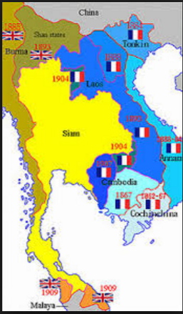

Slide 16
In some parts of their empires, Europeans established settler colonies.
British settled South Africa, Australia and New Zealand
South Africa
Dutch (Boers) there since 1600s
Find diamonds
British come, fight (Boer War), win, takeover
Make it a colony, force natives to work in the mines

Slide 17
II. Imperialism influenced state formation and contraction around the world.
The expansion of U.S. and European influence over Tokugawa Japan led to the emergence of Meiji Japan.
Matthew Perry
The United States and Russia emulated European transoceanic imperialism by expanding their land borders and conquering neighboring territories.
The US and Russia copied what Europeans did in the last unit by taking over lands near and far.

Slide 18
Anti-imperial resistance led to the contraction of the Ottoman Empire.
Balkans and Greeks rebelled due to nationalism.
They had no allegiance to the Ottoman Empire.
Continuing decline led to rise of Young Turks who fought for an independent Turkey.

Slide 19
New states developed on the edges of existing empires.
Southeast Asia in 1900-1920
England has India, Burma, kinda China
US has Philippines
France has French Indochina (Vietnam, Laos, Cambodia)
But, Siam (Thailand) stays independent
b/c king negotiated with England and France to be a buffer between France and England

Slide 20
The development and spread of nationalism as an ideology fostered new communal identities.
Both Italy and Germany unified thanks to Napoleon taking parts of them over
Nationalism grew
Both used to be tons of separate city-states

Slide 21
Italian Unification (1840s)
Napoleon controlled part of north, Spain in the south
Giuseppe Garibaldi (nationalist), got a volunteer army and drove Spain out
Brought country together under one king
Victor Emmanuel

Slide 22
German Unification (1860s)
Holy Roman Empire fell with Peace of Westphalia
Luther led the HRE princes to choose Catholicism or Protestantism
Broke into many small city-states
The Kingdom of Austria controlled much of the city states
Otto Von Bismarck (nationalist) raised an army to oust them
Then started the Franco-Prussian War to take even more land from France
Unified all lands taken to make a new country (Germany)

Slide 23
III. New racial ideologies, especially Social Darwinism, facilitated and justified imperialism.
Social Darwinism said some races weren’t fit to survive and that is why they are behind on the “civilization timeline”
This was used to justify slavery, economic control, political control
Because the non-whites were “sub-human” or at least “sub-white”

Slide 24
Imperialism: Europe in Africa
Europe in Africa
Africa held little interest to Europeans prior to Industrial Revolution
Vast interior unknown to outside world
Because of disease from mosquitos and rivers flowing out into ocean
The steam ship and new treatments for diseases “opened up” central Africa (TECHNOLOGY, YO)
Quinine treats malaria

Slide 25
Scramble for Africa
1880-1910 Europe able to take over “Dark Continent” in “Scramble for Africa”
Almost brought Europe to war
Berlin Conference – 1884-1885 set up rules (not invited? AFR)
By 1910 only Liberia – guaranteed by the US and Ethiopia free
Ethiopia – armed self with modern weapons – drove off Italy

Slide 26
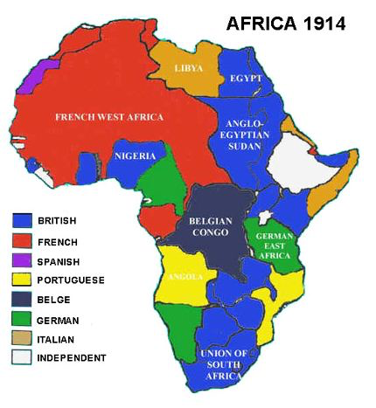
#EuropeanProbz

Slide 27
Before 1880 – 10% of Africa controlled, by 1914 – all but 2 countries
Strong African states resisted foreign domination
Ironically they got the power from Atlantic Slave Trade – weapons

Slide 28
South Africa
Prior to discovery of gold/diamonds – S. Africa only important for shipping/military
a. Dutch arrived first, set up Cape Town as stopping point for ships
b. 1795 British seized Cape Town
S. African Dutch – Boers/Afrikaners moved Northeast where they found diamonds

Slide 29
Boer Wars 1899-1902
British then fought Dutch (Boers) in bloody battles for resources
ENG Wins
All of S. Africa becomes part of British Empire
Natives have no claims – work mines
Boers came in contact with Zulus – most fearsome African enemy
Shaka Zulu in 1816 seized power and united clans
Black Napoleon
Taught how to fight in organized, efficient fashion
Warlike, conquering tribe

Slide 30
Shaka Zulu
any man under his command who showed pain, complained, or dropped his weapon was executed on the spot as a coward.
When a rival tribe defeated by Shaka, he would give them two options – join the Zulu and renounce their native tribe, or receive a catastrophic puncture wound to the brain. Most of his victims took the significantly more appealing option, and, as a result, Shaka Zulu is one of the few military commanders from history who finished a war with a bigger army than he had when he started.
At the time of his death ten years later, he led 40,000 warriors, 250,000 citizens, and claimed two million square miles of territory for his people – arguably the most powerful African empire since Ancient Egypt.
He preferred to charge head-first into battle at the front of his men, decked out in a presumably-awesome-looking uniform made from blue monkey fur

Slide 31
Sure, he made diplomatic contact with the British and established some trade routes, but this guy generally preferred mass executions and public witch burnings (he claimed he could "smell" witches) to anything resembling agrarian reform or due process under the law.
Perhaps the best demonstration of this is how Shaka completely went crazy after his mom died – the distraught ruler ordered a three-month period of mourning for all the Zulu people, in which no one was allowed to eat anything. Then he killed some cows so that the calves would know what it was like to lose a mother, and went around executing 7,000 people who "didn't look sad enough".

Slide 32
South Africa after the Boer War
Became significant British colony
Extensive investment in infrastructure
1910 – colony had its own Constitution
Only white men could vote
1912 – African National Congress organized
Opposed to colonialism and specific S. African policies
Modern era of African history began w/ discovery of diamond deposits in 1870s
Increased exploitation of African labor
White control sharpened racial attitudes already bigoted
Racial segregation in the mines
Laws that restricted African workers
Set precedent for Apartheid laws later

Slide 33
Europe in Egypt
Ottoman Empire ruled Egypt, but didn’t industrialize and was failing
Muhammad Ali takes over and makes in independent/industrial
Works with France to build Suez Canal, borrows money from England to pay for it
Default on debt and England takes over control the canal with France (keeps it until 1956)
Taken back by Egypt by threat of force

Slide 34
Berlin Conference (Berlin Pizza)
1884 – Otto von Bismarck hosted major European power
2. Set up rules for how future colonization and boundaries would be determined
Europeans left Congress in haste – on your mark, get set, go
Within three decades almost entire continent colonized
Positives – added substantial infrastructure – railroads, dams, roads
Negatives
Stripped Africa of its resources
Treated natives harshly
Europeans put in positions of authority

Slide 35
More negatives of the Berlin Conference
Borders based on European political/economic priorities
Not on African history or culture
Tribal lands cut in half between two colonies
Two rival tribes brought together under one rule
Better for Europe – can’t organize opposition
Traditional African culture hurt
European schools
Christian missionaries
Like elsewhere in global colonial – native culture breaks apart
Men forced to work on plantations/in mines
Decreased food supplies for families
Women forced to farm (which they haven't done in centuries)

Slide 36
Imperialism Factors
Economic
Need sources for raw materials
Need a market to sell goods
Military
New weapons mean natives always lose
Machine guns, steam ships, rifles
Need coal stations in the ocean for steam ships to refuel (islands)
Science/Technolgy
Better maps
Steam ships
Treatments for yellow fever, malaria, sleeping sickness

Slide 37
Cultural Factors of Imperialism
Racial superiority
Entitled to conquer and colonize areas that seemed “backward”/”primitives
Cecil Rhodes – Britain/Africa – “I contend that we are the finest race in the world, and the more of it we inhabit, the better it is.”
Social Darwinism (Survival of the fittest applied to humanity) – Herbert Spencer
Why do the white people have awesome buildings and all the money? Because they are more fit to thrive.
That’s why the natives are so poor.
Those technologically/culturally advanced should conqueir others
Duty of Westerners to teach/modernize darker-skinned “primitive” peoples
Rudyard Kipling – “White Man’s Burden”
A bit condescending? Or heartfelt desire to civilize?

Slide 38
White Man’s Burden
Take up the White Man’s burden—
Send forth the best ye breed—
Go send your sons to exile
To serve your captives' need
To wait in heavy harness
On fluttered folk and wild—
Your new-caught, sullen peoples,
Half devil and half child
Take up the White Man’s burden

Slide 39
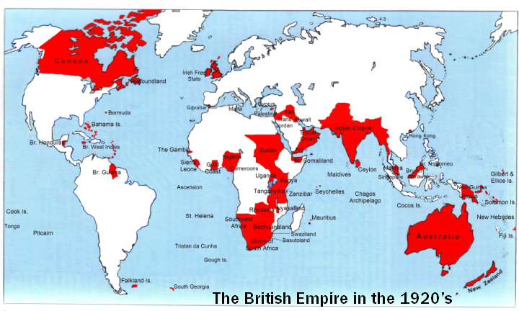
“The Sun Never Sets on the British Empire”

Slide 40
Qing Dynasty (Last Dynasty)
1800 Qing Dynasty at height of power. 100 yrs later, it collapses
Reasons
Pressure from West
Corruption
Pop growth/food shortage
.

Slide 41
Opium War
CHN makes ENG only trade in Guangzhou (GWONG-JO)
ENG imports more from CHN than it exports to it, has to pay w/ silver
AKA imbalance of trade
Frustrated, ENG starts trading opium
.

Slide 42
Grown in IND by BEIC, sent to CHN
CHN gov opposes.
Stops ENG ships and make them surrender Opium. Opium War starts
ENG crushes them.
.

Slide 43
Treaty of Nanjing (1842)
Open 5 cities for ENG trade
Low taxes in ENG goods
CHN pays for war
ENG gets island of Hong Kong (returned in 1997) 99 yr lease
Extraterritoriality – ENG living in CHN don’t have to follow CHN laws
Other Western countries come to trade including Murica
.

