Slide 1
3.1 Federalism Intro

Slide 2
Federalism Intro
Medical marijuana is a clear example of the intricacies of federalism
State says it is okay
Federal gov disagrees
Who wins the argument?

Slide 3
Defining Federalism
Federalism – both national and state govs share power
Only 11 countries use federalism
Most are unitary – one natinal gov has all the power
The third form of gov is a confederation – provinces (states) have the real power and the national gov is really weak
AoC was this, also the UN and the European Union
Intergovrnmental relations – the working between the fed and state govs

Slide 4
The Constitutional Basis for Federalism
The word isn’t in the Cons
But the Framers gave states a lot of responsibility in the Cons
Elections/voting
Fed can’t change states or add new ones w/o state consent
Each state gets two senators no matter what
Fed can’t tax interstate imports

Slide 5
Things states can’t do
Tax imports/exports
Coin money
Grant titles of nobility
Permit slavery
Deny due process (right for everyone to be treated the same by the gov)
Make a military
Declare war
Enter into treaties

Slide 6
Things both the national and state govs do
Make courts
Maintain law and order
Protect health and safety
Regulate the economy
Raise taxes, borrow money, spend money

Slide 7
National Supremacy
SUPREMACY CLAUSE – part of the cons that says the Cons is the supreme law of the land
Then the federal gov
Then treaties made by the federal gov
Then the state govs
No Child Left Behind
Before, education was up to the states
Now the federal gov has taken some of those powers away
Same with healthcare
Affordable Care Act (Obamacare) is a federal program

Slide 8
How has federalism changed over the years?
AS TIME HAS GONE BY, THE FEDERAL GOV HAS GAINED MORE POWER OVER THE STATES
BIG DEAL!!!!
B/c of the Civil War and Civil Rights

Slide 9
The Civil War
Southern states thought the federal gov couldn’t tell them they couldn’t have slaves
That’s why they call this a “states’ rights” issue
During and after the Civil War, southerns tried to use the “Nullification Argument” saying that states could overrule federal laws that they thought were unconstitutional
That didn’t turn out so well

Slide 10
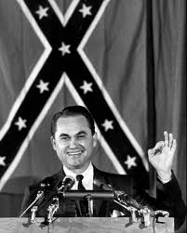
The Struggle for Racial Equality
For 100 years after the Civil War, southern states successfully denied rights to black people
Said “separate but equal” even though the 14th Amendment said all citizens are equal under the law of the Cons
1950s/60s saw Brown v. Board
Separate is not equal
Black and white students must
have the same education
Governor George Wallace stinks

Slide 11
The Tenth Amendment
“the powers not delegated to the United States (fed gov) by the Cons, nor prohibited to the states are reserved to the states or to the people”
Says that the federal government is the most power, what they don’t forbid, the states can have and what they states don’t forbid, the people can have.
Today, SCOTUS has flopped in the wind on the 10th Amendment. They stink.

Slide 12
3.1 Quiz A
States from which part of the country have been most interested in states’ rights regarding slavery and discrimination?
Which court case said that school segregation was unconstitutional?
Which two levels of government share power in federalism?

Slide 13
3.1 Quiz B
What did George Wallace do at the University of Alabama when the federal government forced it to integrate?
What part of the Cons says that the national government is the most important government and it has power above the states?
What type of government is set up as one national government with all the power?

Slide 14
10th/11th and States’ Obligations in Federalism

Slide 15
The Tenth Amendment
“the powers not delegated to the United States (fed gov) by the Cons, nor prohibited to the states are reserved to the states or to the people”
Says that the federal government is the most power, what they don’t forbid, the states can have and what they states don’t forbid, the people can have.
Today, SCOTUS has flopped in the wind on the 10th Amendment. They stink.

Slide 16
11th Amendment
“Federal courts can order the state govs to obey the Constitution or federal laws, but they are immune to some lawsuits” (what you really need to know here)
States are immune to certain lawsuits
Citizens suing states requiring monetary compensation
Exceptions to 11th Amendment immunity
Racial discrimination (14th Amendment)
Bankruptcy cases
Doesn’t really protect local govs
They can be sued for violating any citizen’s rights

Slide 17
Implied Powers/McCulloch
McCulloch v. Maryland
Federal Gov put the “Second National Bank” in Baltimore
Maryland passed a law taxing the bank
McCulloch (bank representative) sued Maryland saying “you can’t tax your dad”
McCulloch wins

Slide 18
Why McCulloch Matters
National supremacy (Federal gov always wins when going against the states) (in the Supremacy Clause of the Cons, btw)
National Gov has implied powers (powers that go beyond what are written in the Cons)
Not just Enumerated Powers (numbered or listed powers in the Cons)
Cons doesn’t say they can make a bank, but they can do things “necessary and proper” to keep America running
(Elastic Clause) it can stretch

Slide 19
Commerce Power
The power to regulate commerce is the most important power of Congress
They stretched the meaning of “interstate commerce” to allow them to control almost anything
If something is transported on an interstate, or made using parts from another state, or washed using water from another state, or money is used for it (that was in another state) Congress can regulate it.

Slide 20
Gibbons v. Ogden and the Commerce Clause
Gibbons had a federal permit to run a ferry from NJ to NY
Ogden had a permit from NY state that said only he could ferry people on the water
Gibbons sues Ogden arguing that his permit trumped Gibbons’ b/c it was federal (AKA the Supremacy Clause)
SCOTUS said Gibbons was right b/c Congress can regulate interstate commerce and is supreme over state laws

Slide 21
Commerce Clause and Civil Rights
Congress used the Commerce Clause to force southern businesses to serve African Americans
Does your hotel take money? Then it must adhere to the Civil Rights Act of 1964. We can shut you down because you are violating interstate commerce.
Heart of Atlanta Motel v. US
Commerce Clause forced them to allow African Americans to stay there
Perfect example of the intricacies of federalism

Slide 22
Commerce Clause is not Absolute
More conservative courts in the past 20 years have reigned in the power of Congress via the Commerce Clause
Regulating gun laws and healthcare

Slide 23
States’ Obligations to Each Other
Federalism includes how states interact with each other
Constitution outlines the interactions regarding:
Full Faith and Credit
Extradition
Privileges and Immunities

Slide 24
Full Faith and Credit
Each state must give full faith and credit to decisions made by other states
Marriages, driver’s licenses, birth certificates, loans, credit scores
Example of the power of the federal government after the AoC

Slide 25
Gay marriage and full faith and credit
Defense of Marriage Act (DOMA) by Clinton in the 90s made gay marriage exempt from full faith and credit
Until 2015, it was up in the air
Now, it is a civil right that no state can deny says SCOTUS

Slide 26
Extradition
Federal gov says states must return criminals caught in their state to the state where they broke the law or “extradite” them
Makes it so a criminal can’t just go to another state when they break a law

Slide 27
Privileges and Immunities
When you are in a state that is not your home, you get treated the same as state citizens
You have to pay sales tax, police will help you
Exceptions to the rule
Voting
Out-of-state tuition
Questions about welfare for new state residents
Don’t have to wait a year

Slide 28
3.2 Quiz A
What is the opposite of enumerated powers?
What is another name for the elastic clause? Hint: it is the _________ and proper clause.
Which court case led SCOTUS to broadly define what the word “commerce” means?

Slide 29
3.2 Quiz B
What term refers to the fact that each state must recognize other states’ public acts, records and judicial proceedings?
Gibbons v. Ogden showed the power of the federal government in regards to its ___________ power.
McCulloch v. Maryland was all about how the federal government tried to create a national _______ and put it on Maryland’s land.

Slide 30
3.3 Intergovernmental Relations 84-94
Sounds like a hoot!

Slide 31
2 Major Changes in Intergovernmental Relations Today
The shift toward the dominance of the federal gov over the state govs
The rise of fiscal federalism (how the federal gov controls the state govs by attaching strings to the money it gives them)
IS FISCAL FEDERALISM A BIG DEAL????
YOU BET YOUR BUNS IT IS!!!!!!!

Slide 32
From Dual to Cooperative Federalism
Two major ways power is divided between states and the federal gov:
Dual Federalism – both stay separated and control their own things. Fed = post office, military. State = schools, roads
Like a layer cake (frosting separates them)
Cooperative Federalism – both levels share responsibilities
Like a marble cake (both cakes mixed together)
Department of Homeland Security – a mix of state, local and federal law enforcement/military

Slide 33
From Dual to Cooperative Federalism
We started as dual federalism (layer cake), but now we are more cooperative federalism (marble cake)
Examples of the move toward cooperative federalism
Schools get money from federal gov now
Universities built on land from federal gov
No Child Left Behind – funding from federal gov if standards are met
Federal grants for college students
Interstates in the 1950s – federal and state govs share the cost

Slide 34
From Dual to Cooperative Federalism
Aspects of cooperative federalism:
Shared cost – to get fed money, states must pay for part of the project
Federal guidelines – states must agree to the “strings attached” to get fed money
Shared administration – states do most of the administration (implementation) of the policies

Slide 35
How MADD = Federalism
Mothers Against Drunk Driving
Lobbied Congress to pass a law that would let the fed gov withold highway funds to states if they didn’t raise the drinking age
Now its 21 in every state
Even Mississippi.

Slide 36
Devolution
Dems want the fed gov to have more power to help those in need
Education, healthcare
Reps want the fed gov to do less and leave that up to the states
See fed power as higher taxes for them
In the 80s, Reagan started devolution (the moving of responsibilities from the fed to the state)
Since then, some policies have began to grow fed power again
NCLB – put fed gov power in education

Slide 37
Fiscal Federalism
Fiscal = money
Fiscal federalism – fed gov attaches strings to “grants in aid” to states to make them do what they want. If they don’t follow the rules, they don’t get the MOOLAH!
Federal grants make up ¼ or all the money spent by state and local govs
17% of all federal spending goes to grants for state/local govs

Slide 38
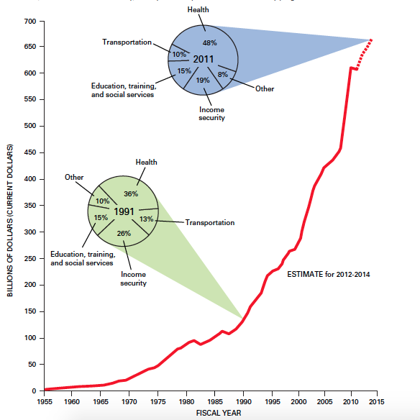

Slide 39
The Grant System
2 Types: Categorical grants and block grants
Categorical grants – for specific purposes (strings attached)
Common
Strings are usually about nondiscrimination, environment, labor laws
Crosscutting requirements – if you break one rule, your money for all fed money is gone, buster.

Slide 40
The Grant System
Block grants – can spend on anything
More rare
Used for community development, food programs, housing, employment

Slide 41
The Scramble for Federal Dollars
All states and many cities pay lobbyists to stay in DC and try to get them as much money as possible
“Bring home the bacon”
Congress fighting for bacon makes it spread well among all states, but not everyone who needs help gets it
Example: Chapter 1 funds. Put aside for poor children to learn better, but used in 95% of schools.
Why? Because it is a cash grab for votes.

Slide 42
The Mandate Blues
Mandate (mandatory) – you have to do it
Medicaid – health insurance for the poor
States paid part, fed gov paid the biggest part
Fed gov expanded it, and the states had to pay more
If they didn’t pay more, they would lose healthcare for their poor
See how this is the fed gov basically controlling the state?

Slide 43
Unfunded Mandates
Fed gov makes a mandate, but doesn’t provide money for a state to do it
Examples:
Americans with Disabilities Act (1990s)
All gov buildings must be handicapped accessible
But no funds were provided to pay for the remodeling
Clean Air Act (1970s)
States must control the air emissions by citizens and companies
But no funds were provided to pay for the testing/enforcement

Slide 44
Housing Mandates
States must build one new house for every one it demolishes
Because they don’t have funds to build a new house, they keep the poor living in sub-standard houses

Slide 45
Quiz 3.3 A
Block grants and ________ grants are the two major types of grants.
List one program/policy that was an unfunded mandate.
These types of requirement says that if an organization violates a rule in one program, it may lose federal aid for all of its programs.

Slide 46
Quiz 3.3 B
Categorical grants and ________ grants are the two major types of grants.
Which term refers to the move away from the federal government having a lot of power and toward more power and responsibilities being on the states?
What term means something that the federal government makes the state or local government do?

Slide 47
3.4 Diversity in Policy and Understanding Federalism
94-100

Slide 48
Diversity in Policy
Different states have different policy
Texas likes the death penalty…because they are Texas
Policy innovation comes from states (policy laboratories)
Environmental, health care, civil rights
All got their starts in states before they went national
Policy is based on the funds a state has
Vermont spends $3 for education for every $1 spent by Arizona

Slide 49
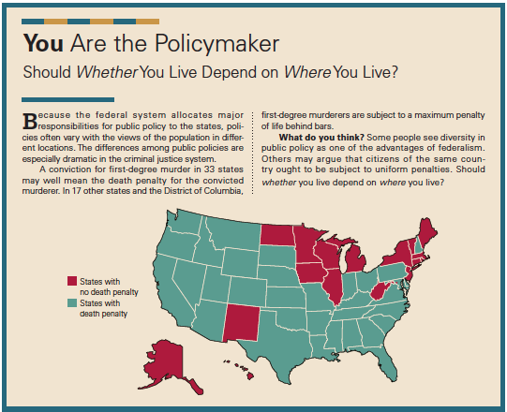

Slide 50
Understanding Federalism
Horizontal checks and balances – among the three branches of the federal government
Vertical checks and balances – between the federal and the state governments

Slide 51
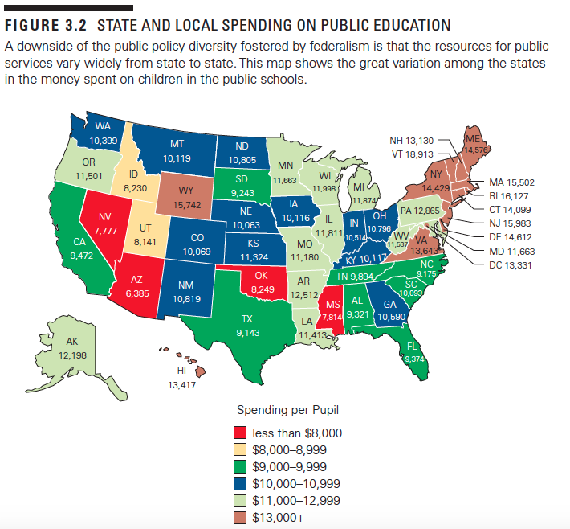

Slide 52
Federalism and Democracy: Pros
If democracy means gov representing the wants of the ppl, then federalism does lead to more democracy
Representatives aren't for the whole country, but for individual states/districts in states
They are then more representative of the ppl
More levels of gov means more opportunities to participate in gov
Civil Rights advocates petitioned the fed gov when states wouldn’t help
Business advocates can get more done in individual states than at the fed level

Slide 53
Federalism and Democracy: Cons
A popular vote for prez would not be federalistic b/c it doesn’t involve the states
Instead we have the (stupid) electoral college system that is 51 popular elections at the state level
#AlGoreProbz in the 2000 election
Also problematic in who really had the say to end segregation in the 60s. States of Fed?
We also have around 90,000 govs in the US
This confuses people when they are trying to get help or be represented

Slide 54
Federalism and the Scope of the National Government
Scope = how much power the gov has
When it comes to big problems, people turn to the fed gov.
Economics
Reagan curbing imports of Japanese cars
Bush loaning money to airlines so they don’t go bankrupt
1900s monopoly busters
The fed gov now spends much more money than the states do
$=power

Slide 55
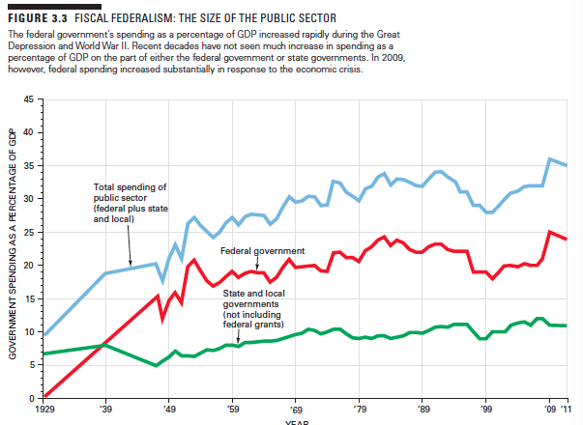

Slide 56
Scope of Federal Gov in Regards to Spending
States did more spending until the 1980s
Devolution: In the 1980s, Reagan shifted power/spending from the fed to the state govs
Since then, the fed gov has gained more power
No Child Left Behind (education)
Affordable Care Act (healthcare)

Slide 57
Quiz 3.4 A
Does the state or the federal government decide how much money is spent on education by each state?
In general, federalism has made government in America _________ democratic.
Federalism has generally __________ the scope of the federal government.

Slide 58
3.4 Quiz B
Is administering the death penalty a state level decision or a federal level decision?
What is one way the federal government has stepped in regarding economic/business issues?
There are an estimated _________ governments in the US today.
890
8,900
89,000
890,000

