Slide 1
Lesson 1.1
Strayer LI – LVIII

Slide 2
Periodization: How historians create time periods
Period 1 = 8000 BCE to 600 BCE
8000 BCE = Agricultural Revolution (when we start to farm)
600 BCE = large regional empires (Greece, Rome, China)
Marker events = big things that change the way of life for people
Places we can divide up history into chunks

Slide 3
Preface
Most cultures have “creation stories”
They help people have purpose
Modern cultures use science
More about how things began than “why”

Slide 4
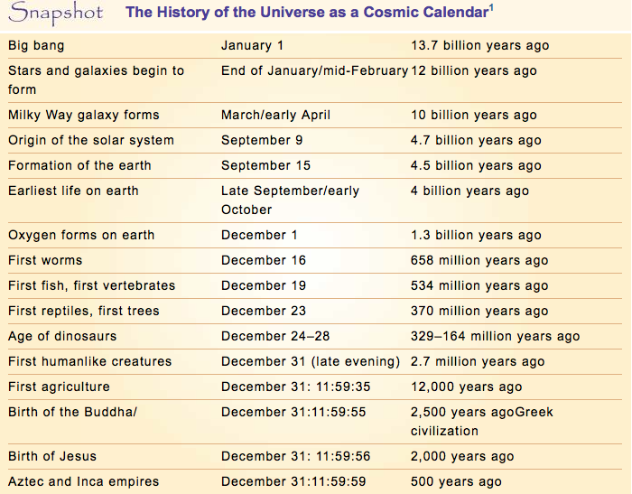

Slide 5
From Cosmos available on Netflix and probably Youtube 27:30 – 29:30, 34:40 – 40:18

Slide 6
How does the cosmic calendar put time into perspective?

Slide 7
Cosmic History (January 1st – September 15th)
Big Bang – large unexplained explosion
15 billion years ago
Gravity brings particles together to form stars, planets
Earth is formed on September 15th (4 billion years ago) from leftovers from the sun
Dark matter – 90% of the mass of the universe
Invisible to the human eye
Really freaky

Slide 8
The size of the universe
Can make us feel insignificant
“This little globe, nothing more than a point, rolls in space like so many other globes; we are lost in this immensity.” – Voltaire (1700s French Philosopher)

Slide 9
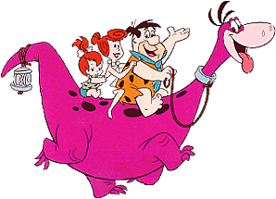
Planetary History
Life stays microscopic for 3 billion years
Dinosaurs were alive for about 5 days on the cosmic calendar
Humans in the last few minutes of December 31st
Never coexisted with Dinosaurs

Slide 10
AP Covers only 10,000 Years
8,000 BCE to 2017 CE
Last minute of the cosmic year

Slide 11
“Humankind has had a career more remarkable and arguably more consequential for the planet than any other species.”
Learning and language have led humans to come to power via tools (technology)

Slide 12
World History in a Paragraph
Based on what tools we used/how we lived our lives
Paleolithic (old stone age) 95% of our existence
Stone tools
Hunter gatherers
Neolithic (new stone age)
Farming/agriculture
Industrial (modern age)
Factory work

Slide 13
New World History
Old focus was country by country
US studies US, England studied England
Was very ethnocentric
Ethno – culture
Centric – centered
Thinking your own culture is best
Was very Eurocentric
New world history is global
Try very hard not to be Eurocentric
Three Cs
Comparison, connection, and change

Slide 14
Lesson 1.2 Peopling of the Earth
Strayer 11-20

Slide 15
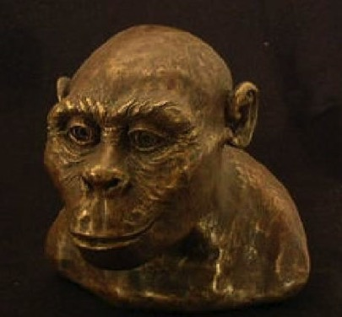
Here’s Lucy. Aint she beautiful?
Lesson 1.2
Let’s put some skin on them bones!

Slide 16
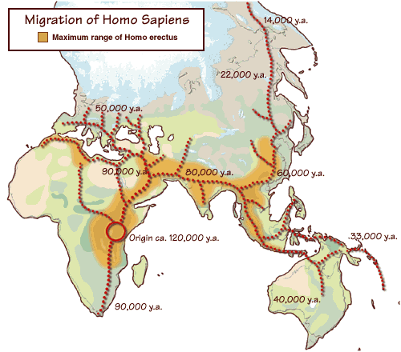
3. Where did Homo sapiens sapiens first emerge?
In the grasslands of Eastern and Southern Africa
(Original: p. 12;
With Sources: p. 12)

Slide 17
4. How were settlements in Africa planned?
Settlements were planned around the seasonal movement of game and fish.
(Original: p. 13; With Sources: p. 13)

Slide 18
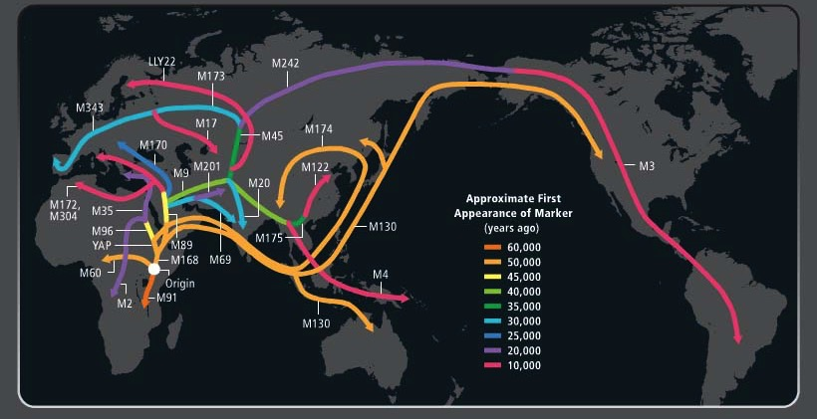
Tracking the Y Chromosome

Slide 19
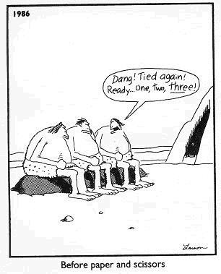
6. What tools were used during the Paleolithic era?
Spears, bows, arrows, clubs, stone axe, fire

Slide 20
6a. What was society like in the Paleolithic Era?
Small groups or bands, usually based on family relationships
Small and limited exchanges of ideas and goods

Slide 21
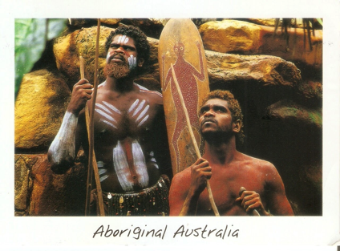
7. Who were the Aborigines?
From East Africa and Madagascar
Took boats to Australia about 40,000 years ago
Via some stops on coastal Asia
Super-rad Dreamtimers
Hallucinogenic drugs
Spirit world
“the upside down?”

Slide 22
8. What were religions like in the Paleolithic Era?
Animistic (animate) – spirits in non-living objects
Rivers, trees, rocks
Ceremonial burial sites – show concern for afterlife, dead left with objects to take on with them in graves
Small statues of god-like figures found

Slide 23
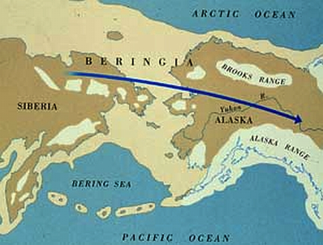
10. What was the route of migration into North America?
From Eastern Siberia, by land across the Bering Strait or by sea down the west coast of North America
(Original: p. 18; With Sources: p. 18)

Slide 24
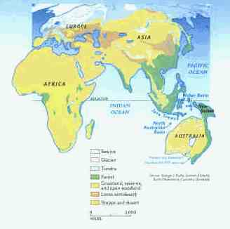

Slide 25
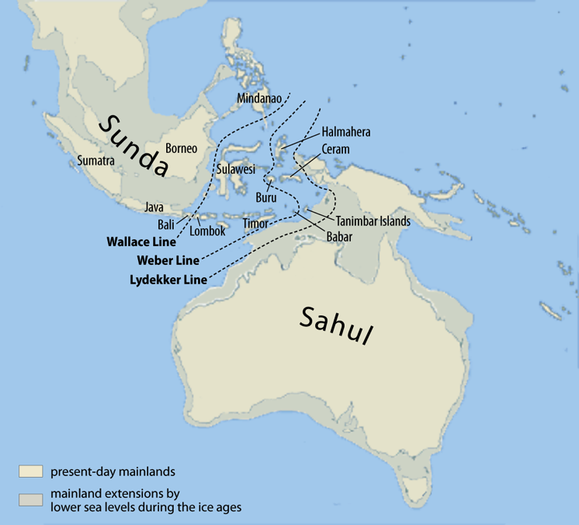

Slide 26
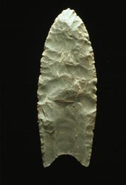
11. What does the wide distribution of Clovis technology suggest?
Arrowheads (Clovis points) were found across a large area.
(Original: p. 18; With Sources: p. 18)

Slide 27
12. How did Austronesian (Australia and Indonesia) migrations differ from other early patterns of human movement?
They occurred quite recently, beginning only about 3,500 years ago.
They were waterborne migrations, making use of oceangoing canoes and remarkable navigational skills.
Unlike other migrations, they were undertaken by people with an agricultural technology who carried both domesticate plants and animals in their canoes.
(Original: p. 19; With Sources: p. 19)

Slide 28
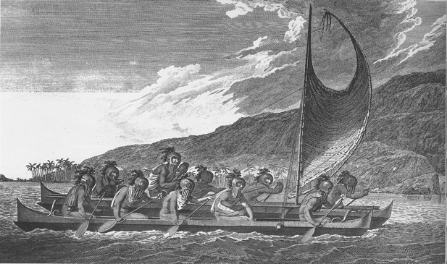
Austronesian Migrations

Slide 29
13. In what ways did a gathering and hunting economy shape other aspects of Paleolithic societies?
THIS IS A BIG DEAL SLIDE!
Because hunting and gathering didn’t allow for the accumulation of much surplus, Paleolithic societies were highly egalitarian, lacking the inequalities of wealth and power found in later agricultural and urban life.
Paleolithic societies also lacked specialists, with most people possessing the same set of skills, although male and female tasks often differed sharply.
Relationships between women and men were usually far more equal than in later societies. This was in part the result of gathering women bringing in more of the food consumed by the family than hunting men.
(Original: pp. 20-21; With Sources: p. 20-21)

Slide 30
Lesson 1.3 Paleolithic Societies
Strayer 20-24 and 31-32

Slide 31
Characterize Paleolithic Societies
Genders more equal
Women gathered 80% of the food
Less to no social stratification
Still were leaders
Less war
More leisure time
“the original affluent society” b/c they “needed so little”
More sharing
“Primitive communism” – Karl Marx

Slide 32
James Cook on Aborigines
“They live in a Tranquillity which is not disturb’d by the Inequality of Conditions: The Earth and sea of their own accord furnishes them with all things necessary for life, they covet not Magnificient houses, Household-stuff. . . . In short they seem’d to set no value upon any thing we gave them. . . .They think themselves provided with all the necessarys of Life.”

Slide 33
15. In what ways did Paleolithic people alter the natural environment?
They deliberately set fires to encourage the growth of particular plants.
Ashes gave nutrients to the soil.
(Original: p. 22; With Sources: p. 22)

Slide 34
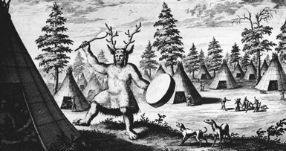
15.A Characterize Paleolithic Religions
Animistic – “spirits” in inanimate objects
Rivers, trees
Ancestor worship
Polytheistic
Shamanistic – shamans could go between spirit world and physical world

Slide 35
16. What does the presence of Venus figurines across Europe suggest?
Some scholars believe that Paleolithic religious thought had a strongly feminine dimension, embodied in a Great Goddess and concerned with the regeneration and renewal of life.
Female goddesses could mean that women were held in a higher regard than in classical civilizations.
(Original: p. 22; With Sources: p. 22)

Slide 36
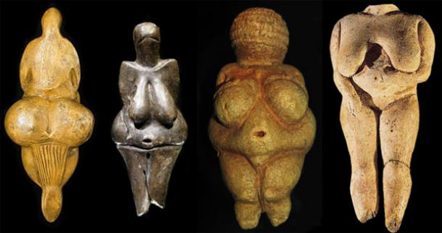
Venus Figures

Slide 37
17.Why did some Paleolithic peoples abandon earlier, more nomadic ways and begin to live more settled lives?
As the world came out of the last ice age, climatic warming allowed many plants and animals, upon which humans relied, to flourish.
The increased food stocks allowed some groups of humans to settle down and live in more permanent settlements.
(Original: pp. 23-24; With Sources: p. 23-24)

Slide 38
Last Ice Age: 10k-15k Years Ago

Slide 39
Paleolithic Rock Art
Found in many places from the Paleolithic era.
Usually paintings of large animals.
Perhaps spirit-based in hopes that painting them would make the animals return for hunting.
Lascaux (los-COE), France is most known.
Sulawesi (sul-uh-WAY-si), Indonesia was discovered in 2014 to be the oldest. (40,000 years old)

Slide 40
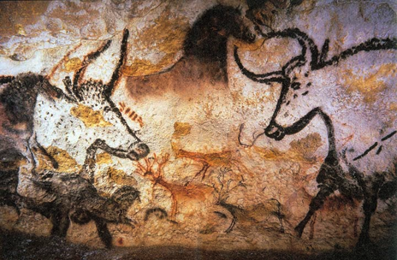
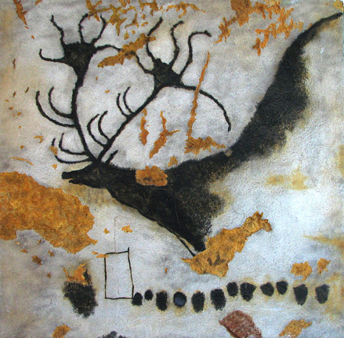
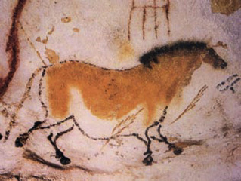
Cave Paintings from Lascaux

Slide 41
Lesson 2.1
Strayer 49-56

Slide 42
1a. Basics about the time between hunter/gatherers and “civilizations”
“Stepping stone” societies
Began about 8000BCE after the last Ice Age
The world was warming up and people could move around more to find better land
Better land = more stable food supply
More food = larger populations
Bigger populations = the beginnings of problems we will see in “civilizations”
Slavery
Patriarchy
Elitism
Disease
War

Slide 43
1. What were the revolutionary transformations brought about by the Neolithic or Agricultural Revolution?
Neolithic = new stone aka metals
We used those new stones to farm and kill people
Growing populations, settled villages, animal-borne diseases, horse-drawn chariot warfare, cities, states, empires, civilizations, writing, literature and more
IN A NUTSHELL, WE BECAME MORE COMPLEX
(Original: p. 36; With Sources: p. 50)

Slide 44
1a. The Neolithic Revolution is the most important event in human history.
Second great human process after settlement of the globe
When people have farms and permanent settlements (food and protection), they start to think…
Why am I here? (religion)
What rules should we live by? (government)
Can I trade my crops for some fur? (economy)
What is beauty? (art)
“People who quote themselves are lame.” – Mr. Brock
“When the food and security is taken care of, cultures began to flourish.” – Mr. Brock

Slide 45
1b. Domestication
Domesticate – “dome/domicile” = home
To tame or make for the home
Plants – breeding for mass production
Known as ‘genetic engerneering
Animals – breeding and taming for herds
Keep in fences

Slide 46
2. What was the importance of “intensification” in the Neolithic Age?
It meant getting more for less, in this case more food resources—far more—from a much smaller area of land than was possible with a gathering and hunting technology.
More food meant more people.
Growing populations in turn required an even greater need for the intensive exploitation of the environment.
(Original: p. 37; With Sources: p. 51)

Slide 47
1c Early Ag Societies Basics
Started due to the warming after the last Ice Age
8,000 BCE ish
Some ppl became ag based, some became pastoral
Ag impacted the environment
Moving of crops from one place to another
Clearing large pieces of land for farming
Growing some crops and killing out others
Irrigation (moving water)
Terrace farming
Domesticated animals were used for ag work

Slide 48
Terrace Farming

Slide 49
3. What accounts for the emergence of agriculture after countless millennia of human life without it?
Warmer, wetter, and more stable conditions thanks to the end of the last Ice Age.
Wild plants
Cereal grasses (rice, wheat, corn)
New knowledge and technology led to more productive crop yields.
Growing populations led to more food production and storing.
Happened in a lot of different places around the same time.
Aliens????
(Original: pp. 37-38; With Sources: pp. 51-52)

Slide 50
3a Where did the Neolithic Revolution happen?
Lots of places at around the same time (10,000-14,000 years ago)
China (Yellow “Huang Ho” River)
Egypt (Nile River)
Fertile Crescent (Iraq) (Tigris and Euphrates Rivers)
New Guinea
Mesoamerica
Andes

Slide 51
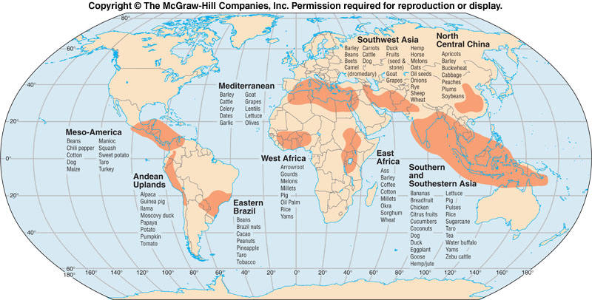

Slide 52
4. How do we know women were probably responsible for the Neolithic Revolution?
In hunter-gatherer times, they controlled the plants, men dealt w/ animals
Probably learned farming from seeds dropping on the ground

Slide 53
7. Why did the peoples of America lack sources of protein, manure, and power to pull carts?
Corn sucks
North/south orientation made crop transplanting hard
There was an absence of animals that could be domesticated.
14 large domesticated animal species in the world and Americas only had one, the stupid llama.
No cattle, goats, sheep, pigs
Bad times
(Original: p. 41; With Sources: p. 55)

Slide 54
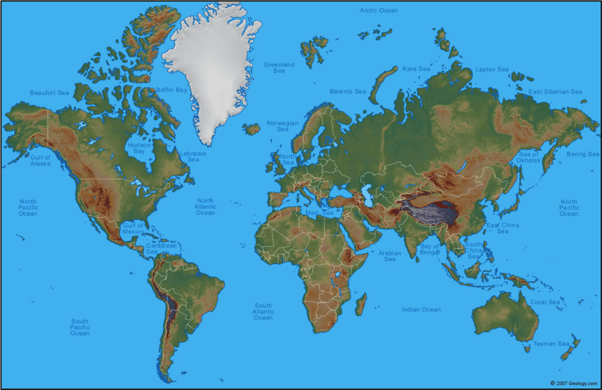
Orientation of Americas v. Afroeurasia

Slide 55
8. In what ways did agriculture spread?
Through diffusion and colonization
Diffusion – spread of ideas through interactions with “outsiders”
Colonization – people moving to new lands
Conquest, absorption
YOU SHOULD KNOW BOTH OF THESE TERMS, YO.
(Original: p. 42; With Sources: p. 56)

Slide 56
Lesson 2.2 Societies of Early Agriculture
Strayer 56-67

Slide 57
Describe the development of agricultural societies in the southern half of he African continent beginning around 3,000 B.C.E.
Starting in Nigeria (North Central Africa) Bantu-speaking people moved east and south over
Spread their language, ag and husbandry skills and iron-working
Bantu language is a commonality among many people in southern Africa today
***One of the major migrations you need to know about
(Original: p. 46; With Sources: p. 60)

Slide 58
Early Agricultural Societies
Status based on lineage (family line)
Also was the gov
Could be used to stratify or rank people in “lesser” families
Sometimes called “stateless societies”

Slide 59
Catalhuyuk
No streets, walked on rooftops
Buried dead in houses, then built on top of them
Thousands of ppl
Little social or gender stratification

Slide 60
Chiefdoms
Got power from charisma or giving gifts
Then passed it down through lineage
Early leaders of hunts or irrigation became chiefs
Maybe a natural process?
Held gov and religious power

Slide 61
Cahokia (near St. Louis)

Slide 62
10. Where was agriculture sometimes resisted? Why?
Either places with bad land or where people didn’t need to farm.
Some hunter\gatherers liked the freer life as compared to the hard life of farming
Like, hippies, maaaan.
(Original: p. 46;
With Sources: p. 60)

Slide 63
11. What was the impact on the environment from farmers and herders?
They changed the ecosystem
In the Middle East, just 1,000 years of farming destroyed the land with soil erosion and deforestation
That land was abandoned
(Original: p. 48; With Sources: p. 62)

Slide 64
10a. When did most Paleolithic societies die out?
By 1CE

Slide 65
12. How were pastoral societies different from early agricultural societies?
Pastoral Societies:
Think of pastures
Where farming was difficult
Depended on animals to survive
Sheep, goats, cattle, camels
AKA Herders, pastoralists, nomads
Mainly in Central Asia, Arabian Peninsula and Sahara
Very mobile
Clan/tribe based

Slide 66
More about Pastoral Societies
Developed more in Afroeurasia
Still some pastoralists around today
Overgrazing – when they allowed their animals to graze so much that the grass wouldn’t grow back
An example of the environmental impact of pastoral societies
Pastoral societies engaged in more cultural diffusion than other society types
Because they are more mobile

Slide 67
14. The use of metals in early societies
Earliest pre-civilization metals were not used for tools
They were used because they looked cool
Aesthetically pleasing
We found at burial sites far away from their origin
Having metals meant you were of a higher status
Copper was mined and could be hammered to become as hard as steel
It was used for tools like knives and sickles
Later, we will see bronze and iron and steel in BCE
Metallurgy – working with metals
Usually associated with “smelting” (melting metals down to get the more pure parts out of them)

Slide 68
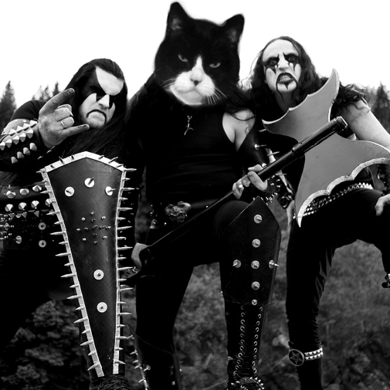
14a. Very metal societies
Lydians (modern Turkey)
First to use metal coins
Hittites (modern Iraq)
First to use metal for weapons

Slide 69
Lesson 3.1 First Civilizations
Strayer 85-94

Slide 70
1. How were the new civilizations different from the earlier agricultural villages, pastoral societies, and chiefdoms?
Surplus of food which leads to a specialization of labor
Shoe makers, magicians, barbers
Before, the only job available was the “get the food” job
Larger populations
Because of the abundance of food
More food, more sex, more babies
City states with power based on coercion (force)
To control the food

Slide 71
Wealth inequality
An upper-class and peasants
Because some people have more and better food
Armies
To get more land to grow food, or to protect our food land
Long-distance trade
For stuff, often rad food
Writing system (sometimes)
To keep record of trade which was mostly food
(Original: p. 56; With Sources: p. 86)

Slide 72
2. Where and when did the first civilizations emerge?
The Six
Sumer in Mesopotamia, by 3,000 b.c.e.
Egypt in the Nile River Valley, by 3,000 b.c.e.
Norte Chico along the coast of central Peru, by 3,000 b.c.e.
Indus Valley civilization in the Indus and Saraswati River valleys of present day Pakistan, by 2,000 b.c.e.
China, by 2,200 b.c.e.
The Olmec along the coast of the Gulf of Mexico near present day Veracruz in southern Mexico, around 1,200 b.c.e.
(Original: p. 56-60; With Sources: pp. 86-91)

Slide 73
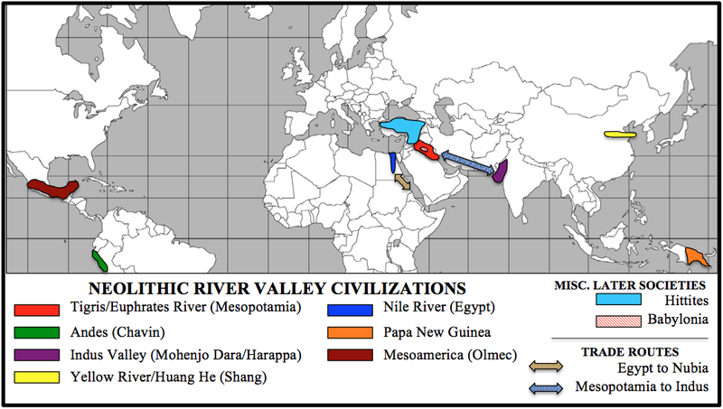

Slide 74
3. What was unique about each of the initial six civilizations?
Sumer—world’s earliest written language; city-states; temples
Egypt—pharaohs and pyramids; a unified territorial state unlike Sumer
Chavin—monumental architecture in the form of earthen platform mounds; quipu for recordkeeping/accounting purposes; self-contained civilization
Ancestors to the Inca

Slide 75
Indus Valley—elaborately planned cities; standardized weights and measures; little indication of a political hierarchy or centralized state
This was before the Caste System
China—Shang and Zhou dynasties
They get their own slides
Olmecs—; colossal basalt heads weighing twenty tons or more; mound building; artistic styles; urban planning; a game played with a rubber ball; ritual sacrifice; and bloodletting by rulers.
Ancestors to the Aztec
(Original: p. 56-61; With Sources: pp. 86-91)

Slide 76
3a. Everything you need to know about China in Unit 1

Slide 77
The Chinese Dynasties Song
Shang, Zhou (Joe), Qin (Chin), Han
Sui (Sway), Tang, Song
Yuan, Ming, Qing (Ching), Republic
Mao Zedong, De!

Slide 78
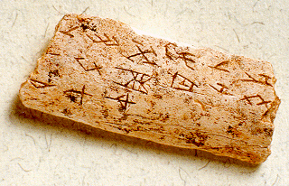
Shang (1523-1028 BCE)
First dynasty
May have been earlier dynasties
This is debated
Cultivated silk worms
Used coined money
Oracle bones
Earliest written Chinese language
Etched into bones, turtle shells, thrown in fires
Cracks read to tell the future

Slide 79
Zhou (1027-256 BCE)
Pronounced “Joe”
Mandate of Heaven
The idea that if the rulers are fair, the gods will allow them to keep ruling
If they are not fair, the gods will bring an end to their dynasty
Perhaps a justification for the takeover of the Shang Dynasty
Birth of Confucianism and Taoism
More on these later

Slide 80
4. What explanations are given for the rise of civilizations?
Come from chiefdoms
An agricultural society ruled by a chief
Power comes from person who organizes irrigation, war, or trade
Special groups get special treatment
(Original: pp. 61-62; With Sources: pp. 91-92)

Slide 81
5a. What is a state?
State really just means country
There are two “first states”
Mesopotamia and Egypt
To be a state you have to be
Big – much bigger than just a small society
Powerful – control a lot of food and resources
Military-based – have an army to defend yourself and, more importantly, take other peoples’ stuff
Ruled by a leader who is divine – chosen by god

Slide 82
6. What was the role of cities in the early civilizations?
political and administrative centers
centers of culture including art, architecture, literature, ritual, and ceremony
marketplaces for both local and long-distance exchange
centers of manufacturing activity
(Original: p. 63; With Sources: p. 94)

Slide 83
7. In what ways was social inequality expressed in early civilizations?
wealth
avoidance of physical labor by the elite
clothing
houses
manner of burial
class-specific treatment in legal codes
Hammurabi
How is American social inequality expressed today?
(Original: pp. 64-65; With Sources: pp. 94-95)

Slide 84
3.2 First Patriarchy/Slavery/Law Code
Strayer 94-98

Slide 85
7a. Tell me more about the Ham Code.
Code of Hammurabi
From Babylonia/Babylon (Mesopotamia)
Eye for an eye
Shows how states used legal codes to rule over people
Strict punishments kept ppl in line
Fear of getting in trouble
Shows how legal codes reflected existing hierarchies
Rich punished less than poor for the same crimes
Class inequality!
Husband can drown wife for sleeping with another man
Totally cool for husband to sleep with servants
Patriarchy!

Slide 86
8. What is urban planning? Give examples from 8000 BCE to 600 BCE.
Urban planning – large-scale infrastructure projects
Examples:
Ziggurats
step pyramids in Mesopotamia
Pyramids
pyramid pyramids in Egypt
Grid street system in Indus River Valley
Sewage system in Indus River Valley

Slide 87
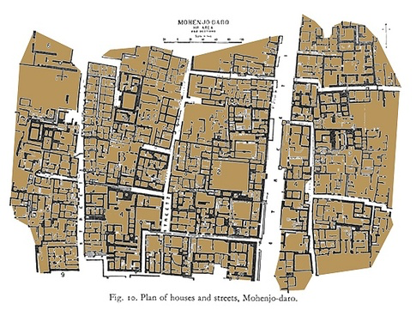

Slide 88
9. Describe slavery in all of the First Civilizations.
Slaves-derived from prisoners of war, criminals, and debtors—were available for sale; for work in the fields, mines, homes, and shops of their owner; or on occasion for sacrifice.
From the days of the earliest civilizations until the nineteenth century, the practice of “people owning people” has been an enduring feature of state-based societies everywhere. (Original: p. 65; With Sources: p. 95)

Slide 89
10. Compare the practice of slavery in ancient times from region to region.
Egypt and the Indus Valley civilizations initially had far fewer slaves than did Mesopotamia, which was highly militarized.
Different from today
many children of slaves could become free people, and slavery was not associated primarily with “blackness” or with Africa.
(Original: pp. 65-66; With Sources: 95-96)

Slide 90
10a What is patriarchy?
Patri – father/male
Archy – ruled by
Patriarchy is a society where the male is the dominant gender
They usually control government, economics, religion and the culture as a whole
Patriarchy has its roots in the Neolithic Revolution, and most historians say it is alive and well today

Slide 91
11. In what ways have historians tried to explain the origins of patriarchy?
Early ag was stick or hoe-based
New ag was plow-based
Need strength to control the ox
More food = more pregnancy = less time for women to work
Either pregnant or raising kids
Mostly women became “home specialists” while men became specialists outside the home

Slide 92
Large-scale military conflict
Female prisoners of war
Men valued because of their strength in war
Male warrior-class emerges as superior
Property and inheritance
Fathers must restrict their daughters’ sexual activity to ensure family property is inherited properly/kinship alliances are made
As trading became more complex, men would buy and sell female slaves, concubines and wives.
All of these trends are almost universal as civilizations grew worldwide.
(Original: pp. 66-67; With Sources: pp. 96-97)

Slide 93
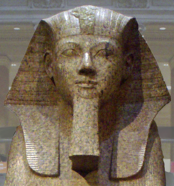
How did Mesopotamia and Egyptian patriarchy differ from each other?
Mesopotamia:
Written laws made women subordinate to men
Respectable women = veiled
Goddesses relegated to home and fertility
Egypt:
Women could own property, start divorce
Hatshepsut (but still in drag)
Less veiling
Statues show married people as equal
(Original: pp. 67-68;
With Sources: pp. 97-98)

Slide 94
Depictions of Men and Women in Art
Egypt
Mesopotamia

Slide 95
Lesson 3.3 Early States/Writing Hammurabi Primary Document
Strayer 99-103 and 119-121

Slide 96
13. What were the sources of state authority in the First Civilizations?
Regulate the community enterprises, such as irrigation and defense.
State authorities frequently used forced to compel obedience.
Authority was often associated with divine right (right to rule given by god).
Writing and accounting helped state authority by defining elite status, conveying prestige on the literate
(Original: pp. 69-72; With Sources: pp. 99-103)

Slide 97
What were the characteristics of writing/record keeping in the early ancient world?
Writing usually came as a method of accounting for trade
Joe owes me five sheep
Wasn’t always written down
Quipu – knotted strings used for accounting in Chavin (Andes)
Cuneiform – wedge shaped writing in Sumer
Hieroglyphics – picture writing in Egypt

Slide 98
Quipus

Slide 99
Cuneiform

Slide 100
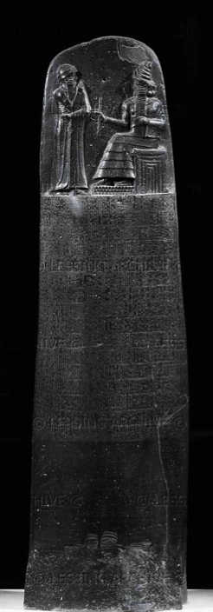
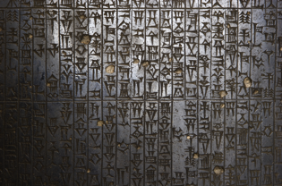
Code of Hammurabi
What does the code tell us about the society of the time?
What does the code tell us about the economy of the time?
What does the code tell us about how patriarchal the society was?
What kinds of social problems did they probably face?
What is “justice” to Hammurabi?
Does that idea of “justice” conflict with modern ideas?

Slide 101
Lesson 3.4 Comparing Mesopotamia and Egypt
Strayer 103-113

Slide 102
14. Compare and Contrast Mesopotamian and Egyptian civilizations. (Original: pp. 73-78; With Sources: pp. 103-108)
Mesopotamia Political:
A dozen or more separate and independent city-states.
frequent warfare among these Sumerian city-states caused people living in rural areas to flee to the walled cities for protection. With no overarching authority, rivalry over land and water often led to violent conflict.
Egypt Political
Merger of city-states under one rule (3,000 years)
Pharaoh ruled all

Slide 103
Mesopotamia Environment:
An open environment without serious obstacles
Flooding of the Tigris and Euphrates Rivers helped to provide alluvial soil for productive agriculture but was unpredictable.
Deforestation and salinization of soil
Led to conquest by foreigners
Egypt Environment:
Egypt was surrounded by deserts, mountains, seas, and cataracts which made it less vulnerable to invasions.
Predictable floods – good soil, less salinization
When floods didn’t happen, social upheaval happened

Slide 104
Mesopotamia Culture:
World is drama, Gods are drama
Egypt Culture:
Gods cause good floods, sun to rise each day
Gods keep us safe from war, invaders (mostly)

Slide 105
15. In what ways were Mesopotamian and Egyptian civilizations shaped by their interactions with near and distant neighbors?
Egyptian agriculture drew upon wheat and barley, which reached Egypt from Mesopotamia
Some scholars argue that Egypt’s steep pyramids and its system of writing were stimulated by Mesopotamian models.
(Original: pp. 79-81; With Sources: pp. 108-112)

Slide 106
16. What are the reservations some scholars have with the term “civilization?”
The first is its implication of superiority.
A “higher” form of living.
A second reservation about using the term comes from who decides what is “civilized”.
A group of people who live differently are usually described as “uncivilized”
Consider Native Americans and European explorers
Both considered the others to be uncivilized
Neither were true historians
. (Original: pp. 83-84; With Sources: pp. 112-113)

Slide 107
18. What were some major religions in the early Neolithic era?
All three of these will have a big influence on the major religions of period 2 (600 BCE to 600 CE)
Judaism (Hebrews/Jews)
One father God protects his chosen people
Influences Christianity and Islam
Vedic Religions (Aryan nomads who invaded India)
Early polytheism based on reincarnation
Will greatly influence Hinduism and later Buddhism
Zoroastrianism (Persians)
Early monotheism based on an evil god and a good god
Probably influenced Judaism which influenced other major monotheistic faiths

Slide 108
19. As states expanded and cities multiplied, how were social hierarchies affected?
Social hierarchies intensified
Class inequality
Patriarchy
Slavery

