Slide 1
Chapter 1…So Awesome!

Slide 2
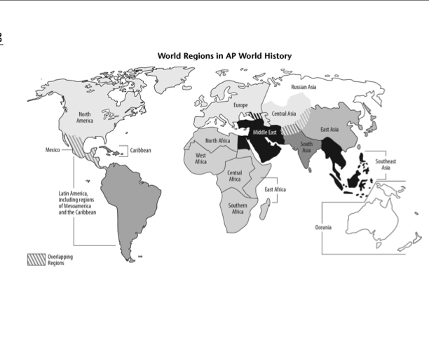

Slide 3
Preface
Most cultures have “creation stories”
They help people have purpose
Modern cultures use science
More about how things began than “why”

Slide 4
Cosmic history – history of the universe
Planetary history – history of the Earth

Slide 5
Cosmic Calendar – Cosmos
Video

Slide 6
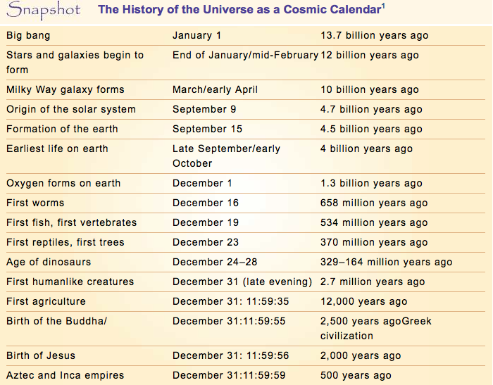

Slide 7
How does the cosmic calendar put time into perspective?

Slide 8
Cosmic History (January 1st – September 15th)
Big Bang – large unexplained explosion
15 billion years ago
Gravity brings particles together to form stars, planets
Earth is formed on September 15th (4 billion years ago) from leftovers from the sun
Dark matter – 90% of the mass of the universe
Invisible to the human eye
Really freaky

Slide 9
The size of the universe
Can make us feel insignificant
“This little globe, nothing more than a point, rolls in space like so many other globes; we are lost in this immensity.” – Voltaire (1700s French Philosopher)

Slide 10
Planetary History
Life came from “cosmic soup”
Stays microscopic for 3 billion years
Dinosaurs were alive for about 5 days on the cosmic calendar
Humans in the last few minutes of December 31st
Never coexisted with Dinosaurs

Slide 11
AP Covers only 10,000 Years
8,000 BCE to 2015 CE
Last minute of the cosmic year

Slide 12
“Humankind has had a career more remarkable and arguably more consequential for the planet than any other species”
Learning and language have led humans to come to power via tools (technology)

Slide 13
World History in a Paragraph
Based on what tools we used/how we lived our lives
Paleolithic (old stone age)
Stone tools
Hunter gatherers
Neolithic (new stone age)
Farming/agriculture
Industrial (modern age)
Factory work

Slide 14
New World History
Old focus was country by country
US studies US, England studied England
Was very ethnocentric
Ethno – culture
Centric – centered
Thinking your own culture is best
Was very Eurocentric
New world history is global
Try very hard not to be Eurocentric

Slide 15
3 Cs – Comparison, Connection and Change
These drive world history
Comparison
We learn about cultures by comparing them to others
Connection
When cultures get together, things get interesting
These connections help cultures grow
Change
What changed and what stayed the same?
What caused changes and continuities?

Slide 16
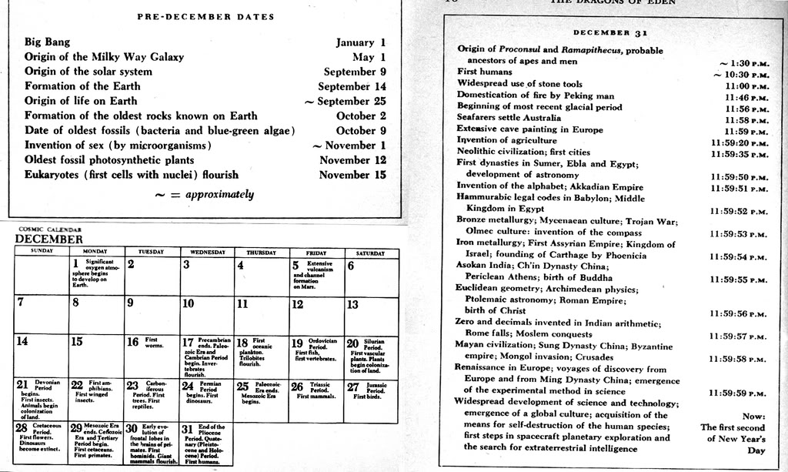

Slide 17
1. What was the first human-like creature?
Australopithicines (Lucy)
Found in Ethiopia

Slide 18
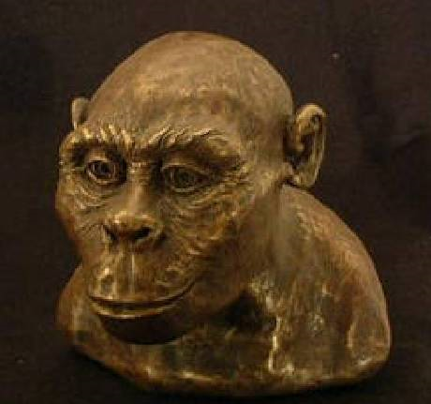
Here’s Lucy. Aint she beautiful?
Let’s put some skin on them bones!

Slide 19
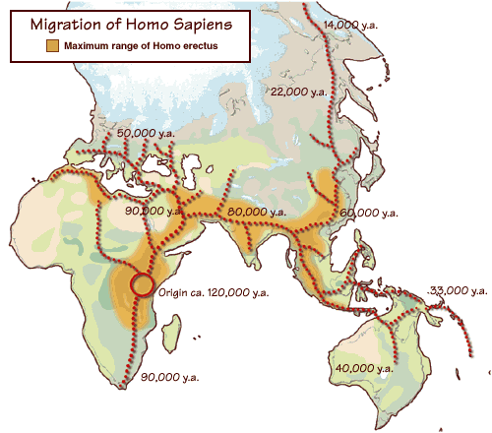
3. Where did Homo sapiens sapiens first emerge?
In the grasslands of Eastern and Southern Africa
(Original: p. 12;
With Sources: p. 12)

Slide 20
4. How were settlements in Africa planned?
Settlements were planned around the seasonal movement of game and fish.
(Original: p. 13; With Sources: p. 13)

Slide 21
5. To where did humans migrate after they left Africa?
First to the Middle East and from there westward into Europe about 40,000 years ago and eastward into Asia
(Original: p. 16; With Sources: p. 16)

Slide 22
6. What tools were used during the Paleolithic era?
Spears, bows, arrows, clubs, stone axe, fire

Slide 23
6a. What was society like in the Paleolithic Era?
Small groups or bands, usually based on family relationships
Small and limited exchanges of ideas and goods

Slide 24
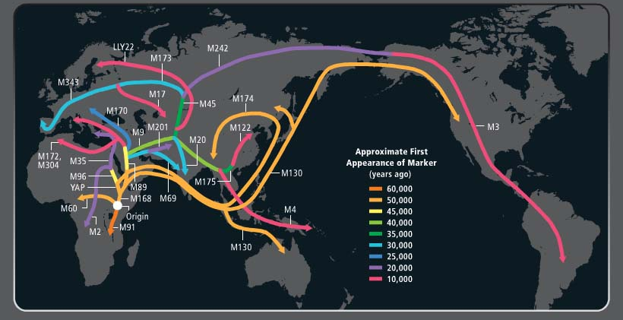

Slide 25
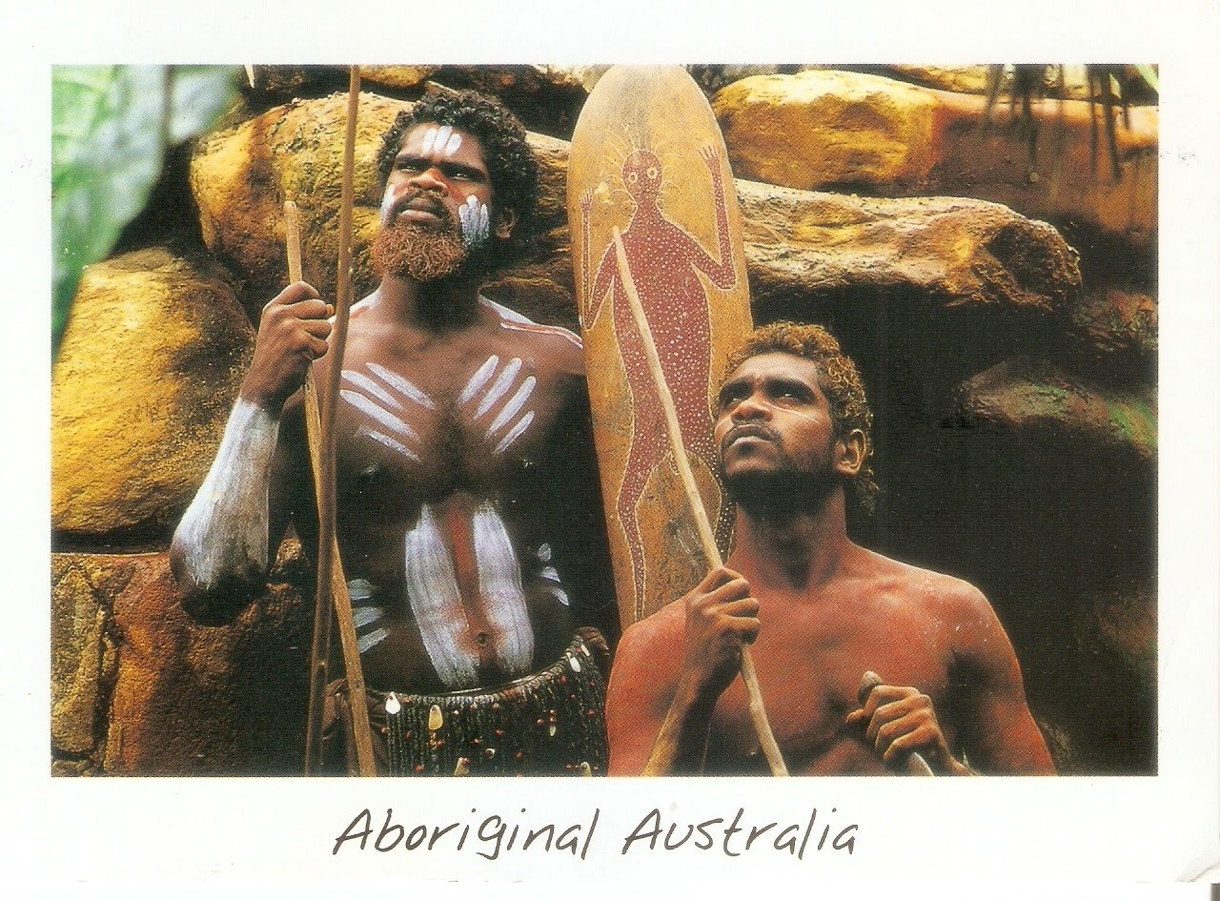
7. Who were the Aborigines?
From East Africa and Madagascar
Took boats to Australia about 40,000 years ago
Via some stops on coastal Asia

Slide 26
8. What were religions like in the Paleolithic Era?
Animistic (animate) – spirits in non-living objects
Rivers, trees, rocks
Ceremonial burial sites – show concern for afterlife, dead left with objects to take on with them in graves
Small statues of god-like figures found

Slide 27
9. Describe Dreamtime and what it represents.
Aborigines developed an alternate world called “Dreamtime”
They view it through rituals/sometimes hallucinogenic drugs
“Dreamtime” was where and when the world was created
Describes how things relate to each other
Animals/rivers/people/stuff
(Original: p. 17; With Sources: p. 17)

Slide 28
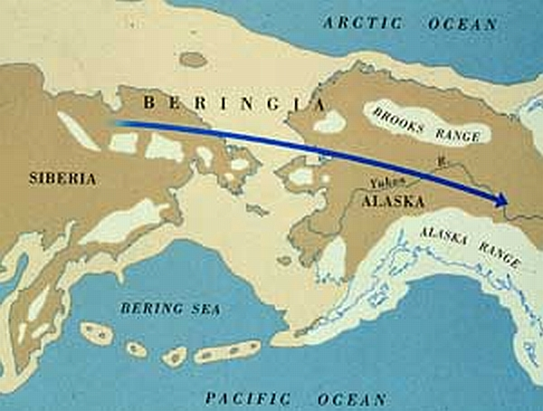
10. What was the route of migration into North America?
From Eastern Siberia, by land across the Bering Strait or by sea down the west coast of North America
(Original: p. 18; With Sources: p. 18)

Slide 29
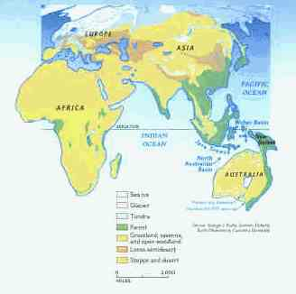

Slide 30
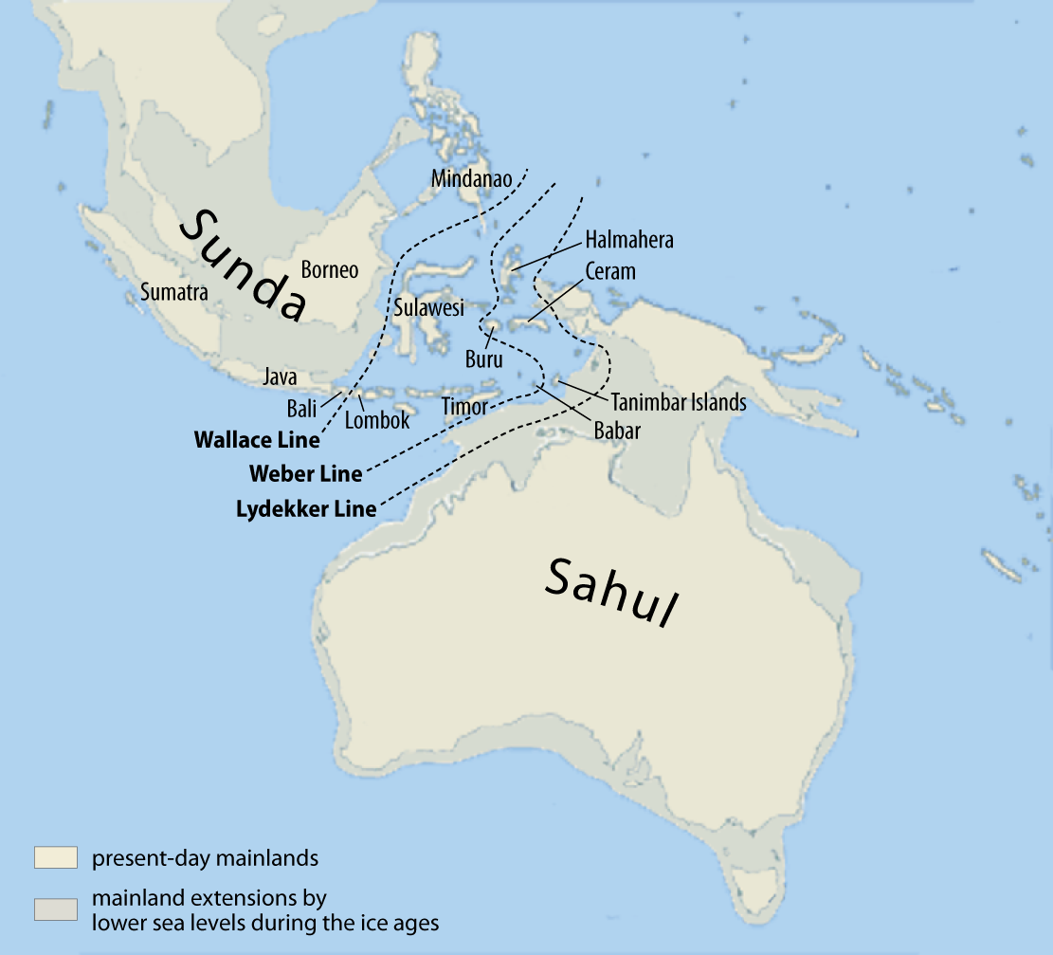

Slide 31
11. What does the wide distribution of Clovis technology suggest?
Clovis culture: The earliest widespread and distinctive culture of North America; named from the Clovis point, a particular kind of projectile point.
Arrowheads were found across a large area.
It suggests a regional pattern of cultural diffusion (spread of ideas among different cultures) and at least indirect communication over a large area.
(Original: p. 18; With Sources: p. 18)

Slide 32
Clovis Point
A Clovis projectile point created using bifacial percussion flaking (that is, each face is flaked on both edges alternatively with a percussor)

Slide 33
12. How did Austronesian (Australia and Indonesia) migrations differ from other early patterns of human movement?
They occurred quite recently, beginning only about 3,500 years ago.
They were waterborne migrations, making use of oceangoing canoes and remarkable navigational skills.
Unlike other migrations, they were undertaken by people with an agricultural technology who carried both domesticate plants and animals in their canoes.
(Original: p. 19; With Sources: p. 19)

Slide 34
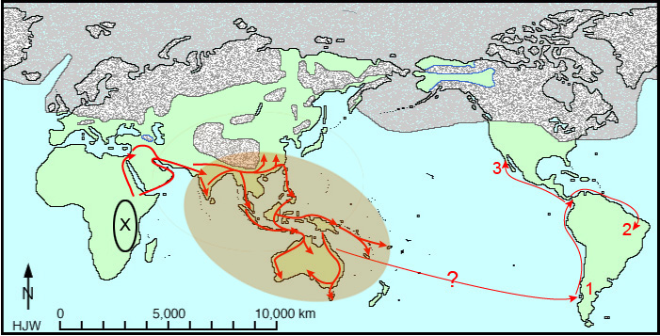
Austronesian Migrations

Slide 35
13. In what ways did a gathering and hunting economy shape other aspects of Paleolithic societies?
THIS IS A BIG DEAL SLIDE!
Because hunting and gathering didn’t allow for the accumulation of much surplus, Paleolithic societies were highly egalitarian, lacking the inequalities of wealth and power found in later agricultural and urban life.
Paleolithic societies also lacked specialists, with most people possessing the same set of skills, although male and female tasks often differed sharply.
Relationships between women and men were usually far more equal than in later societies. This was in part the result of gathering women bringing in more of the food consumed by the family than hunting men.
(Original: pp. 20-21; With Sources: p. 20-21)

Slide 36
15. In what ways did Paleolithic people alter the natural environment?
They deliberately set fires to encourage the growth of particular plants.
Ashes gave nutrients to the soil.
(Original: p. 22; With Sources: p. 22)

Slide 37
16. What does the presence of Venus figurines across Europe suggest?
Some scholars believe that Paleolithic religious thought had a strongly feminine dimension, embodied in a Great Goddess and concerned with the regeneration and renewal of life.
Female goddesses could mean that women were held in a higher regard than in classical civilizations.
(Original: p. 22; With Sources: p. 22)

Slide 38
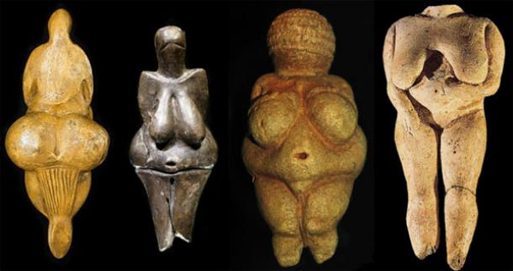
Venus Figures

Slide 39
17.Why did some Paleolithic peoples abandon earlier, more nomadic ways and begin to live more settled lives?
As the world came out of the last ice age, climatic warming allowed many plants and animals, upon which humans relied, to flourish.
The increased food stocks allowed some groups of humans to settle down and live in more permanent settlements.
(Original: pp. 23-24; With Sources: p. 23-24)

Slide 40
Terms
Austronesian migrations: The last phase of the great human migration that established a human presence in every habitable region of the earth. Austronesian-speaking people settled the Pacific islands and Madagascar in a series of seaborne migrations that began around 3,500 years ago. (pron. aws-troe-NEEZH-an)

Slide 41
Terms
Dreamtime: A complex worldview of Australia’s Aboriginal people that held that current humans live in a vibration or echo of ancestral happenings.

Slide 42
Terms
great goddess: According to one theory, a dominant deity of the Paleolithic era.

Slide 43
Terms
Ice Age: Any of a number of cold periods in the earth’s history; the last Ice Age was at its peak around 20,000 years ago.

Slide 44
Terms
Paleolithic: Literally “old stone age”; the term used to describe early Homo sapiens societies in the period before the development of agriculture.
Paleolithic rock art: typically used to describe the hundreds of Paleolithic paintings discovered in Spain and France and dating to about 20,000 years ago; these paintings usually depict a range of animals, although human figures and abstract designs are also found. Lascaux, France is most known.

Slide 45
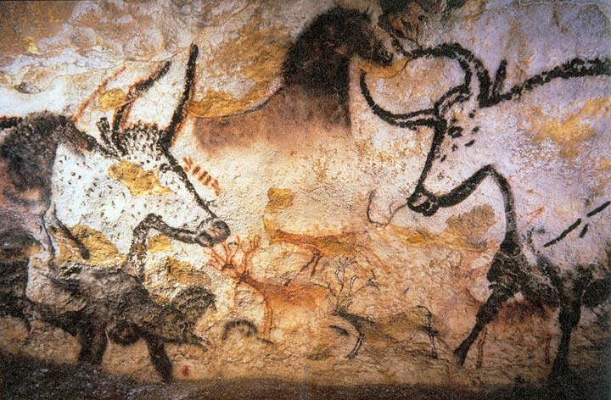
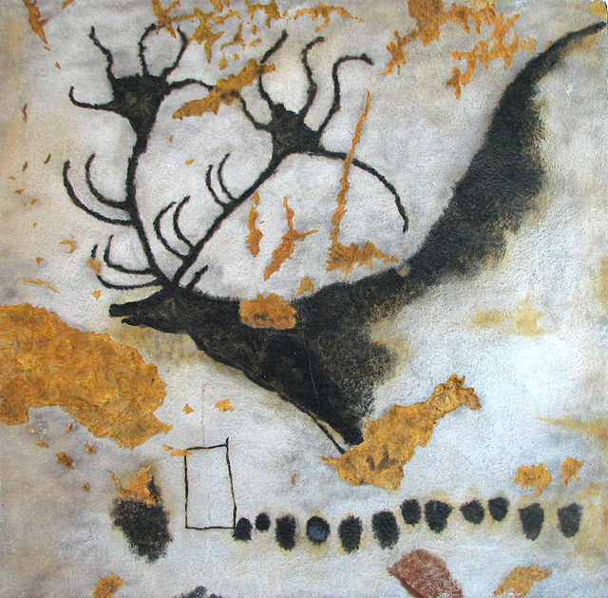
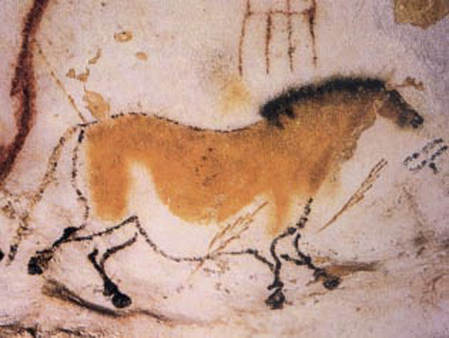
Cave Paintings from Lascaux

Slide 46
Terms
shaman: In many early societies, a person believed to have the ability to act as a bridge between living humans and supernatural forces, often by means of trances induced by psychoactive drugs.
Venus figurines: Paleolithic carvings of the female form, often with exaggerated breasts, buttocks, hips, and stomachs, which may have had religious significance.

Slide 47
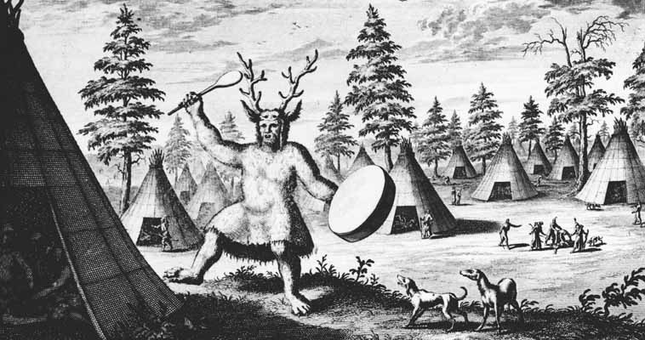
Shaman

