Slide 1
Key Concept 5.1 – Industrialism and Global Capitalism

Slide 2
Industrial Revolution What is it?
Civilizations no longer principally ag/rural
Mass production of goods
Move toward urbanization
Capitalism reigned supreme
Changed life in Europe
How ppl work, where they lived
Forced West to spread practices to colonies to exploit them

Slide 3
History of the Industrial Revolution
Began in Great Britain in mid 1700s
Causes
2nd Agricultural revolution
Improved farming techniques
Half of pop left for city jobs
Needed a way to get good crops w/ half the workers
Why so much better crop yields?
Potatoes and corn from New World
Chemical fertilizers (big deal)

Slide 4
Cause: Why did the pop grow? 50% growth from 1700-1800
More food available
Improved medical care
Nutrition
hygiene

Slide 5
Cause: Technology improvements
Steam power
Steel
Factory system (Henry Ford – Assembly line)
Put factory near water for power source
Suez and Panama Canals
Made sea travel much quicker
New inventions for textile industry
Cotton Gin – Eli Whitney – process cotton quickly

Slide 6
5.1 Quiz A
What term can be referred to a change to in the way people live where they went from primarily living agricultural lives to living more factory-based lives?
By what percentage did population increase between 1600 and 1700?
A major change in the Second Agricultural Revolution occurred with the invention of ________-based fertilizers.

Slide 7
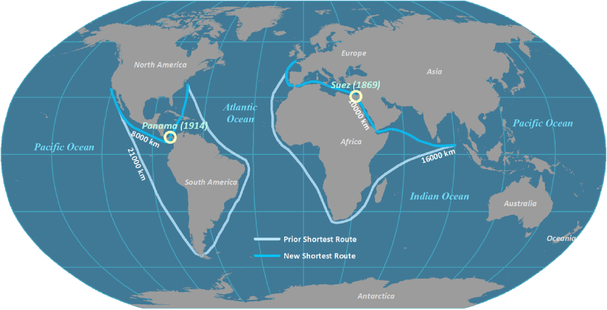

Slide 8
5.1 quiz B
Roughly, when did the Industrial Revolution begin?
In which country did the Industrial Revolution begin?
What to seas are connected by the Suez Canal?

Slide 9
Social Causes
Protestant work ethic
Earthly success is a sign of personal salvation
God likes people who work hard
Domestic system is not as effective
Women weave cotton and make textiles at home
Sell to middlemen
Urbanization – people moving to cities
For factory jobs
Land being bought up by rich
Cities get HUGE

Slide 10
Spread of the Industrial Revolution
Starts in England
Spreads to Western Europe, Russia, US, and to Japan

Slide 11
Why didn’t the IR start somewhere else?
Western Europe had materials (or access to materials), a reason to innovate and skilled labor

Slide 12
Financial Cause: Adam Smith
Wrote Wealth of Nations
Let open market determine demand for goods and services
Laissez faire capitalism “Let them do” – government removes self from econ process
Father of Capitalism

Slide 13
5.2 Quiz A
From what language is ‘lassiez faire’?
In the beginning of the Industrial Revolution, which was the first fully Asian country to industrialize.
What did Henry Ford use to power his first factories?

Slide 14
5.2 Quiz B
By what means of transportation did the Industrial Revolution primarily spread?
What is the name of Adam Smith’s book?
What kind of products were made in the domestic system?

Slide 15
Capitalism Spreads
Qing China and Ottoman Empire resist capitalism
Stay agricultural
SPOILER, that’s make them weak in 1900s
Remember, merchants below peasants in China

Slide 16
More Financial Causes
Banks, lending instiutions and investors grew
More money coming into countries and businesses led to widespread economic growth and more big businesses

Slide 17
Philosophical Cause: John Stuart Mill
Wrote Utilitarianism
People should be utilitarian (useful, beneficial to society)
But, like Smith, he said the government should make no law against any action unless it harms another’s rights

Slide 18
More about Industrial Revolution
Steam engine is used in every economic field
Steam ships, railroads
Electricity, telegraph spreading widely by end of 1800s
Electricity eventually overtakes steam and coal as energy sources
Factory system replaces domestic “putting out system” (women working from home)
Eli Whitney creates interchangeable parts
Assembly line becomes the norm in factories

Slide 19
Transformative Effects of Industrial Revolution
Asians/African provide labor in mines and plantations
Transportation revolution
Locomotive 1820
Steamship 1807
Internal combustion engine 1885-car
Airplane 1903

Slide 20
Social Effects of IR
New classes
Working class (proletariat)
Term coined by Marx
Bourgeoisie (bor ZWAH zee) was the ruling class who kept the proletariat down
Long hours 14 hour days, 6 day weeks
Disgusting, crowded living conditions
Child labor common
Rise of the middle class
Merchants, bankers, factory owners (Bourgeoisie)
Status becomes more about wealth than family position

Slide 21
New family model
Smaller b/c no need for farming families
Women still in home
Women and child labor goes down as factories become more efficient
Industrial working class

Slide 22
IR in Japan (Meiji Restoration)
Lack of resources (like England)
Went outward to get natural resources
Southeast Asia, parts of China/Russia
Caused minor drama there
*spoiler, Japan is going to have lots a drama in unit 6*
Japanese “factory girls”
Sent from country to city to work in silk factories
Unsafe working conditions
Patriarchy led to male supervisors mistreating them

Slide 23
Science in IR
Technology drives IR
Steam engine invented by Robert Fulton
Steam boats, locomotives, factory equipment
Steamed factory equipment modernized the textile industry
Put women out of work
Darwinism challenged traditional ideas of humanity, creation and man’s relationship with Earth

Slide 24
Second Industrial Revolution
1850s
Steel
Chemicals
Electricity

Slide 25
Reactions go Global Capitalism
Marxism (Communism)
Thought up in Unit 5, not started until Unit 6
Now, on to…..the AMERICAN slides

Slide 26
Capitalism vs. Communism

Slide 27
Capitalism
An economic system in which the means of production are owned mostly privately.
Capital is invested in the production of goods for profit in a competitive free market.

Slide 28
Classical Economics
The classical tradition in economic thought emerged in Britain in the late 18th century.
The father of this economic thought, and “The Father of Capitalism” was…

Slide 29
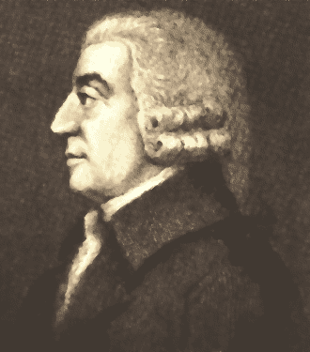
This guy

Slide 30
Adam Smith
A Scottish political economist and moral philosopher (1723-1790).
His Wealth of Nations (1776) founded the modern discipline of economics and provided the rationale for free trade, and capitalism.

Slide 31
Natural Liberty
In his mid-20s he began expounding “the obvious and simple system of natural liberty.”
People should be completely free to trade.

Slide 32
The Invisible Hand
The free market appears chaotic and unrestrained.
Actually, it is guided by “an invisible hand” to produce the right amount and variety of goods.
If a product shortage occurs, the price rises, establishing a profit margin that provides an incentive for others to enter production.

Slide 33
Social Benefit
While human motives are selfish and greedy, the competition in the free market tends to benefit society as a whole by keeping prices low, while still building in an incentive for a wide variety of goods and services.

Slide 34
Laissez-faire
Smith attacked most forms of governments’ interference in the economic process, including tariffs (taxes) on imported goods.
Government restrictions on trade cause inefficiency and high prices.
“Laissez-faire” means “let them do.”

Slide 35
Self-Interest
It is not from the benevolence of the butcher, the brewer, or the baker that we expect our dinner, but from their regard to their own interest. – Smith, Wealth of Nations

Slide 36
Criticisms of Capitalism
Workers can be treated unfairly.
Some people become very poor.
Some must lose for some to win.

Slide 37
Communism
An ideology that seeks to establish a future classless, stateless social organization, based upon common ownership of the means of production and the absence of private property.
“To each according to their needs.”

Slide 38
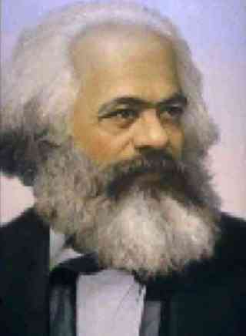

Slide 39
Karl Marx
Karl Marx (1818-1883) was an immensely influential German philosopher, political economist, and socialist revolutionary.
He is most famous for his analysis of history in terms of class struggles.

Slide 40
Communist Manifesto (1848)
The history of all hitherto existing society is the history of class struggles.

Slide 41
Atheism
Marx was an atheist.
He believed that religion was “the opiate of the people.”
The owners of capital used religion to keep the peasants and workers subjugated by leading them to think, not of their present misery, of future happiness in heaven.

Slide 42
Communist Paradise
Marx taught that paradise would appear on earth, following the war between the workers(proletariat) and the owners (bourgeoisie).
The proletariats would win the war because the outnumber the bourgeoisie.
After the war, everyone would be equal and there would be no need for anyone to rule anyone else.
Workers would work to help the society, not for personal gain.

Slide 43
The End Justifies the Means
Marx’s moral teaching was that the leaders of the Communist Party were free to commit any crime as long as it served the end—the destruction of capitalism and the ushering in of communism.
The end of governments and capitalism was inevitable.

Slide 44
Revolution
The state is “a committee of the bourgeoisie” and laws are only there to support the capitalists, the ruling class.
Class conflict between the proletariat and the capitalists can only be resolved by violent revolution.

Slide 45
Marx’s History of Economics
Beginning – Primitive communism
Everyone shares, all are provided for
Then – Capitalism
Brought about by private ownership of goods
No more sharing
Then – Socialism
After the big war, we need to wean the capitalists off the old way
Finally – Communism
Everyone shares and everyone is happy
Paradise

Slide 46
Difference between Communism and Socialism
Communism is the end result
Socialism is a stepping stone to get to communism
Socialism is loosely based on capitalism because what you receive from the government is based on how hard you work
In communism, everyone gets the same stuff

Slide 47
Communism – From each according to their abilities. To each according to their need
Socialism – From each according to their abilities. To each according to their deeds

Slide 48
Criticism of Communism
In the 20th century, it is estimated that 50 million people were killed in the name of communism.
Most of Marx’s predictions haven’t came true yet.
It is inconsistent with human nature.
It degrades religion.

